Slide 1
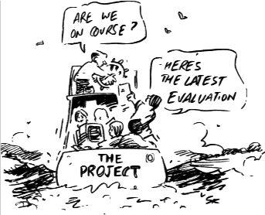
CTP M&E Introduction Training
Module 5

Slide 2
Module content
Setting objectives
Process and impact indicators
Responding to M&E findings
Monitoring prices
Monitoring social issues

Slide 3
Module outcomes
Design objectives and indicators
Analyze and respond to monitoring findings
Appreciate the key issues about monitoring efficiency and effectiveness of cash transfers

Slide 4
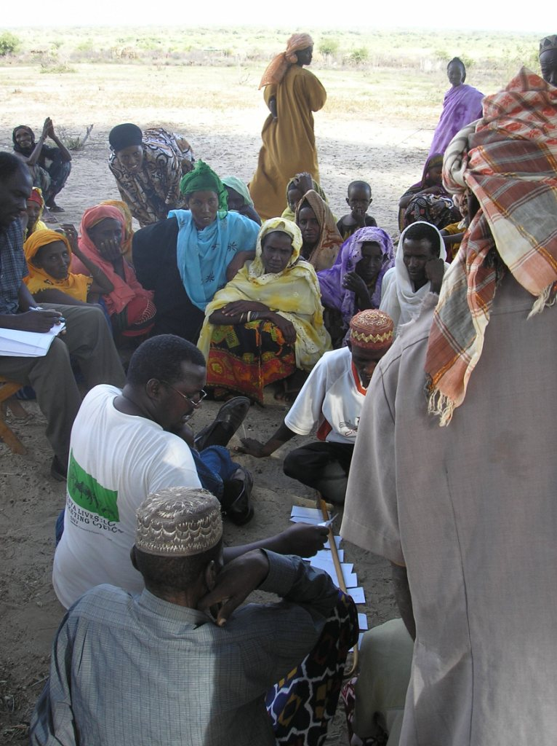
monitoring
Module 5 Session 1

Slide 5
What does monitoring and evaluation start with?
Notes:
5

Slide 6
Setting objectives
Cash is not an end in itself.
Due to their flexibility, cash and vouchers can be used to achieve a wide range of objectives.
Objectives can be defined either tightly or broadly.

Slide 7
Task
Design an objective for your selected response options in the scenario
Take 10’ and please write it on a flip chart
Notes:
7

Slide 8
Process and impact monitoring
Process monitoring : to ensure that the programme is appropriate and relevant to people’s needs; that it is implemented in the way that was intended
Impact monitoring : to ensure that the programme is having the intended impact and is minimising negative impacts more effectively and efficiently than are other types of programmes
Notes:
8

Slide 9
Monitoring process
Process: How well are we doing the work?
Progress: How are we measuring up to our objectives?
Design: Is the cash value right? Are we using the right disbursement mechanisms? How secure is the programme?
Notes:
9

Slide 10
Monitoring: impact
Context : what is the security situation like? What is happening to market prices?
Results: who received what?
Impact: on livelihoods, societal norms, local economies
Notes:
10
Monitoring: impact (to ensure that the programme is having the intended impact and is minimising negative impacts more effectively and efficiently than other types of programme.)

Slide 11
Criteria for indicators
S pecific
M easurable
A chievable
R ealistic or relevant
T ime bound
Notes:
11

Slide 12
Task
In your groups, revolve round the flipcharts
Which process indicators might you monitor for each of the objectives?
Which impact indicators might you monitor for each of the objectives?
5’ at each flipchart
Notes:
12

Slide 13
Process indicators for cash
Were correct sums of money received by beneficiaries/suppliers?
Were payments made on time?
Were the beneficiaries satisfied with the process and the methods of implementation?
What else are beneficiaries receiving?
Notes:
13

Slide 14
Impact indicators for cash
Have income and expenditure changed?
Have sources of food or coping strategies changed?
What was the cash used for?
Were items available in the markets?
Were there changes in market prices of key commodities?
Notes:
14

Slide 15
Process indicators for CFW
Number and quality of projects completed
Enough people, adequate training, number of days invested
Payments prompt, regular, timely and appropriate
Number and type of direct/indirect beneficiaries
Measures for equality and participation
Notes:
15

Slide 16
Impact indicators for CFW
Has the project affected livelihoods strategies?
Have beneficiaries saved some of the wages?
How did HHs manage the cash they earned?
Are people economically active again?
Was there an impact on family relations, gender roles?
Were projects useful and relevant?
Would beneficiaries have preferred alternative interventions ?
Notes:
16

Slide 17
Process indicators for vouchers
The voucher distribution process
The amount and quality of the commodities purchased by voucher recipients
Traders supplied agreed products
The voucher distribution process was transparent and understood
The use of the commodities purchased
Satisfaction of the beneficiaries
Notes:
17

Slide 18
Impact indicators for vouchers
What was the impact on commodities received on livelihoods, meeting of basic needs, etc.?
What was the impact of the vouchers on market prices?
How was the income that was saved through provision of voucher used?
What was the effect on traders’ livelihoods?
Notes:
18

Slide 19
Monitoring: essential points
The monitoring plan should be established at the programme design phase
Monitoring is an ongoing task
The purpose of monitoring should be explained to stakeholders
Use participatory tools for monitoring
Use the results of monitoring systematically to feed into evaluation
Gather quantitative and qualitative data
Notes:
19
Use this to review basic concepts and assumptions about monitoring.

Slide 20
Monitoring the minimum
Achievement of objectives
Expenditure, prices and inflation
Availability of items people want to buy
Cost-effectiveness
Targeting and distribution
How cash is used: gender, corruption and security
Beneficiary preferences
Comparing cash with alternatives
Link between the approach and people’s recovery
Notes:
20
Use this to review basic concepts and assumptions about monitoring.

Slide 21
How?
Questionnaire surveys
Semi-structured interviews
Case study interviews
Complaint and feedback mechanisms
Photographs
Document review
Notes:
21

Slide 22
Responding to monitoring (1)
… market price monitoring shows local inflation of shelter items. Focus groups blame traders that are charging additional fees for transportation.

Slide 23
Responding to monitoring (2)
… your monitoring team reports that some people have registered strategically as two households with separate heads so that they can receive double transfers.

Slide 24
Responding to monitoring (3)
… anonymous beneficiaries have complained to the telephone hotline that some shops are providing sub-standard items in return for vouchers.

Slide 25
Responding to monitoring (4)
… women targeted for unconditional grants have been abused by husbands who say that men are responsible for household money.

Slide 26
Responding to monitoring (5)
… evaluation results indicate that grant expenditure was used to pay debts instead of for purchasing essential food and non-food items as planned in the proposal.

Slide 27
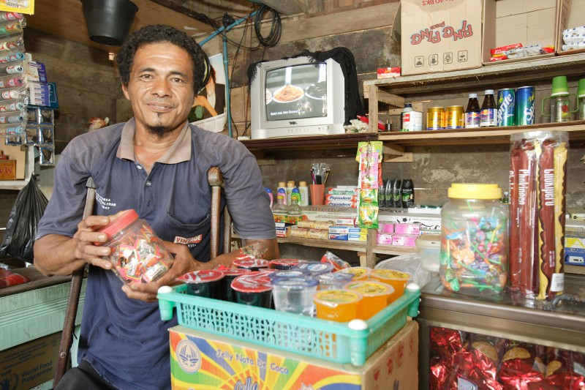
Monitoring PRICES
Module 5 Session 2

Slide 28
Why monitor prices?
To determine whether cash recipients are able to purchase the commodities and services as intended by the programme
To determine whether the cash injection is causing inflation

Slide 29
Monitoring prices
Collect prices from different parts of the market or from different markets
Collect prices weekly in case of extreme volatility
Collect prices form the same list of items in each market survey
Collect prices for the varieties and quality most likely to be purchased by beneficiaries
Use a predefined scale to record prices of commodities
ACF 2007

Slide 30
Commodity tracking tool
Item | Local unit price | Local unit | Local unit in kg | Market 1 | Market 2 | US$ amount | Buyer/ trader reporting changes | Comments
Rice imported
Rice local
Bread
Water
Soap
Shoes
Blanket
Tarp

Slide 31
Price monitoring

Slide 32
Food basket monitoring

Slide 33
Monitoring social issues
Module 5 Session 3

Slide 34
Monitoring anti-social use
Implies moral judgement
Is difficult to monitor
Needs greater triangulation
Must use independent monitors and evaluators

Slide 35
Monitoring multiplier effects
Project monitoring usually stops at ‘what money is spent on’
Multiplier analysis follows the cash flow from the beneficiaries to other market actors
Monitoring answers questions like:
Does the cash remain in the local economy?
Are additional goods and services created to meet the additional demand?

Slide 36
Key learning messages
M&E should include indicators specific to cash and vouchers
M&E should be part of response design
Monitoring should be timely enough to respond to findings
Implementing agencies should be flexible enough to respond to M&E findings

