Slide 1
Cash Hub platform
www.cash-hub.org

Slide 2
Why a Cash Hub platform?
Cash Hub platform
Programme
and technical support
Training
and
development
Innovation
Policy
Research
Advocacy
Accelerate the use and increase
the scale-up of cash based assistance
in the International Red Cross and
Red Crescent Movement
For more info about the Cash Hub
https://cash-hub.org/about-us

Slide 3
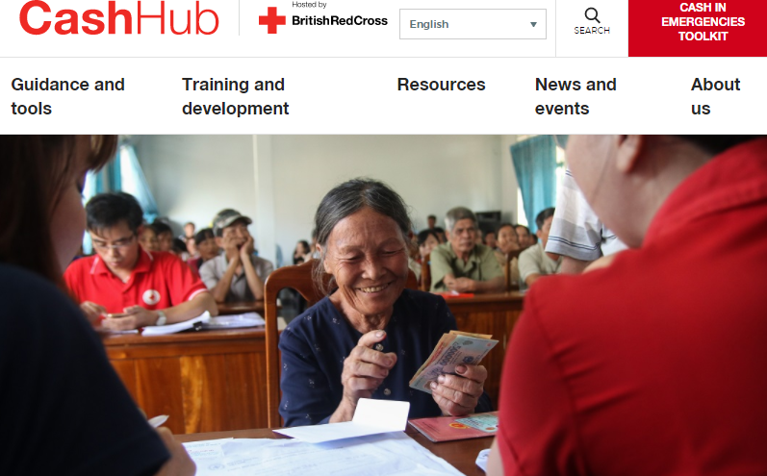
Cash Hub online platform
www.cash-hub.org
Access to information, tools, data, evidence and learning

Slide 4
What does the Cash Hub platform offer?
Resources on a range of thematic and geographic areas
Information on upcoming training
Access to interactive Cash Maps
Access to the Cash in Emergencies Toolkit
Access to the Helpdesk for the Movement
Information on upcoming cash events and jobs
Latest news & blogs

Slide 5
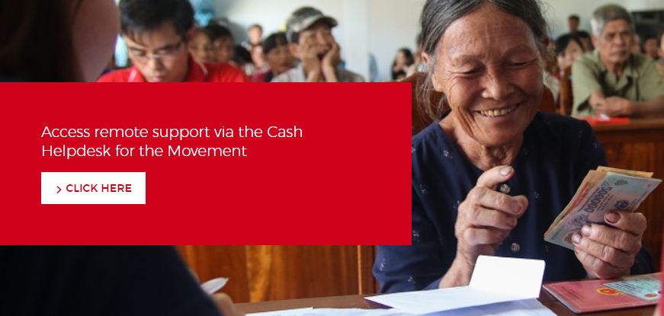
Helpdesk for the Movement
Request ad hoc technical support through a dedicated helpdesk (for the Movement)

Slide 6
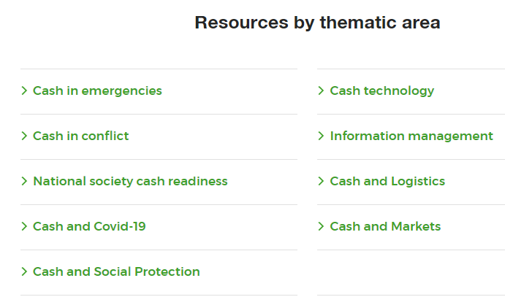
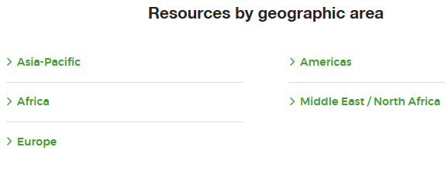
Resources section
We work with
section owners
across the Movement to ensure:
quality
new resources

Slide 7
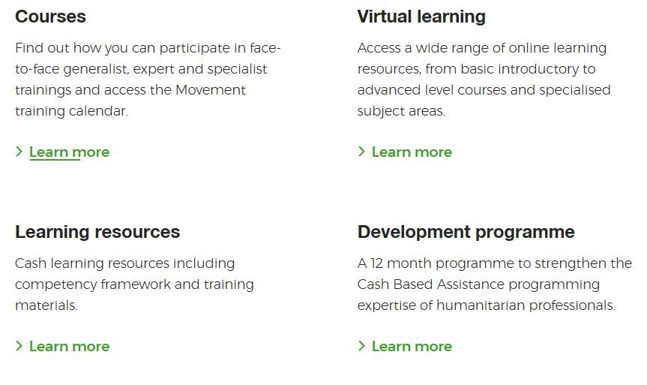
Training and support
Developing cash assistance expertise of humanitarian professionals across the Red Cross and Red Crescent Movement

Slide 8
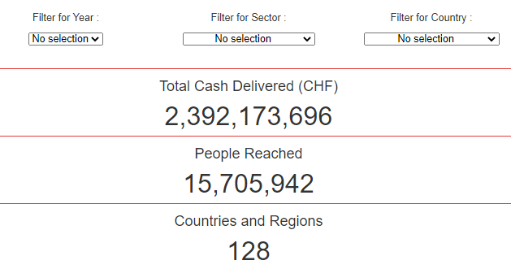
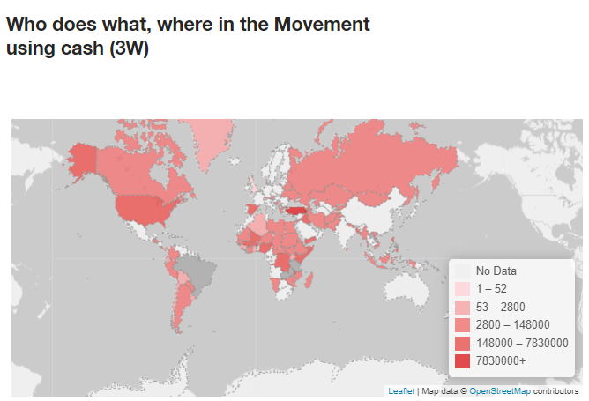
Interactive Cash Maps

Slide 9
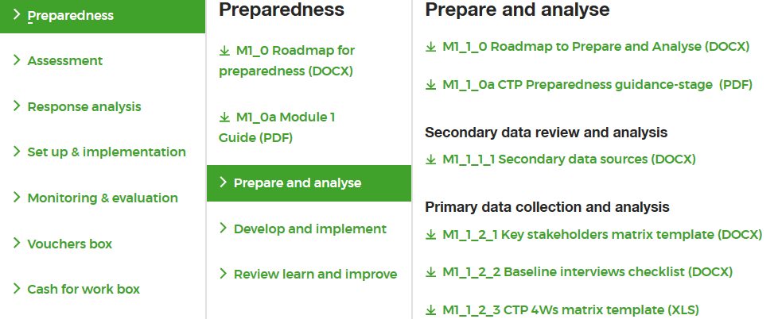
Cash in Emergencies Toolkit

Slide 10
How to find content on the Cash Hub platform
Or use the search box on each “Resources page”

Slide 11
How can you engage?
Share cash content to contact@cash-hub.org (e.g. resources about cash programmes, news, jobs, events and training opportunities)
Participate to webinars
Follow the Cash Hub LinkedIn account
Use the Helpdesk and share your experience
Questions?
Get in touch : contact@cash-hub.org

