Slide 1


Learning from the Ukraine Crisis Webinar Series:
Digital Solutions for Remote Registration
^{29 March 2023}
 | Agenda | Speaker
3 mins | Housekeeping & Opening | Cara Wilson, Cash Hub Helpdesk Manager, British Red Cross
7 mins | Ukraine Crisis: Overview of Operational Context | Stephen Hagerich, CVA Coordinator, IFRC
20 mins | Creation of the IFRC self-registration app, its role in the Ukraine response & remote data management. | Kanhong Lin, CVA Officer Romania & Moldova, IFRC Natalie Gyles, CVA IM Coordinator Roving, IFRC Surge
20 mins | Panel Discussion | Peter Mujtaba, CVA technology consultant Maria Panasiy, Cash and Markets Specialist, ICRC Etienne Gaboreau, Cash and Markets Specialist, ICRC
10 mins | Panel Q&A

Slide 2

Self-Enrollment App for Financial Assistance – Ukraine Crisis
Sign up wherever you are

Slide 3




Guiding Development Principles
Challenge Our Assumptions
Simplify the work & design
Communicate & Manage Emotions
Access to the program

Slide 4

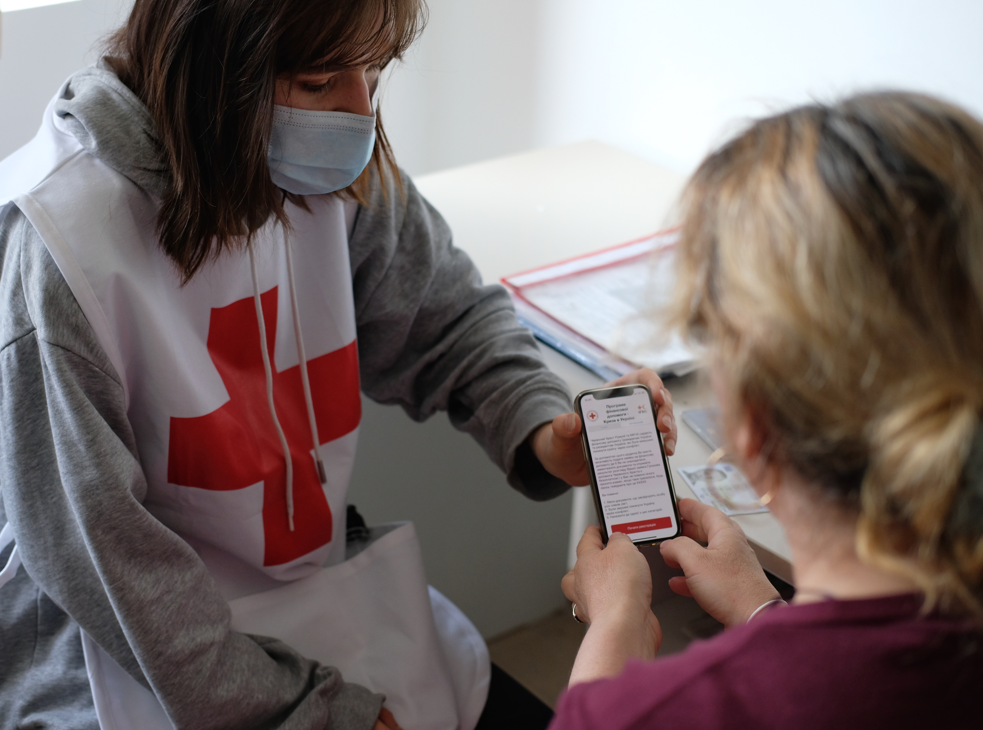


IFRC Vision
Build a digital enrollment process to massively scale up access to the cash programme no matter where people are.
Website
Clear communication about eligibility and requirements
Drive people to download iOS or Android app
Smartphone App
Guided user experience
Utilize technology to reach programmatic goals while having a controlled rollout
Multi-purpose Cash
Bank transfers
Cash pick up
Provide pre-paid cards for those without financial access

Slide 5
Karacak
Learning and resources cash-hub.org
Helpdesk cash-hub.org/helpdesk/
Webinars cash-hub.org/resources/webinar-series/
Cash Helpdesk helpdesk@cash-hub.org

Slide 6
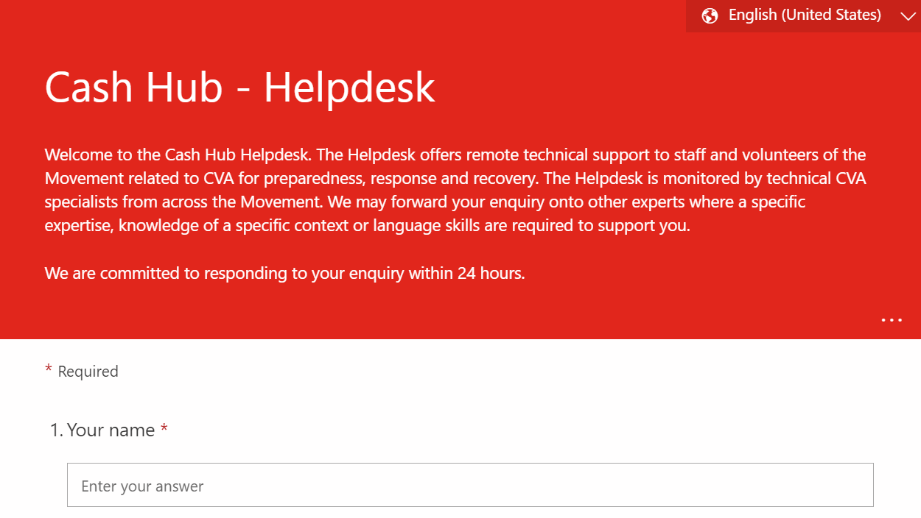


Karacak
Questions and technical supports requests can be submitted through the Helpdesk’s query form. The form is available in English, French, Spanish and Arabic.
cash-hub.org/helpdesk

