Slide 1



EDITAR: EL TÍTULO SE COLOCA AQUÍ
October 6th, 2022

Slide 2




Thank you for joining
Please kindly mute your microphones when not speaking
Following the call, we will share the presentation slides and the relevant materials with all of you
Please be advised that today’s session will be recorded
There will be a Q&A session at the end of the webinar
Notes:
2

Slide 3
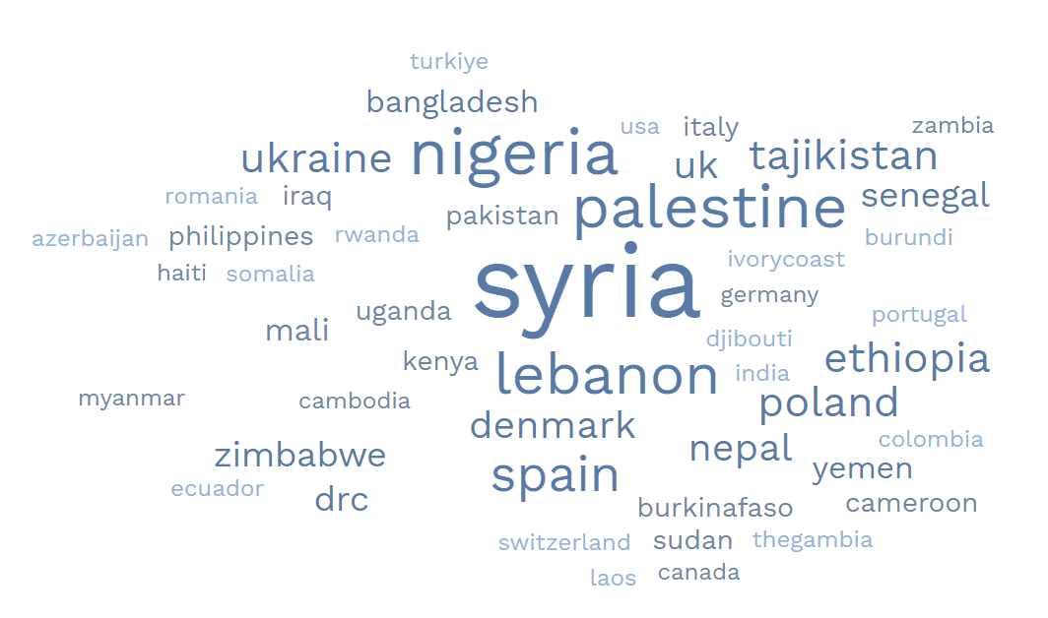
Welcome: Who is with us today?
Notes:
XXx participants registerer
In many different locations all over the world
Most of the from the RC RC Movement, but also colleagues from other International NGO, Agencies and International Organizations.

Slide 4


Using CVA in the design and management of micro-entrepreneurship programmes
^{5th July 2023}
 | Agenda | Speaker
5 mins | Housekeeping & Opening | Cara Wilson, Cash Hub Helpdesk Manager, British Red Cross
10 mins | Overview of Toolkit | Lucía Taboada Keller, LLH Advisor, Livelihoods Resource Centre
15 mins | Learnings from Ethiopian Red Cross Society and Syrian Arab Red Crescent | Ensermu Legesse, Project Coordinator, Ethiopian Red Cross Society Randa Daioub, Livelihoods Deputy Manager, Syrian Arab Red Crescent
25 mins | Audience Question and Answer Session to Panel | Chair: Andra Gulei, Cash and Markets Advisor, Cash Hub
5 mins | Wrap Up

Slide 5
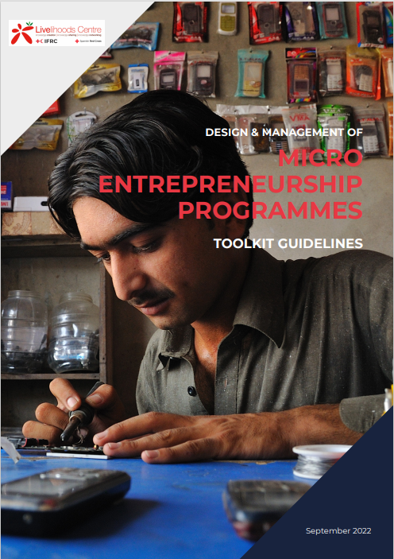
2
ME Toolkit & Guidelines
ME programmes using CVA
Notes:
MEs targeted by RC/RC programs are usually informal – not officially registered- businesses as a type of self-employment. They are often operated at or near the home and using one’s own labour, and/or the labour of family members, accessing local markets.
Micro-enterprise
Liquid and fixed assets ranging in value from several hundred to several thousand USD.
1 to 10 employees
Sometimes lacking a formal license, but often with a fixed location and hours
Income Generating Activities
Little or no fixed assets, total assets of USD 30–1,000
Work may be part-time or sporadic, perhaps done from the person’s home
Self-employment, with several ways of earning income

Slide 6
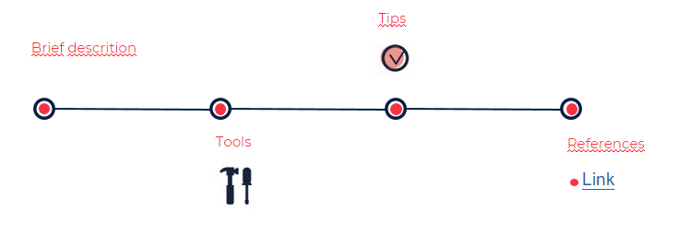


What will you find in the toolkit?
Urban /Rural contexts
Individual/Groups
Why?
Increasing interest
Experience gathering & sharing
Practitioners’ needs
Increasing interest
Sequential guidance, tips and tools throughout the different phases and stages of the process.
Notes:
So, What you will find?
You will find a Toolkit guideline to help livelihoods practitioners in programming micro-entrepreneurship (ME) interventions from the beginning of the project to the end from the market assessment, design, implementation up to monitoring and evaluation.
Each stage starts with a brief introduction followed by a proposal of tools, then we give some tips (TIPS) that come from our experience, and finally the guide refers to Links to documents and tools from other actors of the movement or other organisations...
The guide can be used in rural and urban context as well as is adapted to support individual and business run by groups. In the future, it is planned to develop some other tools to support cooperatives more specifically, but this guideline can be used as well for ME groups.

Slide 7
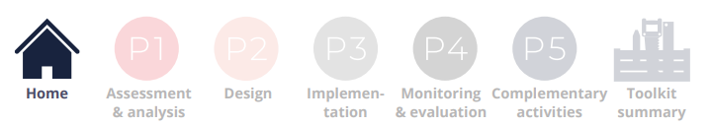
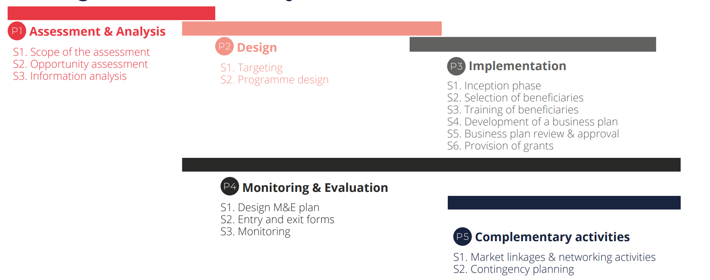

ME programmes phases
Notes:
I am going to show you how to move around the toolkit, for this I will ask you to open the toolkit guideline (PDF). The link in case you don’t have yet is in the chatbox. Please open de document and go to page 8. You can also just click on the HOME icon in the header and it will take you to the toolkit overview.
I will wait one minute so you all have the toolkit guidelines open.
…
Are you ready? Everybody in page 8?
This chart is the core of the document, as it summarizes the different phases of the micro-entrepreneurship projects, each phase divided into stages.
As you can see, there are 5 different Phases:
P1 Assessment & Analisis, divided into three stages
P2 Design
….
P4 – Monitoring & Evaluation, starting srom the analysis
P5 – Complementary activities
​
The structure of the toolkit is based on the assumption that the process starts by identifying Microentrepreneurship opportunities; however, in practice, the ME support component is often part of a more comprehensive programme already underway, so teams may join the roadmap at different stages.​

Slide 8
01
ASSESSMENT & ANALYSIS

Slide 9
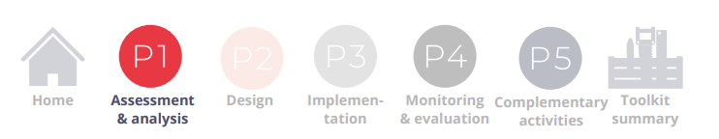
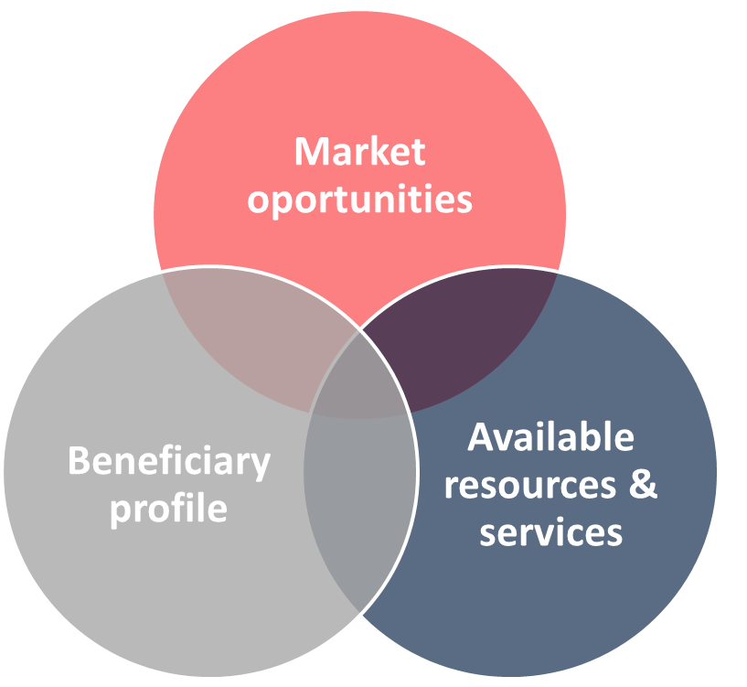
P1 Assessment & Analysis
Assessing and analyzing micro-entrepreneurship opportunities in the target area.
E.g. Objective:
Defining the average cost of setting up a ME per beneficiary (training, coaching, seed capital or start-up grant, etc.).
Obtaining a list of the main ME activities
Notes:
As mentioned before, this stage can be carried out at different points in the programme cycle:
at the beginning for the definition and design of the intervention (as presented in these guidelines),
or once the programme has started (inception phase) to guide the beneficiaries in selecting business
This phase, as mentioned, introduces the market assessment methodology (used by the Livelihoods resource center), based on three axes:
market opportunities and gaps,
target group profile, and
available resources & services to facilitate / enable the creation of ME.
All the tools included have already been used (tested) in different contest (Mali, Niger, Siria, Libano, Mauritania, etc.)

Slide 10
02
DESIGN

Slide 11
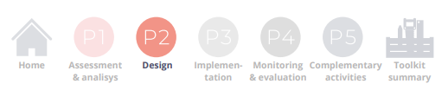
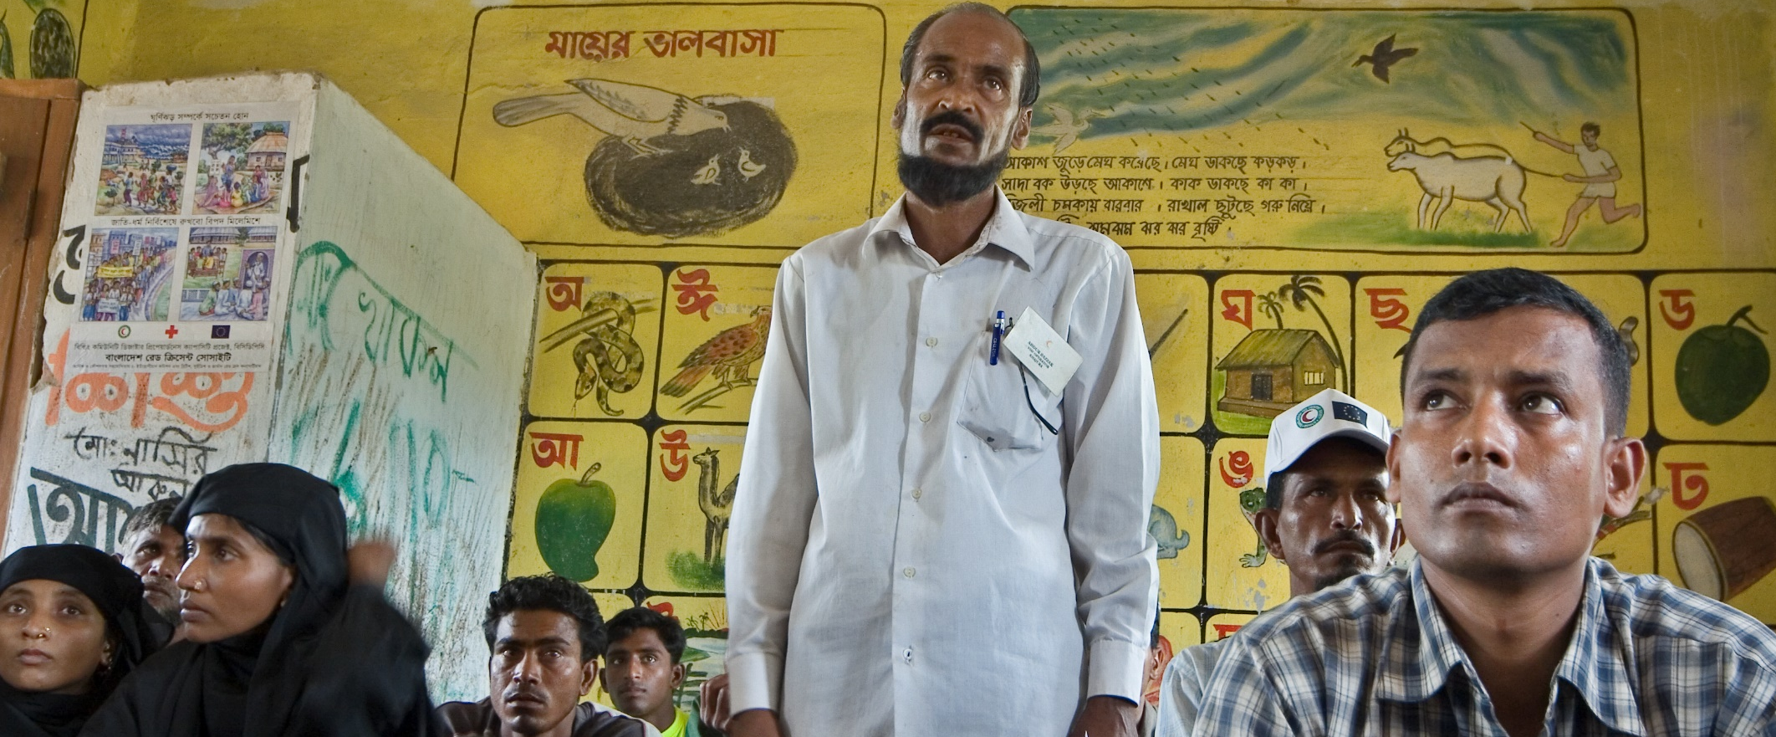
Variables to consider:
ME developed by an individual or a group
Objective: recovery of the ME or start up a new ME
Formal and informal legal status
Rural and urban / peri-urban settings
Type of start up grant(size /transfer mechanism..)
Timeframe
Complementary activities (market linkages, savings groups, ME contingency plan)
P2 Design
Targeting
Programme design: Operation plan, work plan, tips for budget, Risk matrix and mitigation measures, possible livelihoods indicators.
Notes:
DESIGN
Based on the previous analysis, you will be guided to design the intervention, including the feasibility study of this type of program. (There is a checklist that will help you decide whether a Micro Entrepreneurship programme is a feasible option or not).
Once we know is feasible, the next step would be targeting. Targeting beneficiaries to ensure that assistance reaches those who need it the most in an appropriate way, providing guidance and tools to establish the targeting approach, indicators and mechanisms.
As a reminder, the LRC has created a guideline and tools on targeting. The link is in the chatbox: Targeting in urban and rural contexts - Guidelines and Tools - Livelihoods Centre
available in different languages, we encourage you to have a look at the document and tools.
During the design phase, you will also be guided and equipped with tools to develop the operational plan of action.
TIPS,
along this section you can find key tips, as for example:
When establishing the targeting process: Involve communities, agencies and authorities throughout the whole targeting process.
Pilot the programme: Make sure that the size of the pilot programme allows you to devote sufficient time to following each assisted household very closely to draw meaningful conclusions.
The most common mistake when planning a programme is to set unrealistic targets for the number of beneficiaries and to ask for insufficient human resources.
Lastly is Essential to evaluate the risks that could appear during the implementation and select mitigation measures among all stakeholders for a common agreement

Slide 12

Tools
Notes:
Examples of tools:
P2.S3.T5. Risk matrix and mitigation measures: This tool lists common risks that should be considered during the implementation of ME programmes and the mitigation measures that could be put in place to avoid them.
Inspired in the cash toolkit, risks are divided by: contextual risks, programmatic risks, institutional risks, where you can find potential risks and potential mitigation measures listed.
All the tools and templates need to be adapted, and it is recommended to reach a consensus with the team and, if any, with the project committee or the community.
Secondary information review
P1.S2.b.T1 Secondary information &
Stakeholders map
Data gathering / Surveys
P1.S2.d.T1.i Target group survey
P1.S2.d.T1.ii Consumers survey
Semi-structured interviews
Focus Group Discussions (FGD)
Direct observation
S3. Information analysis
P1.S3.T1 Qualitative data entry - analysis
P1.S3.T2 ME Opportunity assessment

Slide 13
03
IMPLEMENTATION

Slide 14




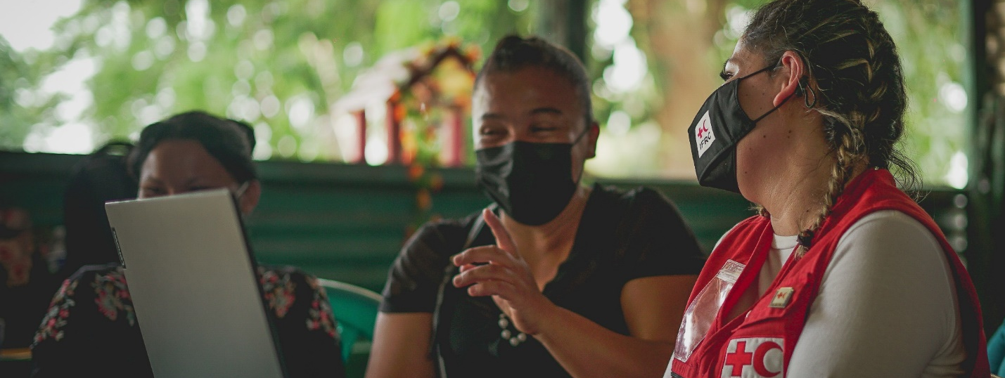
P3 Implementation
Content
Tips
S1 Inception phase
S3 Training of beneficiaries
S5 Business Plan review and approval
Inception phase: Check NS Cash preparedness status (FSP, capacity building, SoPs/Road map..)
S2 Selection of Beneficiaries
S4 Development of Business Plan
S6 Provision of grants
Key factors: business plan and the appropriate management of the business
Business idea.
Start-up budget.
Economic plan: Estimation of the potential income, expenses and profit
Key resources, Key partnerships
Notes:
In this phase, you will find guidance on setting up internal resources and capacities during what we call the inception phase, and from there proceed to the selection of the beneficiaries, training them to develop their business idea and business plan, as well as in basic aspects of business management and reinforcing or upgrading technical competencies. This stage includes guidance and tools to coach beneficiaries in business plan development, after which viable microenterprises could receive a start-up grant, which may be in cash or in-kind.
I will highlight key points of some of the steps mentioned.
Inception phase: possible actions during this step, among others: Building relationships with local partners and/or service providers (FSP for CVA) . Capacity building for staff and volunteers. Develop and implement a communications strategy and awareness materials
NS Cash Preparedness:
Appoint a National Society CTP focal point
Establish a CTP technical working group (TWG)
Develop the CTP preparedness Plan of Action (PoA)
Incorporate CTP into human resource systems, financial systems, (M&E) systems

Slide 15

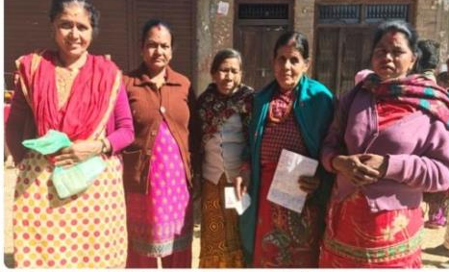
P3 Implementation - S6 Provision of grants
Determine the minimum amount to start the ME of their choosing
Cash grants
First instalment: conditioned to:
Attendance to training and submission of business plan
signature of individual contract (MoU) between beneficiary and NS
Second Instalment:
conditioned to the correct expenditure of the first instalment and restricted to the purchase of the remaining items
Tips
Check: availability of items in the local markets, existence of reliable money transfer providers and their costs, preferences, legal restrictions, security issue, cash transfer mechanisms.
Notes:
The provision of financial support is normally complementary to business training in order to start, recover or consolidate micro entrepreneurships. After submitting a business plan that is considered viable and once it is approved, beneficiaries could receive economic support in the form of cash or in-kind grants to start implementing activities.
Allocating too small an amount will not meet the objectives of the program; conversely, providing too large an amount will also have negative consequences such as wasted resources and inclusion errors.
In some cases for various reasons (inflation, security, quality or even choice of the beneficiary or NS preference), it is decided to support the delivery of goods IN-KIND

Slide 16
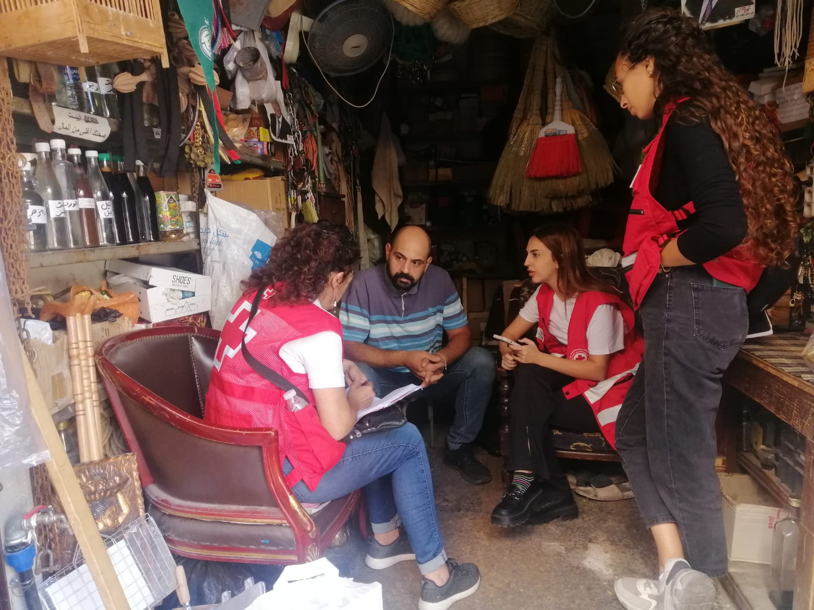
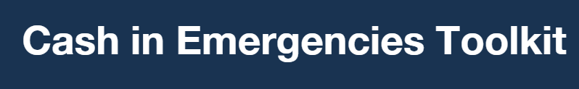
Tools
M3_1_2_1 cash feasibility checklist.
M3_1_3_2 Advantages and Disadvantages of response modalities
M3_1_6_1 Decision-making matrix template.
Beneficiary communication and accountability
Financial Service Provider
  M4_3_1_3 E-transfer requirements checklist
M4_3_1_4 Assessing mobile money template
Notes:
Tools for implementation phase
Outsourced
P3.S3.a.T1 Model Consultancy Agreement
P3.S3.a.T2 Model ToR for training on business skills _ business planning
In house
P3.S3.a.T3 Business Skills Training course P3.S3.a.T6 Business Model Canvas
P3.S4.T1a Business plan format (long/short)
P3.S4.T2 Economic plan formats
P3.S4.T3 Canvas business model
P3.S4.T4 Simple initial market assessment form
P3.S5.T1 Table of criteria for Business Plan approval
P3.S5.T2 MoU with beneficiaries’ template
P3.S5.T4 Assessing your Entrepreneurs Characteristics

Slide 17
04
MONITORING & EVALUATION

Slide 18
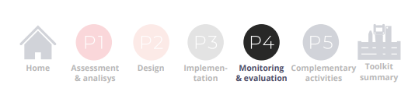

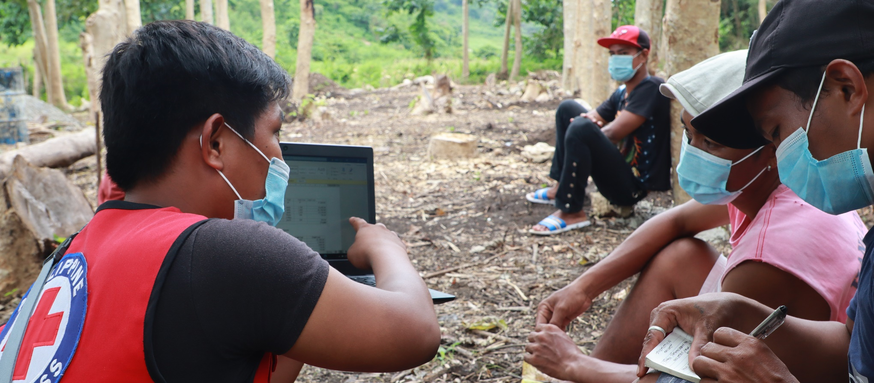
P4 Monitoring & evaluation
Content
Tips
Design the M&E plan
Monitoring: Baseline, Cash follow-up form, Quarterly monitoring form
Staff and volunteers in charge of monitoring should have the capacity to follow up cash grants according to business plans
Establish deadline from 1st and 2nd instalment, signed MoU. Discuss measures to take in case of incorrect use, deadlines..
Notes:
In this phase, the guidelines provide tools, tips and guidance to monitor progress against programs’ objectives and indicators, but also to follow up and coach the micro-entrepreneurs in order to support them in solving problems related to business management that they might face.
TIPS
Staff and volunteers in charge of monitoring should have the capacity to follow up on business plans to ensure effective coaching, therefore training staff and volunteers should be previously assured.
In addition to the indicators defined in the programme’s logical framework, other specific indicators that could be considered key to monitoring the evolution of the MEs and aspects of the context that may affect it can be included
The monitoring process can help the MEs to adapt their businesses from what was planned, introducing updates based on the evolution of the situation: changes in prices, business profits different than expected, changes in the supply chain, etc.
S1. Design M&E plan
P4.S1.T1 Monitoring plan
S2. Entry and exit forms
P4.S2.T1 Entry form
P4.S2.T2 Exit form
S3. Monitoring
P4.S3.T1 In-kind follow-up form
P4.S3.T2 Cash follow-up form
P4.S3.T3 Quarterly monitoring form
P4.S3.T4 Bookkeeping templates

Slide 19
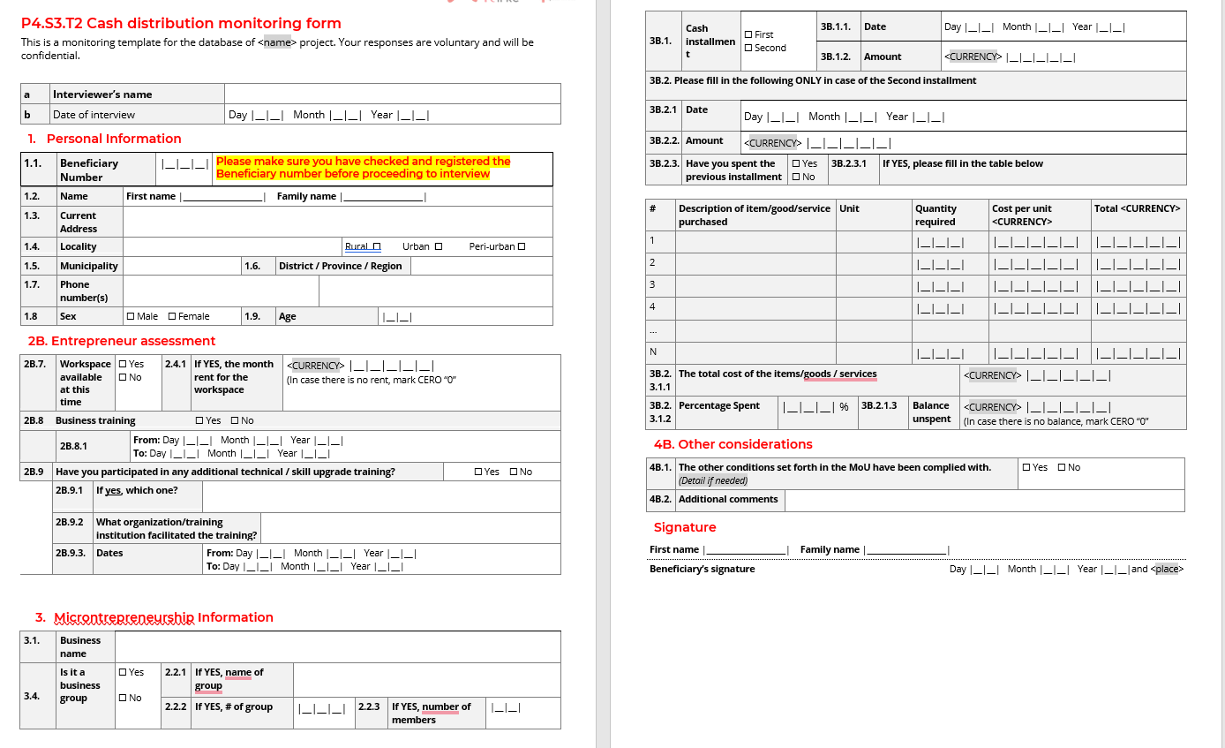
Tools
Cash follow-up form
Notes:
P4S3T3 Quarterly Monitoring Form. Template starting with filling up the personal information, followed by HH economy (income and expenditure information), entrepreneur assessment, and the microbusiness information (from if you have positive net gains, or if you have hired new staff or workers, to challenges and risk that the business may face)
We have already used in Ethiopia, Gambia, Guinea con Acry, and Filipines.
I hope this section was useful for you, as you can see there are plenty of tools and guidance for these phases.

Slide 20
4
Micro-entrepreneurship experiences: Ethiopia and Syria

Slide 21
Ethiopia
Transformation from “Committee oriented livelihood support” to empower beneficiaries to make decisions on its own destiny in Migration project

Slide 22







Project “Well-being and resilience for migrants and vulnerable communities”
Context
Characteristics
The project provides humanitarian assistance, livelihood support, psychosocial support services that target the social reintegration of returnees.
Intervention area: Amhara, Oromia and Tigray
LLH Beneficiaries: 1030 HH recipients of CCG for developing their businesses
Transfer value: 26,000 ETB (475$)
Implementation period: 4 years 2022-2025
Initial project from 2018 (supported more than 600 HH)

Slide 23
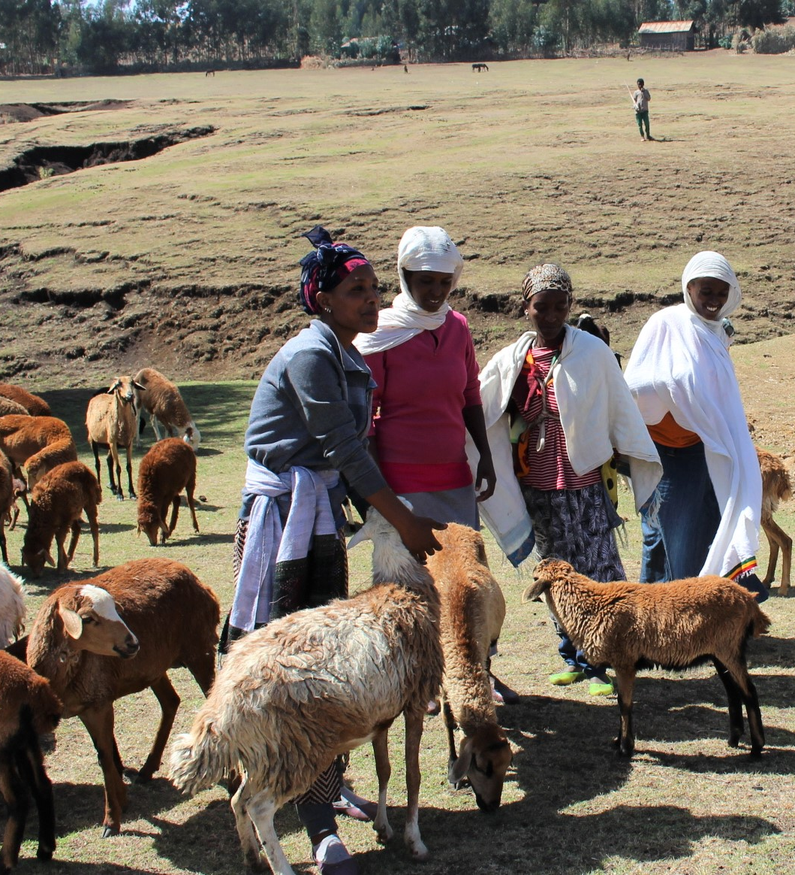

Previous trends in livelihood support (in-kind)
Main activities
Basic Business skills and management training to each beneficiary
A business plan was developed
Procurement committee from the local community performed purchase of items for livelihood support to these beneficiaries based on their business plan
Project livelihood officers followed up all these activities
The project financed all required logistical and financial matters for this process of procurement and supply to the beneficiaries
Key tools from toolkit
ToR for for the training of entrepreneurs.
Model Training Agreement
Development of a business plan
Business plan format simplified
Canvas business model
Group supported by ERCS – goat farming

Slide 24
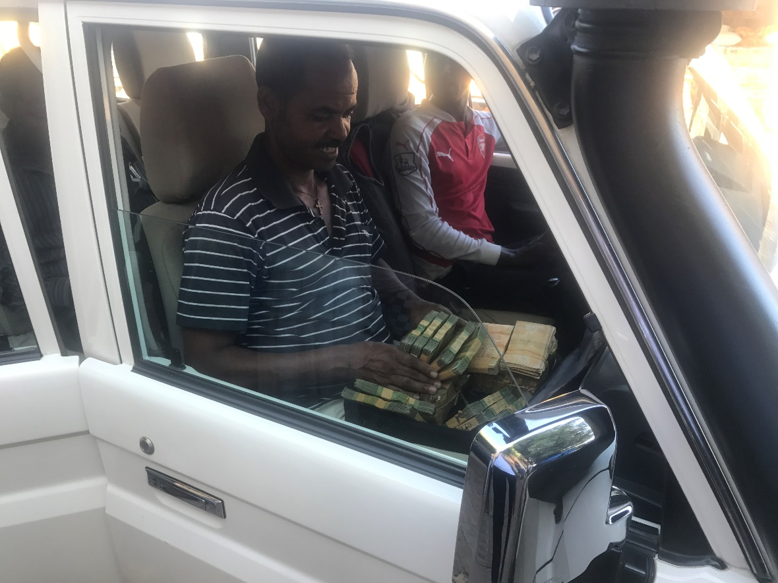
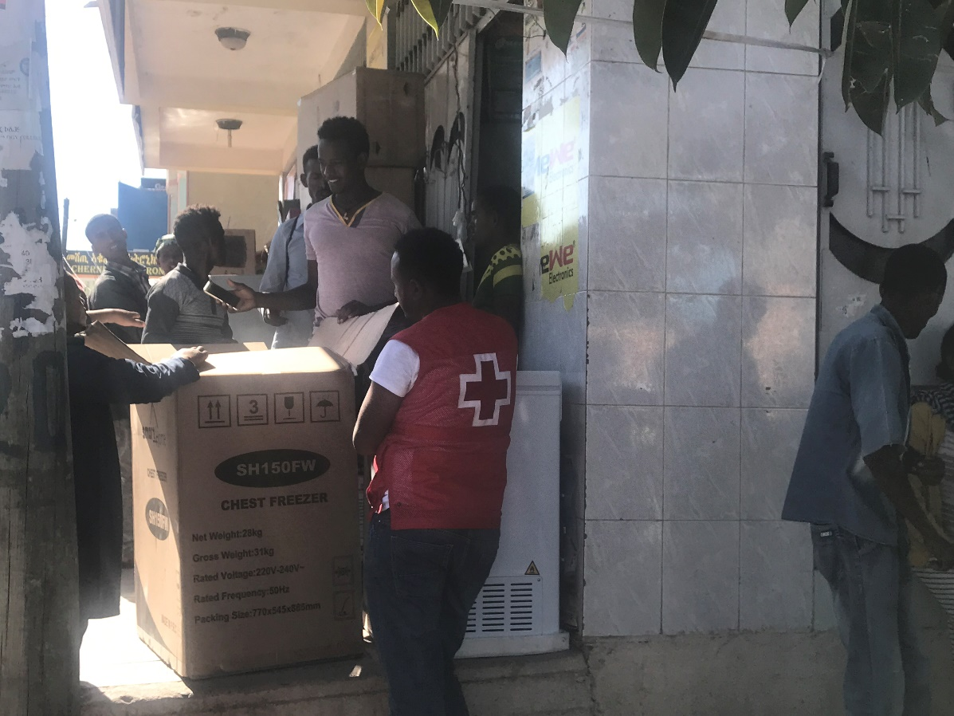
Previous trends in livelihood support (in-kind)
Procurement in Tigray by ERCS
Disadvantages
It was less empowering to the beneficiaries as it is the committee that conducted the procurement on behave of hundreds of beneficiaries.
Financially costly process as the project has to cover the per diem, accommodation and related expenditures for the committee which may take weeks to complete this procurement.
Time wasting for the beneficiaries who usually wish to start their small business and earning income soon after the training.
Prices increase in some cases when an organization is behind purchasing item (instead a beneficiary alone)

Slide 25
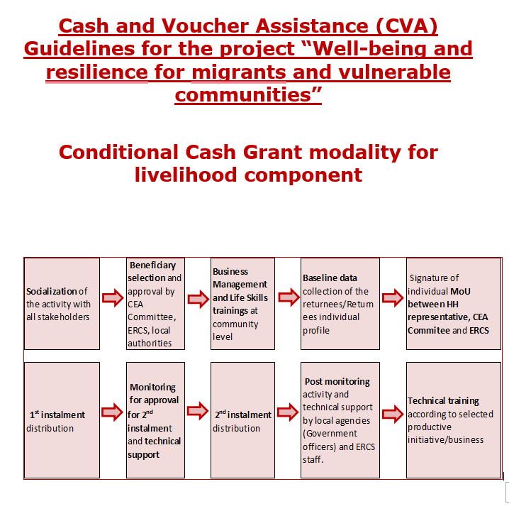
The transformation from in-kind to CVA as modality
Initial steps
A comprehensive feasibility assessment conducted participating the field office project staffs to see whether it can be really possible to shift to the CVA for Livelihood beneficiaries in the year 2023
A thorough discussion and debate was made to find any challenges of starting the CVA
Possible risk and challenges were identified and solutions were forwarded including having a guideline for CVA specific to this project, strictly following up the preconditions for CVA to beneficiaries
Key tools
M3_1_2_1 cash feasibility checklist.
M3_1_4_2 Risk matrix template
M3_1_6_1 Decision making matrix template

Slide 26
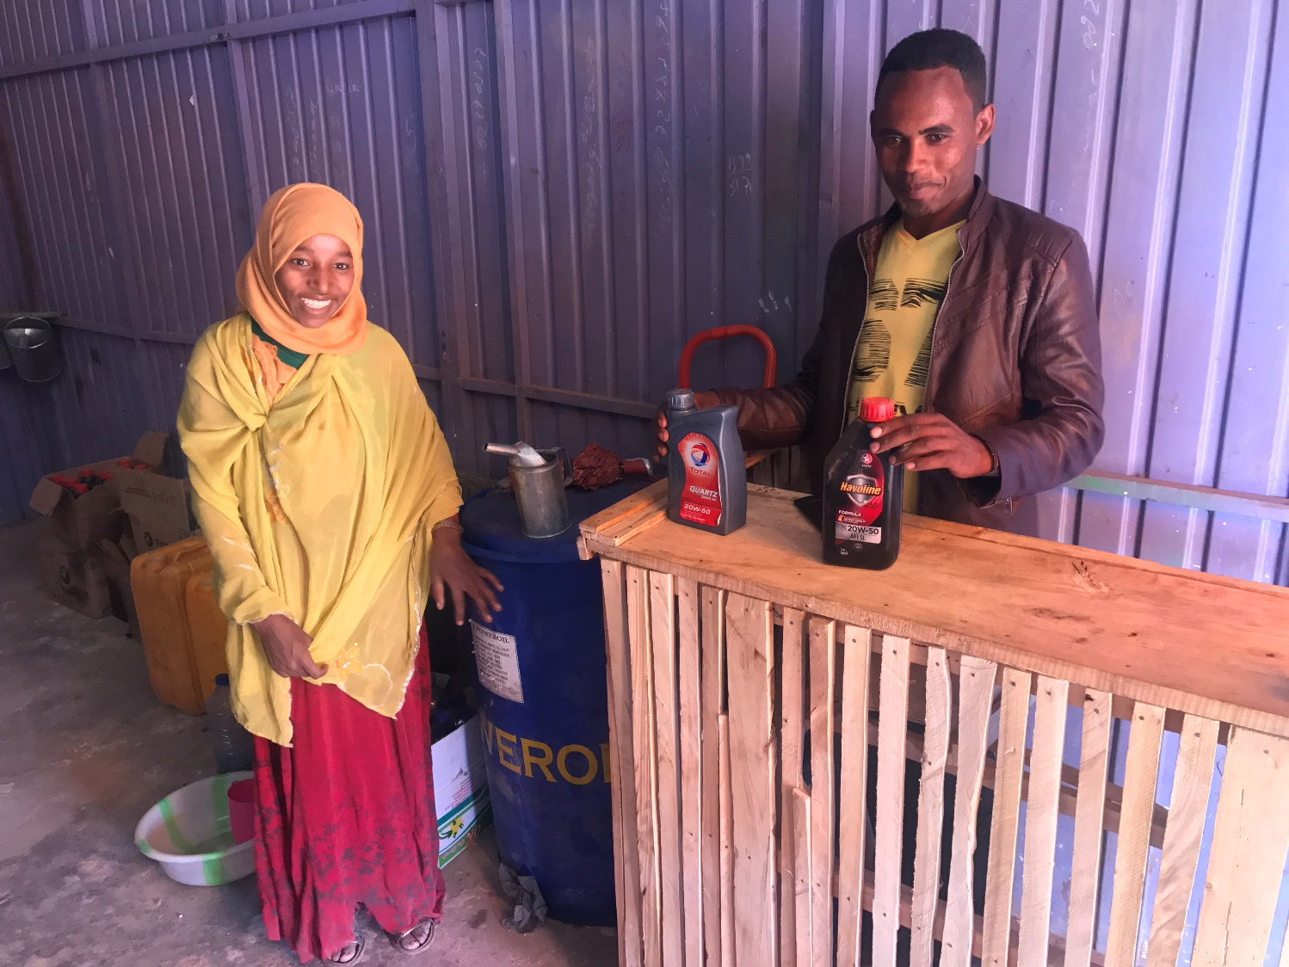
Implementation - Provision of cash grants
First instalment, conditioned to:
Attendance to business management and life skill training.
Submission of business plan and approval.
Workspace available for the group or individual returnees.
Opening their own bank account
Having a group collateral and include the data in the MoU
Signature of individual contract (MoU) between ERCS, targeted returnee and local authorities
Deadline of 2 weeks→ monitoring visit
Group supported by ERCS in Arsi – Vehicle shop-spare parts
Returnees will show items purchased or receipts/invoices of the expenditures of 1st instalment (if available) to the ERCS monitoring teams before receiving the 2nd installment

Slide 27
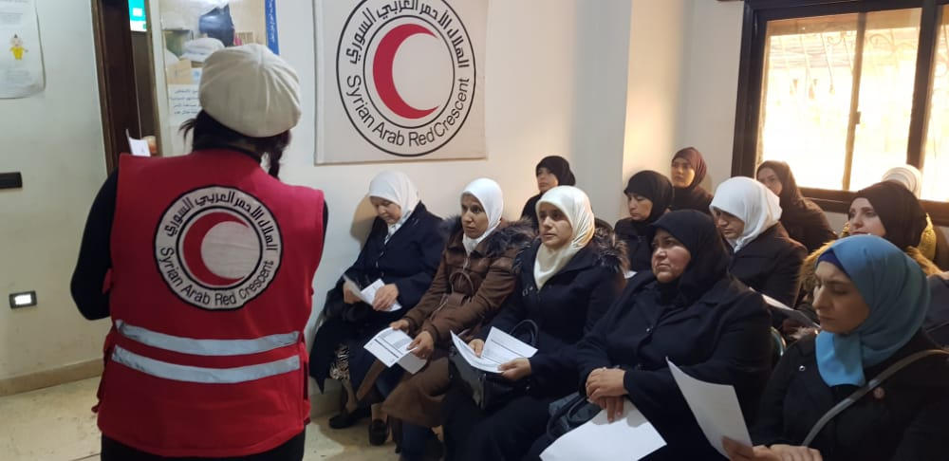
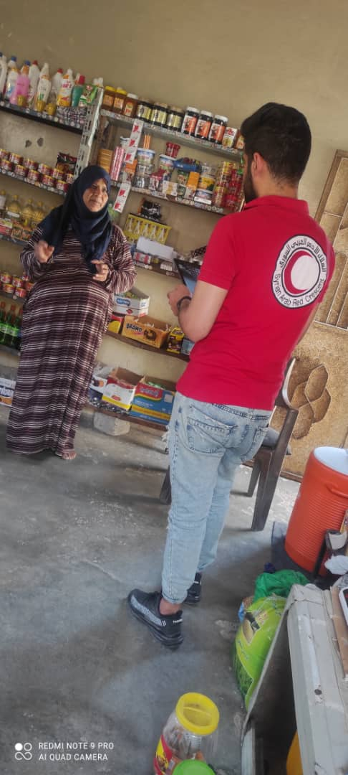
Syria
Contributing to improving living standards and reducing the vulnerability of IDP’s, returnees, and host communities in Syria

Slide 28

Syria
Restoration and protection of Livelihood of affected Women Head of Households through Income Generating Activities /ME
Context
Characteristics
The project has targeted the IDPs and returnees WHOH in both Deir Azzour and Rural Damascus who lost their assets (machines ,tools ..etc) or were using negative coping strategies. The project was focused on building the capabilities of the women head of household on enabling them to accumulate assets in income generation activities to enhance livelihood opportunities.
Partner : IFRC
Modality : Conditional Cash
Intervention area:
Al Mayadeen –Deir Azzour
Daraya –Rural Damascus
No of HHs : 141
People targeted : 720
Implementation period: 2022 -2023

Slide 29
Project implementation steps
Area Selection
Conducting Labour Market Assessment
Conducting Cash Feasibility Study
Dissemination of the project to the communities
Registration (application collection)
Verification
Delivery of basic business management skills training.
Presentation of business plans and final selection
Conducting Baseline -Entry form
First installment of Cash Transfer to the beneficiaries
Cash follow up
Second installment of Cash Transfer to the beneficiaries
Post Distribution Monitoring
Conducting End line -Exit form
Modality :
Conditional Cash Transfer -2 installment -
Value money : 3500,000 SYP (1000$)
First condition before receiving any installment is attending the basic business management training and to have a successful business plan
To receive the second transfer, they must have spent the money on what was planned in their business plan developed after the training. This is verified through the cash follow-up form and the home visits.
Small Business tools for SARC :
Using Livelihood Resource Center tools for ME programme
SARC is still adapting to fit Syria context
Standardization of the ME tools for SARC with partners

Slide 30
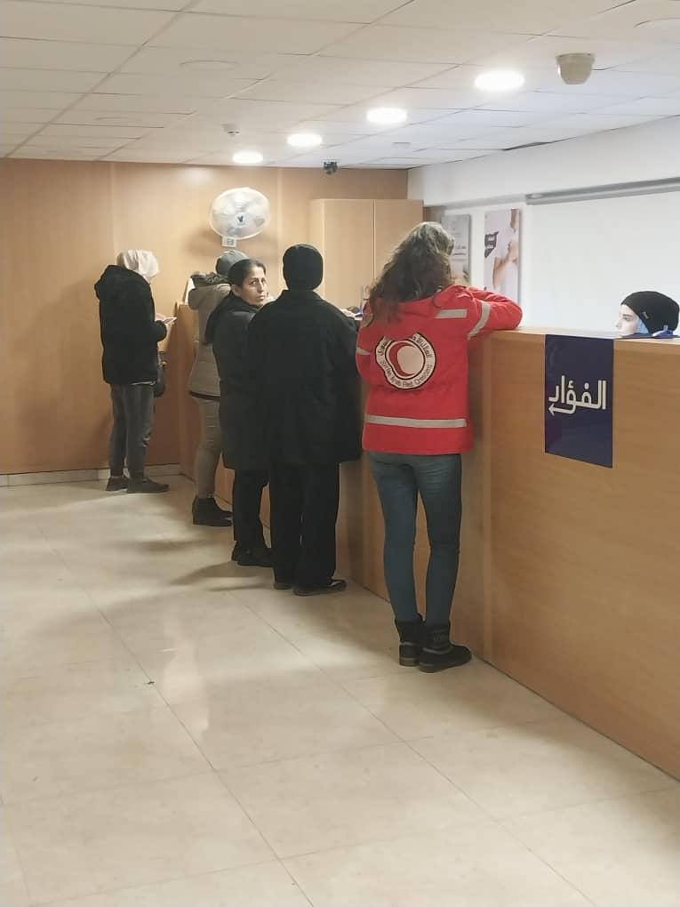
Why Cash has been used as modality
A cash feasibility and risk assessment was completed by SARC CVA team to support effective initial decision making for whether CVA is an appropriate response option or not :
According to the results of the focus group discussions, the modality selected was Cash due to:
Community preference to receive Cash rather than in kind
Familiarity with Remittance companies :The targeted population
is familiar and well acquainted with remittances companies available
In the area as Al Fouad, Al Haram, etc..
Governorate Acceptance
By piloting Cash for Livelihoods, this intervention is strengthening the current capacities and systems in the Branches.
At the same time, the use of cash in the local economy is also injecting money in local market and strengthening the local economy and early recovery of Deir Ez Zor and Rural Damascus.

Slide 31
Advantages and Disadvantages of using CVA in the small business project
Advantages :
Greater Flexibility for affected people to purchase the items and select the market
Increasing dignity for the affected people
Availability of the remittance companies in the areas
Faster process
Disadvantages :
Variability of prices and inflation every time since starting the market assessment till transferring the money which affect the value money between the first and second transfers .
Market changes as due to prices changes this is impacted the availability of some items in the markets.

Slide 32
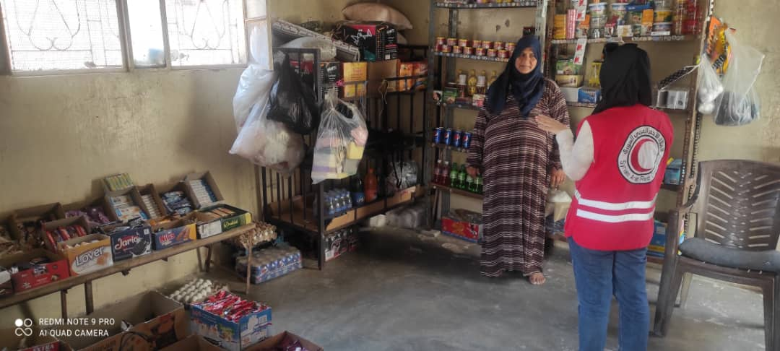
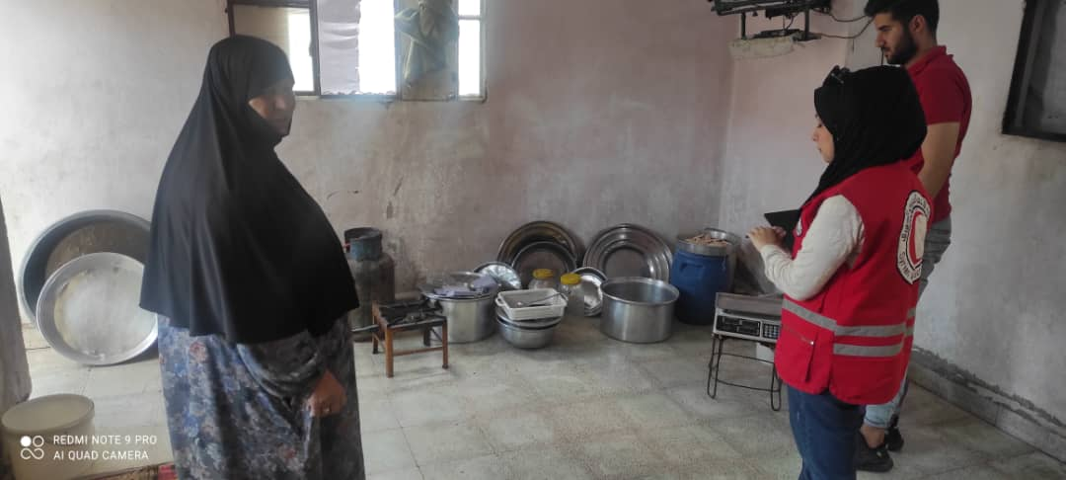
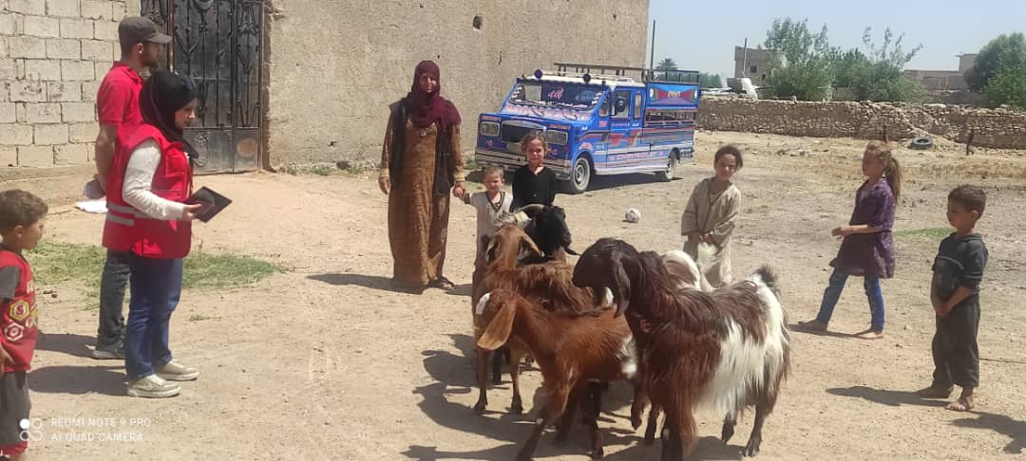
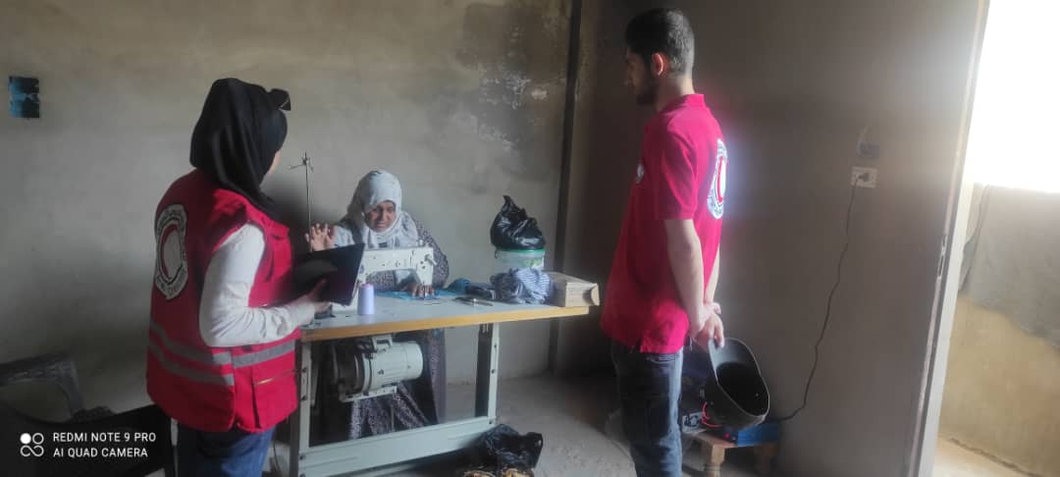

Slide 33
5
Discussion (Q&A) and Closing remarks

Slide 34
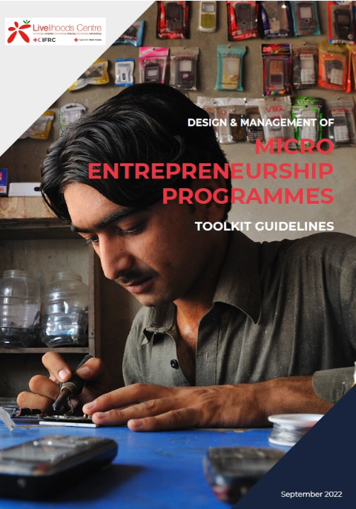

Karacak
Micro-entrepreneurship Programmes Toolkit Guidelines
https://www2.cruzroja.es/web/livelihoods-centre/technical-toolkits/me-toolkit

Slide 35
Karacak
Learning and resources cash-hub.org
Webinars cash-hub.org/resources/webinar-series/
Livelihoods Resource Centre www.livelihoodscentre.org
livelihoods@cruzroja.es
Cash Helpdesk www.helpdesk@cash-hub.org
cash-hub.org/helpdesk/

Slide 36
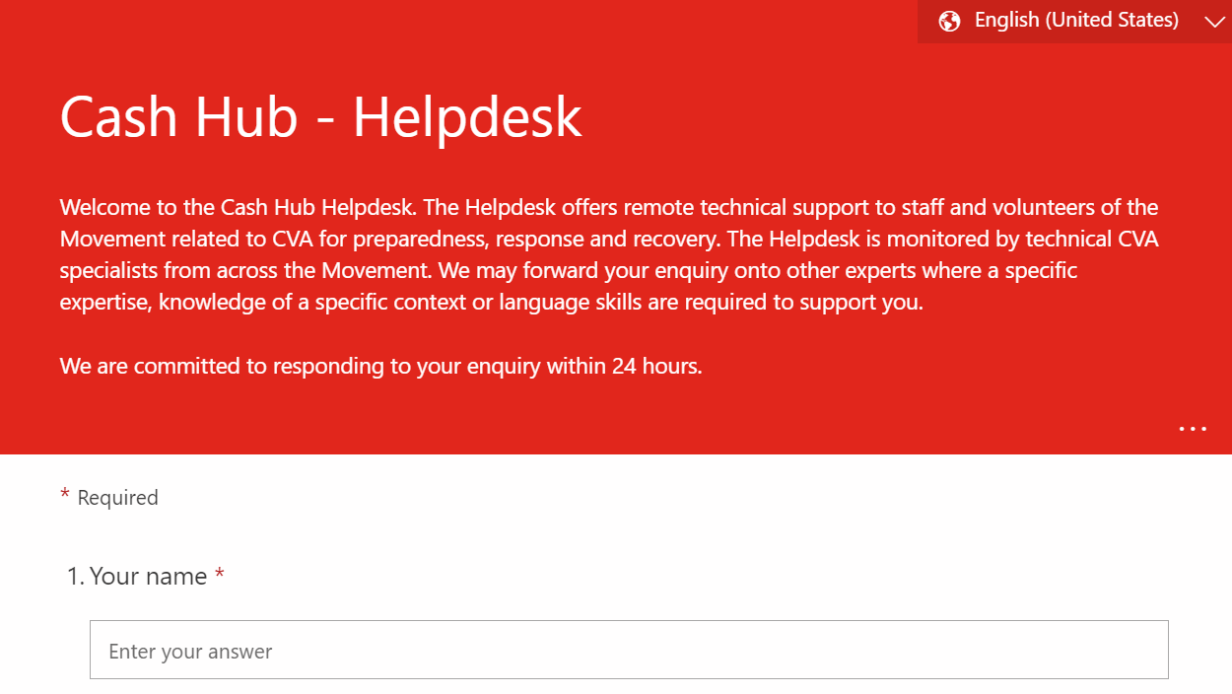


Karacak
Questions and technical supports requests can be submitted through the Helpdesk’s query form. The form is available in English, French, Spanish and Arabic.
cash-hub.org/helpdesk

Slide 37
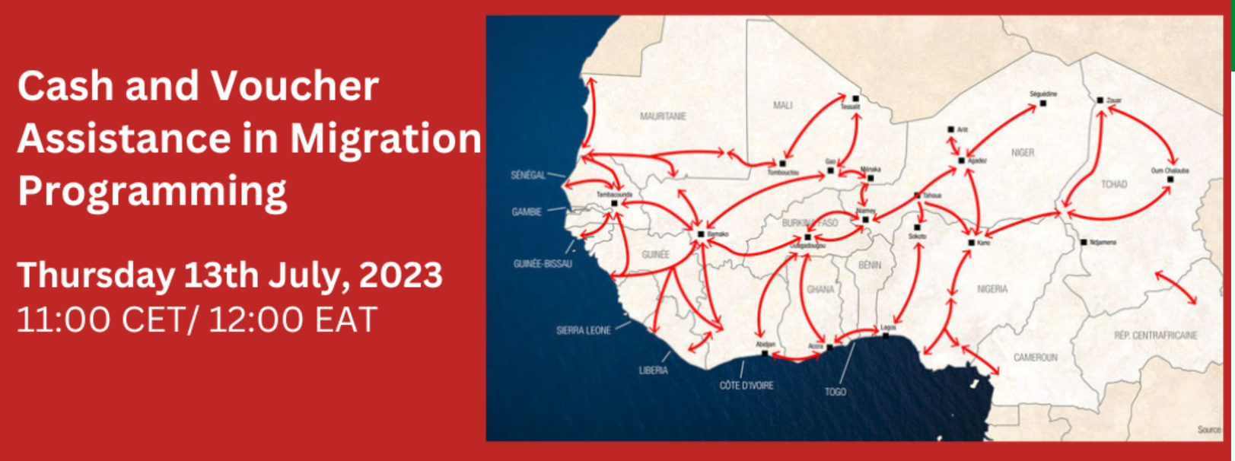
Karacak
https://cash-hub.org/news-and-events/events/

