Slide 1
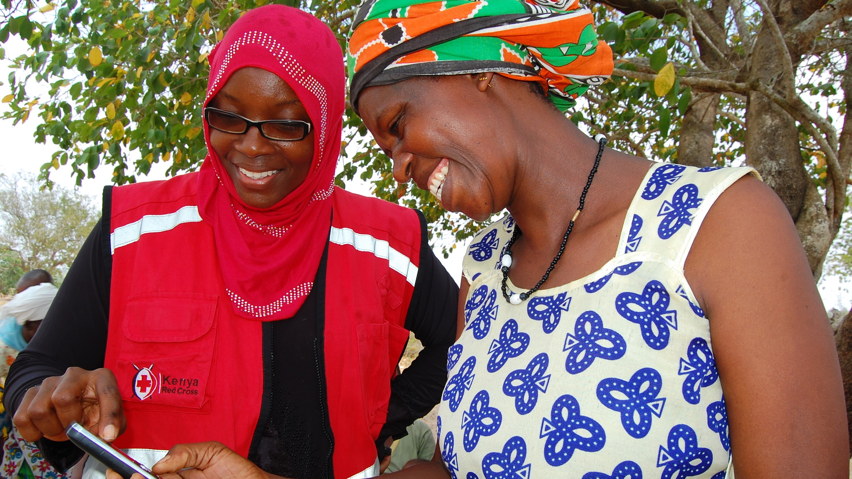

Cash and Voucher Assistance (CVA)
Awareness Presentation
(Location)
(date)

Slide 2
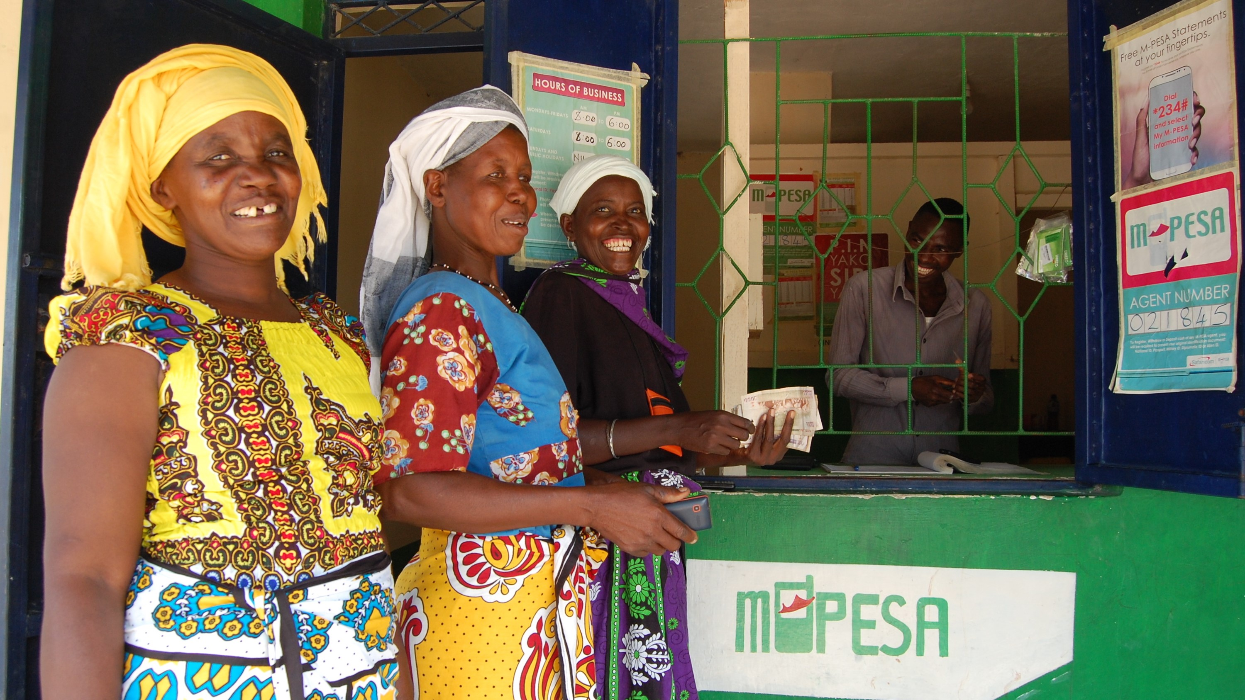

Introductions to CVA

Slide 3
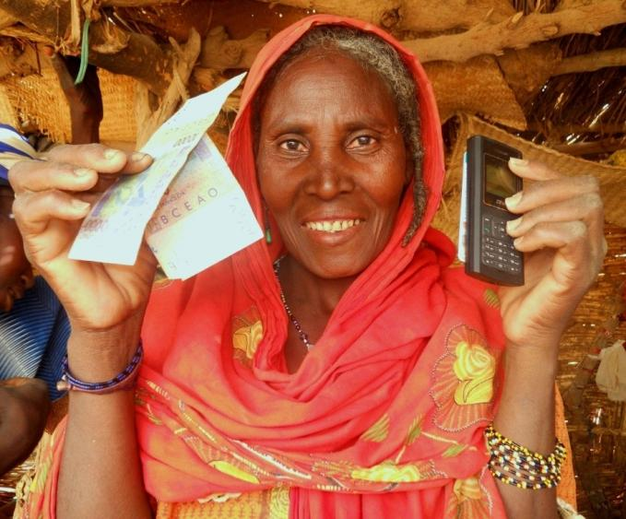
What is Cash and Voucher Assistance (CVA)?
CVA refers to the direct provision of cash transfers and/or vouchers for goods or services to individuals, households, or group / community recipients.
It is not a programme objective itself; it is a means of implementing one.
CVA has several synonyms (e.g., Cash Based Interventions, Cash Based Assistance, and Cash Transfer Programming), but Cash and Voucher Assistance is the recommended term.
– Calp glossary of terminology-

Slide 4

Why Choose CVA?
Notes:
Link to short YouTube video (hyperlinked in presentation slide)
https://www.youtube.com/watch?v=V08DZytvjXg

Slide 5
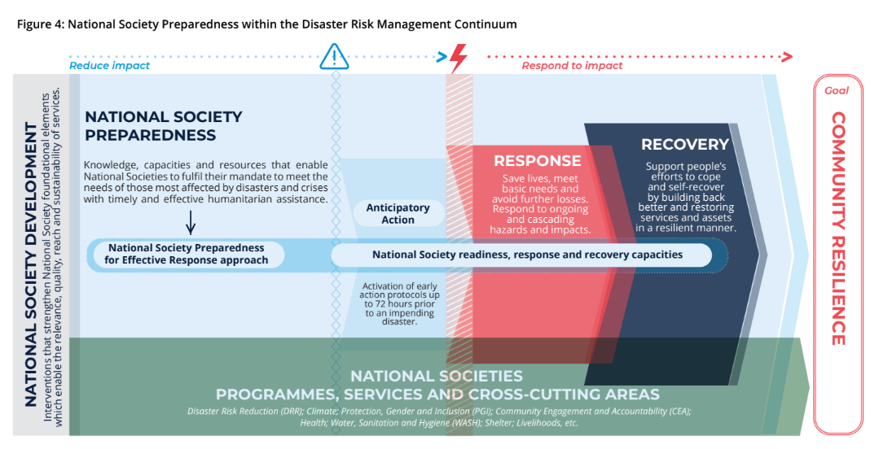
When can CVA be used?
CVA for Anticipatory Action
CVA for disaster emergency response
CVA for early recovery and recovery programming
CVA preparedness
Notes:
Figure 4: shows the NS preparedness within the DRM continuum.
Prior to the shock or hazard, CVA is utilised in anticipatory action to reduce the impact of hazard. Such as livelihood protection, Evacuation and restocking of food.
During Response CVA also can be used to address the needs of the affected population. Mostly at this stage Multipurpose cash is used.
During recovery CVA is used within sectors to address sectoral activities.
Prior to response CVA preparedness initiatives are implemented to increase the efficiency and agility of the CVA intervention.

Slide 6
Why choose CVA?
Humanitarian reasons
Empowerment and dignity
Choice and flexibility
Power transfer
Links response to recovery
Effective across sectors and in situations with varied needs
Pragmatic reasons
Cost efficient
Multiplier effects
Support to local trade linked to economic recovery
Fewer costs for recipients
However, CVA is not always appropriate in every situation and should be informed by response analysis....
Notes:
Dignity – cash can be better at maintaining the dignity of recipients. It may, for instance, be possible to avoid long, degrading queues.
Choice – cash allows recipients to decide what they should spend the money on. This enables people to choose what they most need, and allows for this to vary from person to person
Power transfer - cash often allows recipients to make their own choices thereby increasing their power and control over how they respond to disasters
Links response to recovery - because of the multiplier effect of many cash projects the impact can continue into the recovery phase. For example a cash for work programme can help build the infrastructure enabling better transport to markets, or a cash grant programme can protect livelihoods enabling people affected by disasters to recover more quickly. This aspect of the humanitarian response is also known as ‘Early Recovery’ now represented by the Global Cluster Lead Agency UNDP
Cost efficient – distributing cash is likely to be cheaper than commodity-based alternatives because transport and logistics costs are lower. Be clear that it is not always true that cash transfer is cheaper, but often can be
Multiplier effects – distributing cash can have knock-on economic benefits for local markets and trade if the money is spent locally, and it may stimulate agricultural production and other areas of livelihoods
Support to local trade – unlike commodities (food, shelter) cash is unlikely to discourage local trade or production, and may even lead to contributing to economic recovery
Fewer costs for recipients – food often costs recipients a significant amount to transport from the distribution site to their home, or to mill into a usable format. Cash avoids this or can build in these costs.

Slide 7
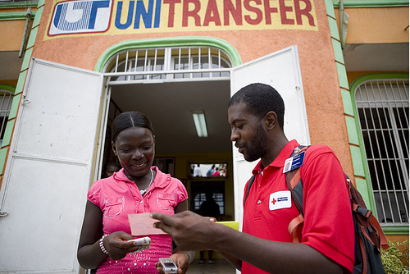
Types of CVA
CVA can be:
Cash grants or vouchers
Conditional or unconditional
Restricted or unrestricted
Multipurpose
Targeted at a wide range of sectors
One-off or repeated payments
Blanket provision or targeted to specific groups
Implemented alone or in partnership with authorities (e.g., as part of social assistance)

Slide 8

Terminology
CVA
Modality
Delivery mechanism
Transfer value
MPG or MPC (multipurpose cash)
Financial service provider (FSP)
Operational model (e.g., collaborative cash)
Technology platforms or software (e.g., RedRose, ODK)
Notes:
CVA is the standard terminology for cash and vouchers assistance, that the RCRC Movement now uses and is the official CALP terminology.
However, CVA is sometimes also referred to as CTP (cash transfer programming), CBA (cash based assistance) or CBI (cash based interventions) by other agencies. Generally these terms are usually referring to the same thing.

Slide 9
Delivery Mechanisms
Plastic card with a chip, usable with POS devices and ATMs,for cash transfers, e-vouchers/store purchases
Encrypted code that can be cashed at various retail or other outlets, used
for cash grants and vouchers
Personal bank accounts or sub-bank accounts that are used to deposit cash. Requires formal ID (ID)
e.g. banks, post office, non-bank FSPs
e.g. mobile network operators (MNOs), banks
e.g. banks
Adapted from UNHCR Cash Delivery Mechanism Assessment Tool

Slide 10


Perceived risks of CVA
Diversion/fraud
Security
Digital and data protection
Protection risks for affected community
Sector outcomes not achieved
Donor/NS risk appetite
Notes:
Do as question/exercise.
Ask group what do they think are the main risks associated with doing CVA?
Then show the slide and discuss.
Some suggested text:
All forms of programming will involve risks, which must be balanced against the imperative to meet the needs. CVA doesn’t fundamentally change this dilemma, but may present new types of risk and new opportunities for mitigating them.
Studies to date have revealed that CTP is inherently no riskier than in-kind or other assistance, and in some cases can be less risky. Perceptions continue to hinder CVA uptake. Many of the perceived risks related to programme quality.
NS should do their own risk analysis and risk management in their context. Risks management intends to enable rather than constrain action. Improved risk awareness need not and should not lead to risk aversion, but can rather strengthen the quality of response.

Slide 11
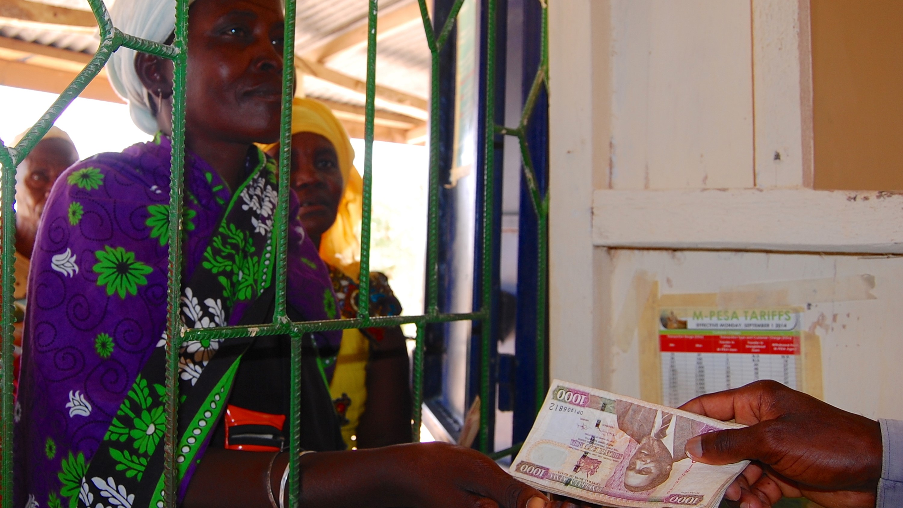
Current CVA trends and External Environment

Slide 12
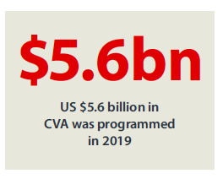
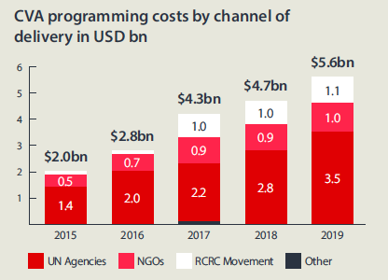
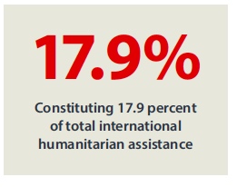
State of the Worlds Cash (2020)
Notes:
The State of the World’s Cash Report was produced in 2018 and and updated in 2020. It provides a neutral and critical analysis of the current state of CVA globally, based on extensive regional and country based consultations with CVA organisations and practitioners around the world + analysis of recipient perception data.
CVA continues to grow in scale and is now a major part of almost every humanitarian response.
The total amount of CVA delivered to recipients has doubled since 2016, from $2.8 Bn to $5.6Bn. CVA also grew as a percentage of international humanitarian assistance, standing at 18.9% in 2018, up from 10% in 2015. Growth in the use of CVA is expected to continue.
Note that whilst CVA has grown within the RCRC Movement, its global share has only slightly increased.
The report evidence shows that CVA is now a proven well established humanitarian response tool that saves lives and livelihoods and is challenging actors to think differently and deliver better.

Slide 13
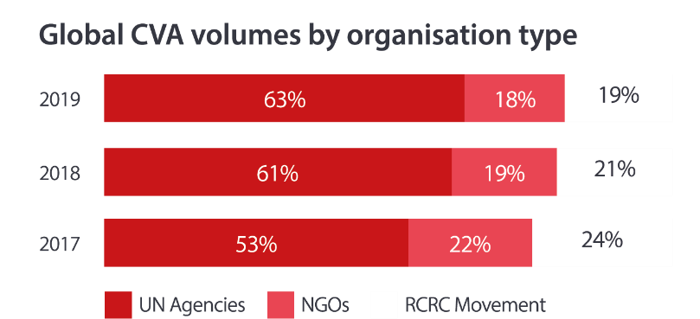
What others are doing?
CALP
Grand Bargain
UN (WFP, UNHCR and UNICEF) significantly scaled-up CVA
ECHO and FCDO. Donor CVA positioning is stronger, clearer and better coordinated. More focus on supporting collaborative approaches to CVA.
Notes:
Mention latest initiatives from CALP at the time – perhaps regional specific, pitched to context. At minimum, explain what CALP is and how it can be a helpful resource.
Grand Bargain: There are 62 signatories to the Grand Bargain, including international humanitarian donors, UN, Red Cross Red Crescent Movement, NGOs and local humanitarian partners. It comprises 51 shared commitments to make humanitarian aid more effective and 8 work streams. There is a work stream on CVA, led by DFID and WFP. IFRC, ICRC and BRC are members. The work stream has several commitments including to increase the appropriate use of CVA (many agencies including the Movement have set their own markers), invest in new delivery models and improve the evidence base for CVA.
Donors:
ECHO Has a CVA policy, 10 common principles for multipurpose cash and Guidelines for medium and large-scale CVA. EU commitment to provide 35% of its humanitarian assistance as CVA
FCDO (formerly DFID) promotes more use of innovative approaches, including digital cash.
Overall, amongst large donors there is a big push for more collaborative cash approaches for greater collective impact and to enhance efficiency, including the use of operational models or cash platforms.
Mention Red Cross examples– e.g., ESSN, Turkey (main one in the Movement) or any smaller platforms/consortia in the NS region/country.
Global CVA volumes: As shown here and on the State of the World’s Cash slide, despite the Movement scaling up the volume of CVA it is providing, the % of this in global CVA terms is not increasing. (Graph: 24% in 2017 but down to 19% in 2019) The main reason for this is due to UN operational capacity scaling up very rapidly. Donors are also taking a more operational model approach and awarding less contracts to individual agencies, but preferring a single delivery approach/one contract which typically the UN gets awarded as they have the operational capacity. WFP is now the main player globally. It’s unlikely the Movement can ever compete with the UN but it is good to be aware of the external environment.
Instead the Movement should play to its strengths and added value – local, community based, reaching where many others cannot go, auxiliary to government etc. To remain relevant in such donor models, NS can consider being selected as the partner to the larger delivery based agencies in collaborative models and can provide core programming in activities such as targeting, community engagement and M&E (non-delivery)

Slide 14






Current Trends and Debates in CVA
Measuring CVA
Operational Models
Multi-purpose Grants
Should cash and vouchers be measured separately or together?
How do we ensure that both efficiency and effectiveness are given due weight in the selection of operational models?
How should we use MPGs appropriately, while ensuring necessary sectoral outcomes?
Critical Debates
Capacity Building
Financial Inclusion
What do new ways of implementing CVA mean for capacity building?
What are the most appropriate ways to combine humanitarian CVA with longer term financial inclusion?
Social Protection
How and when can humanitarian CVA align best with social protection systems?

Slide 15


Other trends in CVA
Covid 19 – CVA as an enabler to build back better
Focus on market assessment and analysis
Deeper engagement with the private sector and use of digital CVA
Multi-sector use of CVA, beyond FSL
CVA for early recovery and recovery
Importance of cash preparedness
Notes:
COVID 19 has accelerated efforts for new, innovative partnerships between international actors and local civil society. It is also creating the need for a rapid shift to remote programming options, including digital channels for registration, delivery and monitoring of CVA.
The importance of market assessment/analysis is key for CVA, but COVID in particular is highlighting the need for better market analysis and understanding of how humanitarian response can strengthen market systems.
The landscape for scaling up the delivery of cash means a greater role is being played by the private sector. The recent IFRC Roadmap also flags in particular how the Movement should invest more in developing stronger relationships with the private sector (as well as other actors), so NS can be the partners of choice within coordinated international and nationally led responses.
CVA was primarily done within the FSL sector but in recent years this has developed to include multi sector use including Shelter, WASH, Health, Livelihoods, Education, Protection and increasingly Nutrition. This is mirrored in NS usage of CVA also.
The Movement is also seeing more use of CVA for early recovery and recovery and this is a growing area. More awareness is still needed on how CVA in recovery may differ from CVA in emergencies and how CVA is relevant for both contexts (as well as in longer term programming).
The importance of cash preparedness is not just something the Movement is focusing on….widespread awareness of the importance of preparedness, although donor investment in funding preparedness is still an area needing improvement.

Slide 16

Social protection and Cash
Since the start of the COVID-19 crisis, governments have introduced 271 targeted cash transfer programmes as part of national social protection
systems in
Working with social protection systems is key to strengthening the humanitarian-development nexus.
Since 2017, significant work has taken place by humanitarians in shock responsive social protection
Movement added value – auxiliary role, support localisation, long term presence
New opportunities from COVID-19
ILO World Social Protection Report 2020-2022 – contains country specific data
131
countries
Notes:
This slide gives on overview on why social protection and cash is important. Depending on the level of experience/engagement by the NS in this area, this slide can be contextualised to fit the audience.
wcms_817572.pdf (ilo.org)
Country specific data will be provided and can be added for the NS context, as well as any useful global aggregated data.
Some general points expanding on the above slide that may be useful to presenters in particularly if the NS are asking and trying to answer the question, “Why should we care about social protection as the RCRC”?
COVID-19 has brought social protection to the forefront of discussions around the humanitarian-development nexus especially, and it seems prudent to anticipate that SP will continue to be a central element of current and future COVID-19 mitigation and (early) recovery efforts by governments, donors, UN and other (I)NGOs – it is therefore crucial that we, as the Red Cross Red Crescent, have a seat at the table, in our capacity as auxiliary to public authorities, and as principled humanitarian actors.
Related to the above – donors are increasingly clear and vocal on their interest in, and indeed preference for, social protection and the linkages between cash and social protection. At a webinar in June 2021 hosted by ECHO entitled, “Linking humanitarian cash and social protection – ECHO’s vision” (https://socialprotection.org/linking-humanitarian-cash-and-social-protection-%E2%80%93-echo%E2%80%99s-vision-and-practical-examples-somalia-and See recording, PowerPoint and Summary at that link), ECHO was clear in stating their position as wanting to move towards a continuum approach prioritizing their preference for government-led sustainable and shock-responsive social protection systems. Or where not possible, their wish to at the very least see explicit links between cash programmes that should be designed and delivered with 1. an eye on transition to SP programmes in the future; 2. alignment along the delivery chain, and; 3. efforts to adapt existing SP systems/programmes to better address shocks. Interestingly, they also stated they now have a cross cutting objective - to be inserted into their ‘DG ECHO Thematic Policy on Cash Transfers’ - which is to “influence other donors” on the above. If we are serious about our commitments regarding delivering CVA as a Federation, and we wish to secure funding from donors to do so, SP and linkages to SP will become increasingly important. We must be ready.
Finally, we should care about SP, because of the growing evidence of its effectiveness in meeting the multi-sectoral needs of the people we support, in both development and increasingly humanitarian contexts. Many of our contemporaries such as UNICEF, WFP, FAO, UNDP, UNHCR, Save, Oxfam and CRS and Care are all noted to be exploring their role and contribution to SP. And whilst, the contributory or linking role of a NS will be country specific, and a comprehensive risk assessment will need to be conducted when planning any engagement (as should be the case with all programmes) of a NS in SP-related activities, there remains a number of opportunities available to NSs with regards to their contribution and involvement in:
Humanitarian CVA gap filling
Support to emergency/temporary expansion of SP schemes (horizontal/vertical expansion, see next slide)
Advocacy and public information campaigns to improve access/equity/targeting/feedback systems etc
Contributary activities to improve the design and delivery of current schemes
Aligning and/or integrating complimentary ‘cash plus’ activities with SP programmes

Slide 17
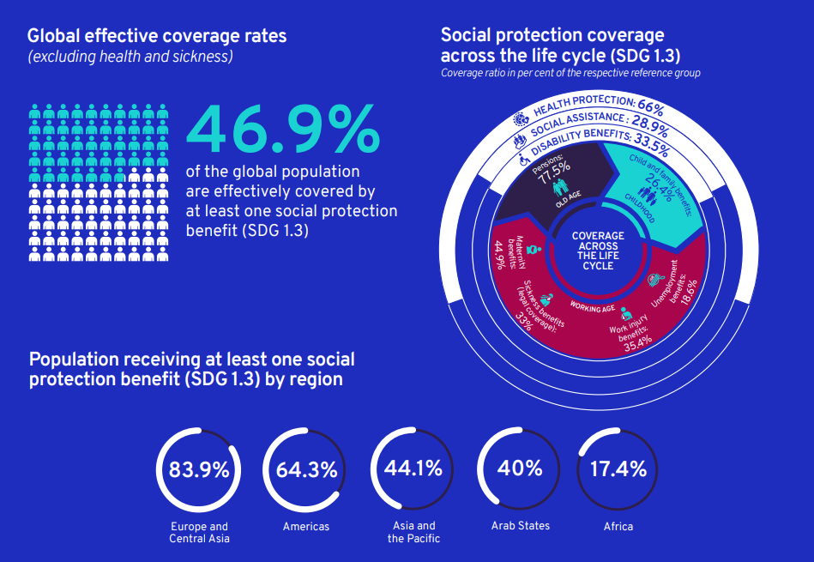
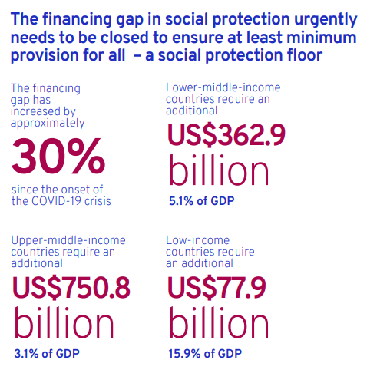
The state of social protection worldwide:
Progress Made but not enough
Notes:
This slide gives on overview of Social protection protection programs coverage and the financing gap disaggregated data. This shows there are opportunities that NSs can support the authorities in providing SP support as an auxiliary depending on the level of experience/engagement by the NS.
wcms_817572.pdf (ilo.org)
Some general points expanding on the above slide that may be useful to presenters in particularly if the NS are asking and trying to answer the question, “Why should we care about social protection as the RCRC”?
There is an unmistakable historical trend of growth in the number of countries building their social protection systems, yet large gaps in coverage, comprehensiveness and adequacy remain.
Only 46.9 per cent of the global population are effectively covered by at least one social protection benefit* (SDG indicator 1.3.1), while the remaining 53.1 per cent – as many as 4.1 billion people – are left wholly unprotected. Behind this global average there are significant variations across and within regions, with average coverage rates in Europe and Central Asia (83.9 per cent) and the Americas (64.3 per cent) above the global average, while Asia and the Pacific (44.1 per cent), the Arab States (40.0 per cent) and Africa (17.4 per cent) have pronounced coverage gaps.
The lack of protection renders people vulnerable, particularly informal workers, migrants and the forcibly displaced, and especially women in those groups who face multiple discriminations. The rapid extension of social protection coverage to those not yet adequately covered, through social insurance, tax-financed schemes or a combination of both, is essential for reducing their vulnerability and promoting decent work.
Progressively ensuring comprehensive social protection against the full range of risks and contingencies is essential to realize the human right to social security. At present, only 30.6 per cent of the working-age population are legally covered by comprehensive social security systems that include the full range of benefits.
In addition to universal coverage, adequate and comprehensive social protection benefits are essential for achieving the SDGs. Extending social protection to those in the informal economy and facilitating their transition to the formal economy is of key importance for tackling decent work deficits and alleviating the pressure on non-contributory social protection provision. Ensuring adequate social protection for women and men requires addressing labour market insecurity and inequalities, including gender gaps in employment and wages, which adversely affect the capacity to make contributions and therefore benefit levels. Minimum benefit guarantees or care credits can help to provide adequate levels of benefit for those with interrupted contribution histories or low earnings.

Slide 18
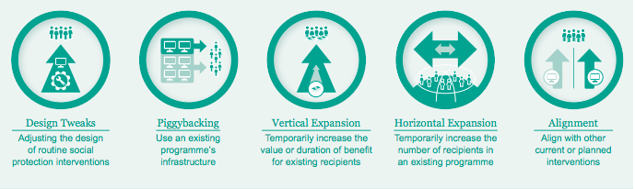
Social protection and Cash
Source: Oxford Policy Management
Notes:
The following notes provide a short overview of each of the five shock-responsive social protection options, as developed by Oxford Policy Management in their SRSP toolkit, available here: https://www.opml.co.uk/projects/shock-responsive-social-protection-systems
Piggybacking is common right now – this is when humanitarian use existing programme infrastructure to deliver a one-off support to help communities deal with an emergency. ie. borrowing specific programme beneficiary list, its staff, a national database and/or a particular payment mechanism.
Examples:
in Iraq the ICRC piggybacked by providing ‘bridging grants’ until widows are able to access governmental social protection systems.
Kenya RC piggybacks on Kenyan governments SP prog Hunger Safety Net Programme to reach most vulnerable drought-affected communities.
(KRC engaged review process of the National Social Protection Policy ( Shock Responsive Pillar & use of single beneficiary registry platform - KRCS plans to participate in reg process & gain access to collected data & use to deliver its services).
Lesotho El Niño-induced drought '16, FAO/CRS piggybacked Child Grant Prog’s beneficiary list to distribute seeds, training, vouchers.
With vertical and horizontal expansion an existing program is changed to offer more assistance or bring in new people to the programme.
Vertical Expansion is popular as it is relatively easy to administer – use existing beneficiaries/transfer mechanisms – beneficiaries may receive a CVA top-up or programme duration is temporarily increased for some/all existing recipients
the current biggest humanitarian cash assistance programme worldwide - Turkish RC or Turk Kizilay - The Emergency Social Safety Net Programme (ESSN) - horizontal and vertical expansion of an existing gov. safety net programme provides cash for basic needs - migrants living in Turkey
In Nepal, following the 2015 earthquake, UNICEF and the government provided cash top-ups as part of the government’s child grant.
Phillipines - Typhoon Haiyan, WFP and the Pantawid partnership top-up
Horizontal Expansion – is when the existing programme extends its geographical coverage, it can also add beneficiaries (i.e. ‘near-poor’ or ‘near-eligible’ in areas already covered – and in an emergency where the eligibility criteria is modified and simplified to temporarily allow new beneficiaries to be included
2008 many countries in LAC extended the coverage of their cash transfer programmes.
Ecuador, the coverage of the BDH, a Human Development Grant, increased from 1 million to 1.2 million between 2008 – 2009
Following the 2015 Nepal Earthquake, the child grant, which was only available to certain families, was extended to all children under 5 in especially affected areas. Now in 2021, progress is being made on extending this further to a universal child grant for all children in Nepal under five.
Design tweaks
Some examples of Design Tweaks: could be if the usual electronic payment system is no longer functioning, cash can be given over the counter, or where conditionalities are waivered such as school attendance. So the program design changes, i.e.to improve coverage, timeliness, predictability in the event of a crisis.
Example
Mozambique – CTP Basic Social Subsidy Programme (PSSB)-disbursement delays (new financial year in Jan/cyclones and floods): design tweak - as a double payment in December. Source: Kardan et al. (2017)
Alignment
And lastly, with alignment, interventions are planned to align with existing social protection programmes, often used when the government is unable support additional caseload. This is your classic humanitarian programming, but additionally, with Alignment humanitarians tries to design programmes so they parallel/replicate existing SP programmes. So an alignment of objectives, targeting method, transfer value or delivery mechanism. This makes it easier for a government to eventually take over the programme when it is able to do so.
Example:
Consortium, CARE, ACF, WFP and WV supporting the Government of Haiti in est a replicable safety net system to reduce food insecurity and vulnerability while building resilience. The Kore Lavi programme is implemented in 24 communes
Note on design tweaks
With regards to design tweaks, it could be useful to encourage NSs to explore how to get involved in the design and delivery of SP programmes (when appropriate of course in line with principles and auxiliary role), and also make use of, for example, national ID and social registries, financial service capacity, communication and feedback mechanisms etc, that are all being built and strengthened to serve these large-scale gov’t run social assistance programmes. There is so much that NSs could do in terms of alignment, gap-filling and emergency expansions with CVA for sure, but also in terms of making use of these systems and their features, and also contributing to strengthening their design and delivery, in terms of promoting accessibility (Referral and public information campaigns), equity (advocacy for excluded groups), efficiency (support to SP business processes) etc. i.e. Exactly the same way we contribute to health system strengthening in the public health sector, for example.
------------
After describing the approaches, depending on the experience and engagement level of the NS within social protection, briefly discuss which of the above the NS is using, or likely to use.

Slide 19
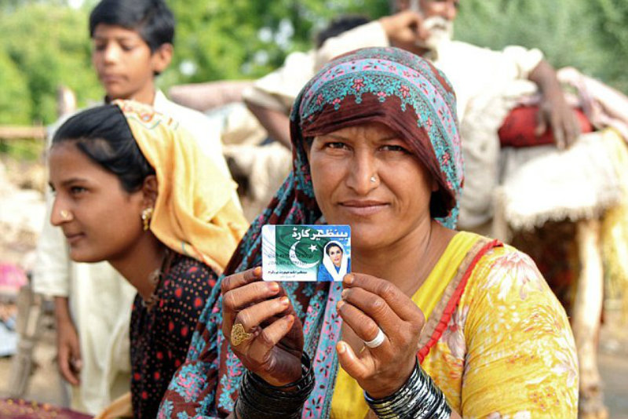
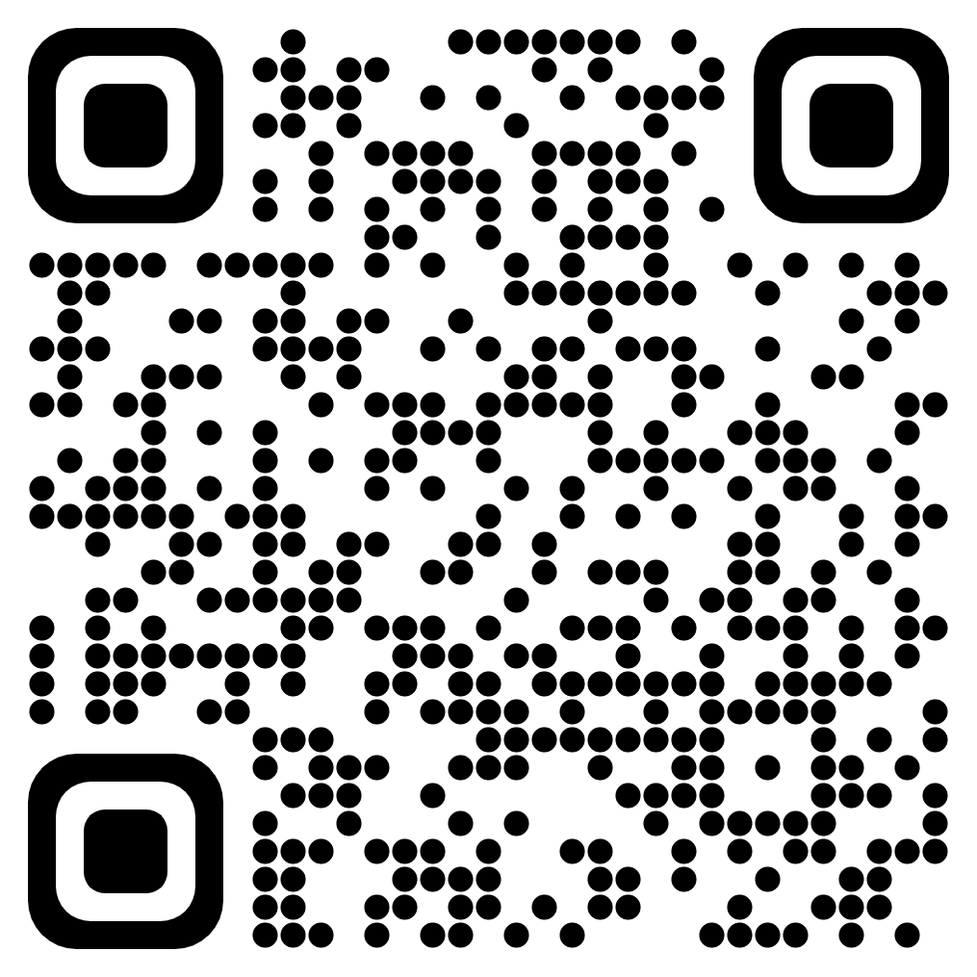
Example Case Study
See Movement CashHub page on CVA and Social Protection for a range of useful resources and case studies.
https://cash-hub.org/resources/cash-and-social-protection/
Notes:
The CashHub has a dedicated page on CVA and Social Protection with various resources on the topic of social protection including advocacy pieces, guidelines and further case studies with practical examples of NSs engagement with government SP and safety net programmes.

Slide 20
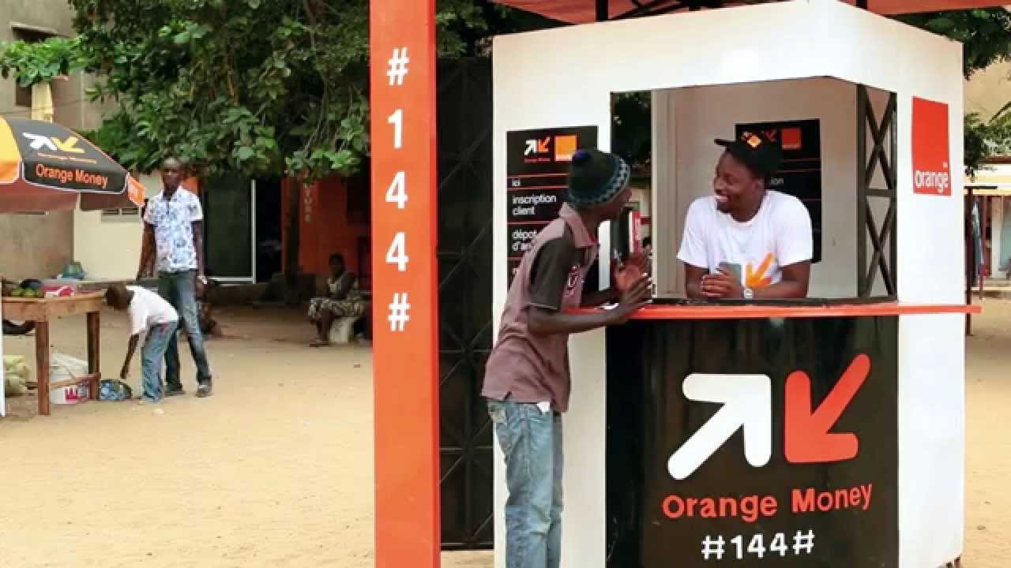
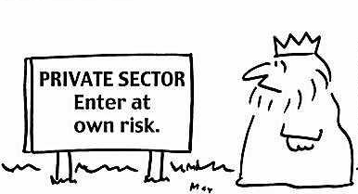
Working with the private sector
Notes:
Slides on working with private sector – could be contextualised further for NS context

Slide 21
Use of delivery mechanisms
IFRC Global
More than 50 % of cash assistance launched across the world in 2021-2022 has used electronic payments
Notes:
Please update this and put it regionally if relevant
Updated with 2021 - 2022

Slide 22
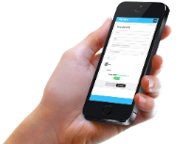
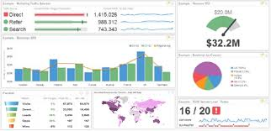

Technology Cash Tools
Data Management
Payment Mechanisms
Data Collection
Key Functions:
Beneficiary data
Biometrics
Market data
Assessments
Post-distribution, surveys
Beneficiary management
Distribution planning & tracking
Monitoring & reporting
Audit trails
Payment administration (FSP integration)
Payment scheduling (individual, bulk)
Identify validation & security
Inventory management
Reconciliation
Technology tools:
ODK
RAMP/Magpi
Devicemagic
Kobo Toolbox
ONA
LMMS
RedRose
SCOPE (WFP)
Segovia
Prepaid cards
Money Transfers (remittance)
Mobile payments
E-vouchers
Digital wallets
Notes:
Optional slide (if NS is more experienced in CVA) around using technology systems and platforms and digital cash.

Slide 23
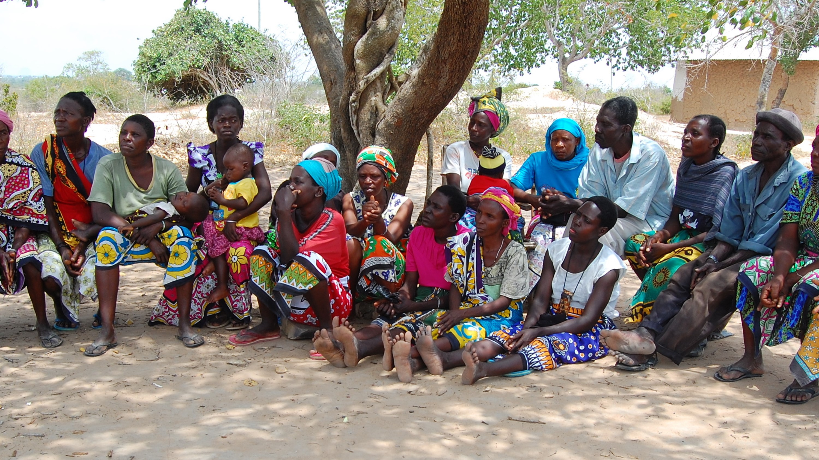
CVA in the Movement
CVA Commitments and tools

Slide 24
IFRC Commitment
"By 2025, the IFRC commits to deliver 50% of humanitarian assistance through the use of cash and vouchers"
Notes:
As part of the IFRC Global Plan 2021-2025 a number of Flagship Initiatives were formulated. One of the targets under the Flagship Initiatives is that 50% of direct humanitarian assistance (excl. Services) should be through CVA by 2025.
Before that, the IFRC and ICRC made commitments on behalf of the Movement for the Grand Bargain during the World Humanitarian Summit in 2016, where they committed to scale up the use of CVA.
A 5 year IFRC CVA Roadmap was developed in 2017 on the back of this (due for update end of 2021) setting out the investments needed for the IFRC to support National Societies to provide more CVA. The roadmap was developed at a time when donors were increasingly starting to call for larger scale cash programmes and other organisations (eg WFP and UNHCR) were also making major investments in their ability to deliver CVA at scale.
The roadmap consultation process agreed that the Movement is well placed within the humanitarian system and should do more CVA as well as remain a viable player and leader in CVA. The global reach of the Movement, combined with local prescence through the unique role of NS staff and volunteers means the Movement has a clear niche and addded value with regards the provision of CVA.

Slide 25








Movement CVA Strategic Framework 2030
Vision:
“People are able to anticipate, respond and recover from crises while generating resilience to lead safe, healthy, and dignified lives with opportunities to thrive.”
Goals:
Localisation
CVA is locally led through leveraging Movement permanent presence and access within local communities and role as auxiliaries to public authorities.
Global Reach
The Movement’s unique position as local actors within a global network leverages on its collective strength, by optimizing coordinated response and CVA enabled humanitarian action.
Mainstreaming
Cash and Voucher Assistance is a default response option for and across all sectors promoting integrated assistance and meeting diverse needs throughout all phases of humanitarian action.
Enablers:
Leading Change
Transforming systems, processes and tools
Resourcing through people, expertise and funding
Leveraging our collective strength
Doing better, reaching more
Notes:
Movement CVA Strategic Framework 2030
This framework aims the Movement’s ambition that CVA becomes a default response option for and across all sectors, able to provide locally led and community driven CVA which is strengthened by its unique global network.
Goals Definition:
Localisation - National Societies are local actors committed to investing in permanent presence, access and trusted relationships rooted within communities. National Societies across the world have a legislated mandate to serve communities through their auxiliary role, alongside their national and local authorities. Central to ensuring efficient, effective, and accountable National Societies, is the need to continuously sustain and upgrade core institutional strength at national and branch level through National Society Development and Cash and Voucher Assistance Preparedness (CVAP). A core goal of this Strategic Framework is that National Society leadership is committed to mainstreaming CVA, through both cash ready local action and global reach, and where possible linking humanitarian assistance with pre-existing national social protection structures.
Global Reach - The Movement can deliver humanitarian assistance through CVA across countries and contexts, providing local action with global reach. In committing to this global reach, it is the goal of both the International Federation of Red Cross and Red Crescent Societies (IFRC) and the International Committee of the Red Cross (ICRC) to have range of appropriate systems in place that are fit for purpose and can be leveraged by the Movement network in order to deliver scalable, timely accountable operations using CVA.
The strength of the Movement’s CVA footprint is rooted in processes that are fit for purpose, socialized, speak to the standards and requirements of support functions, and ensure clear roles and responsibilities, thereby promoting quality and accountability across the design and implementation of operations using CVA.
Mainstreaming - CVA is considered a default modality throughout the Movement in all phases of humanitarian action, including in anticipatory action, response, recovery, and resilience building. Quality and accountability are ensured through the integration of CVA into a wide array of support function profiles in the design, implementation, and monitoring of programmes.
Central to providing CVA as the default modality is the mainstreaming of CVA throughout Movement’s processes and systems, building CVA as a multisectoral and versatile response option.
Enablers:
LEADING CHANGE
Movement leadership demonstrate their commitment to strengthening and mainstreaming CVA by both allocating the necessary resources to build cash readiness and through externally advocating for the transformative role of CVA.
(L) National Societies include CVAP as a priority theme within their organisational development plans, committing the necessary funding and human resources for cash readiness activities.
(L) National Societies establish CVA as a recognised component of their auxiliary role with public authorities and as an integral part of their commitment to localisation with other humanitarian actors.
(L&M) CVA is considered a default response option for and across all sectors, with National Society’s leadership supporting the integration of accountable and timely CVA into local branch services.
(G) IFRC and ICRC advocate with donors and other international partners to invest in Movement CVA capacities as a key localisation investment.
(L/G/M) Principled leadership guides decision-making on CVA mainstreaming and positions the Movement as a key CVA thought leader in both humanitarian and development contexts.
TRANSFORMING SYSTEMS, PROCESSES AND TOOLS
Through the transformation of systems, processes, and tools CVA is mainstreamed throughout the Movement, with support services playing an elevated role in the design and delivery of CVA.
(M) Agile and appropriate decision-making processes are developed which are flexible enough to respond to rapidly changing contexts and evolving needs on the ground, while maintaining accountability and transparency within CVA delivery.
(G/M) The roles and responsibilities of support services are elevated, including procurement, finance, legal, and information management, allowing the Movement to meet the increased demand for CVA effectively and efficiently through transformed processes that are fit for purpose and scale.
(G/M) Greater collaboration and cross-functional coordination is fostered between different stakeholders involved in CVA design and delivery, eliminating operational silos and promoting a more cohesive approach to programming.
RESOURCING THROUGH EXPERTISE AND FUNDING
Ensuring that timely and accountable CVA can be delivered at scale, the Movement will commit sufficient financial and human resources to support effective CVA capacity building at both global and local levels.
(G) Anticipatory action using CVA is enabled by the pre-positioning of programme funds at local levels and through Movement investment in fund replenishment mechanisms.
(L) National and regional CVA expertise is ensured by National Societies through investment in staff capacity building and in the integration of CVA throughout departments and branches.
(M) Accountable, timely and scalable CVA is designed and implemented by staff and volunteers across the Movement, who have access to appropriately funded training and dynamic learning pathways.
(G&M) CVAP and longer-term programmes delivering CVA are funded through joint proposals which are developed and championed by Movement members.
LEVERAGING OUR COLLECTIVE STRENGTH
The Movement’s internal collaboration and shared commitment to the prioritisation and scale-up of CVA both strengthens the delivery of humanitarian assistance and positions the Movement as a partner of choice at local and global levels.
(L) The delivery and impact of CVA is strengthened through long-term partnerships forged by National Societies with local actors and public authorities, including in the use of CVA within existing social protection mechanisms and shock responsive systems.
(L&G) Movement staff are equipped and prepared to lead CVA coordination roles, at national, regional, and global levels.
(G) CVA is delivered at scale and in complementarity with other forms of assistance, with Movement members prioritising internal coordination in both bilateral and multilateral operations.
(G) The speed, reach, and accountability of humanitarian responses delivering CVA are improved through the development and maintenance of strategic partnerships, which are updated as global contexts evolve.
DOING BETTER, REACHING MORE
Striving to improve the accountability of CVA and empower communities at the heart of the response, the Movement will invest in developing evidence-based learning and harnessing people-centred innovation.
(L) People are in the lead - designing, driving, and monitoring CVA; they are empowered through the greater participation of National Society volunteers and the Movement’s prioritisation of communities at the heart of the response.
(G & M) Quality CVA is achieved through the investment in inclusive monitoring and evaluation practices, with strengthened accountability mechanisms and minimum standards in place for each programme.
(L) Local expertise, knowledge and skills are captured and shared within the Movement and with the wider humanitarian sector to inform ongoing CVA practice, policy, and advocacy.
(G) The Movement fosters a mindset and culture of evidence-based learning, striving to continuously improve programme design and implementation and investing in a research agenda which identifies knowledge gaps and emerging trends in CVA.
(G) Regional and global hubs and centres ensure Movement experience and learning is shared, promoted, and disseminated across various channels, such as peer-reviewed publications, learning events, and online platforms.
(M+G+L): The quality of CVA in both programming and systems is continuously improved through a Movement-wide emphasis on innovation, which is cultivated by adaptive management, a culture of creativity, dynamic design thinking, and the accepted use of new technologies.
(M+ G+L): Digital innovations are harnessed to improve CVA delivery, help address the digital divide, and promote financial inclusion where feasible and where accessible for crisis-affected communities.

Slide 26




Movement Cash Community
Regional coordination – Community of Practices (COPs)
Global technical coordination for a specific area or task – Technical Working Groups (TWG)
Global Strategic Technical Coordination – the Cash Peer
Working Group (CPWG)
Global Strategy - Cash Advisory Group (AG)
Notes:
Movement Cash Community - Red-Cross-Cash-Community_v11-1.pdf (cash-hub.org)
Membership and how to get involved Movement members, staff, volunteers, and leaders can join the Cash Community. Membership includes a registration on the Cash Hub to join the conversations and access resources.
• Members contribute learning and know-how from their cash programme to other National Societies, the Movement, and other cash practitioners.
• Members provide content about their cash programme to support others and profile their National Society and the Movement.
• Members provide peer support by sharing their knowledge, asking a question or presenting an issue they face in their programmes via the Cash Hub online forum. Members can learn with peers and read existing discussions.
• Members also share and find out about relevant news, jobs, events and training opportunities in cash within the Movement. Here is a video that explains more about the Cash Hub platform.
• Members will learn about the Movement’s cash experience in a range of thematic or geographic areas, search by theme or region or using key words, year of publication or type of document i.e. article, case study, evaluation, learning, research, tool and video.
• Members can access to the Cash in Emergencies (CiE) Toolkit and the latest programme guidance on cash in the Movement
Regional coordination – Community of Practices (COPs) - Community of Practices (COPs) is established to provide regional-level expertise towards the outcomes of the Cash Strategic Framework for the International Red Cross and Red Crescent Movement and build a network of National Societies (NS) and practitioners to share learning and advocate to support cash uptake. The COP is expected to achieve specific regionallevel outputs that move the Movement towards the outcomes.The COP may task the CPWG, or vice versa, with specific outputs, and/or the group may recommend outputs from their perspective to prioritise.It is expected that each of the five (5) IFRC regions will have a working group. This includes the Africa, Americas, Asia Pacific, Europe, and Middle East/North Africa. ICRC representation will also fall into these regions. Where possible, IFRC Cash Focal Point in the region will be responsible to establish the Community of Practice. The Group will then set its Terms of Reference and will appoint the Chair and confirm group member criteria and membership.
Global technical coordination for a specific area or task – Technical Working Groups (TWG) - A Technical Working Group (TWG) is established by the Cash Peer Working Group (CPWG) to provide specific technical expertise towards a specific outcome of the Cash Strategic Framework for the International Red Cross and Red Crescent Movement. A technical working group is expected to achieve specific outputs that move the Movement towards the outcomes. The CPWG may task the technical working group with specific outputs, and/or the group may recommend outputs from their perspective to prioritise. The technical working group is established for as long as determined necessary by the CPWG. The TWG is established or disbanded by the CPWG. The CPWG will review and endorse the identified outputs developed by the Technical Working Group. The existing Technical Working Groups are cash preparedness, data management / information management and training.
Global Strategic Technical Coordination – the Cash Peer Working Group (CPWG) - The Cash Peer Working Group (CPWG) is a core group of the International Red Cross and Red Crescent Movement stakeholders, with cash and voucher assistance (CVA) expertise. The group meets on a regular basis as peers to collaborate on strategy, guidance and tools, providing technical leadership, to encourage and equip the Movement to embrace and increase its institutional capacities in CVA and guiding and contributing to the Cash Strategic Framework for the Movement. The CPWG is informed by the technical and regional working groups and provides overall guidance and direction to these groups. Individual members of the CPWG ensure linkage to and from the Cash Learning Partnerships Technical Advisory Group to ensure application of sector wide standards and good practice and to share Movement experience.
Global Strategy - Cash Advisory Group (AG) - The Cash Advisory Group (AG) is a high-level group of International Red Cross and Red Crescent Movement leaders, established to provide strategic direction to the British Red Cross hosted Cash Hub as well as to support the Movement’s delivery of the global commitments and ambitions to scale up cash and voucher assistance (CVA). The members champion CVA in the Movement, influencing the commitment and support of Red Cross and Red Crescent leaders and strengthening the position of the Movement as global cash actor and partner of choice. It should be noted that the Advisory Group is not a formal statutory body of the Movement and, therefore, does not have official decisionmaking responsibilities

Slide 27
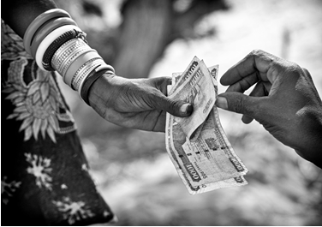
IFRC CVA Roadmap
Core Targets & Vision
8 core targets for CVA delivery (including scale, speed, and accountability)
4 models of cash-based response for IFRC & NS:
IFRC supports NS on small/medium scale CVA
IFRC supports NS including surge capacity for large-scale CVA
Domestic implementation by NS in partnership with UN and/or NGO consortia
IFRC supports NS as an auxiliary to Government with cash-based responses linked to social protection.
Notes:
CVA Roadmap is being updated currently. Regions, please use the regional information.
In the past, the main focus of the IFRC and NS has been around developing the systems and capacities for the Red Cross to deliver CVA independently. While this remains a core model of response, the CVA roadmap introduces the idea that the Movement needs to invest and strongly position itself to play a central role in coordinated multi sectoral international responses and to support NS to play an auxiliary role to government in nationally led response. The 4 models illustrate this vision

Slide 28



International Red Cross and Red Crescent Movement CashHub online platform + cash helpdesk, enabling knowledge sharing and information exchange across cash practitioners in the Movement.
Information
Tools
Data
Programme evidence
Learning
Case studies
Technical advice
https://cash-hub.org/
Notes:
The Movement Cash Hub is hosted by the British Red Cross (in partnership with IFRC and ICRC) and aims to accelerate the use and scale up of cash assistance in the Movement in order to improve the effectiveness and efficiency of humanitarian action.
The CashHub is an online platform that enables knowledge sharing and information exchange among the network of cash practitioners in the Movement. The platform provides access to information, tools, data, programme evidence, learning, case studies and technical advice. (Keep text - see if BRC Audiovisual can provide graphics for some of the bullets (e.g information, tools and data and any others?)
The Cash Hub also hosts an online community on CVA for staff and volunteers of the Movement, to discuss and connect with colleagues.
As well as English, the Cash Hub has been translated into Arabic, Russian, French and Spanish.
As host, the British Red Cross is responsible for the oversight of the Cash Hub and supports the programme of activities with a dedicated Cash team sitting within its International Directorate.
Cash hub website: https://cash-hub.org/

Slide 29
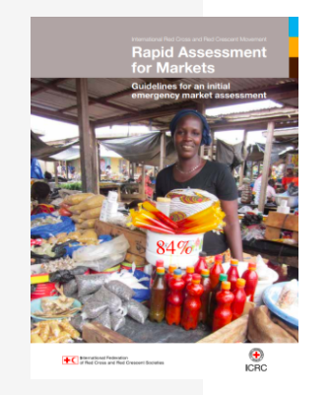
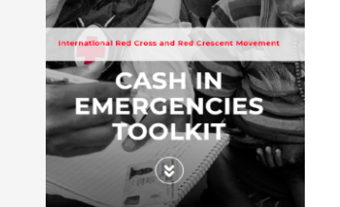
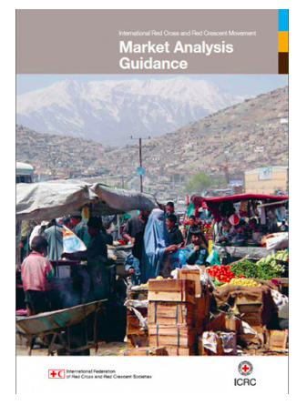
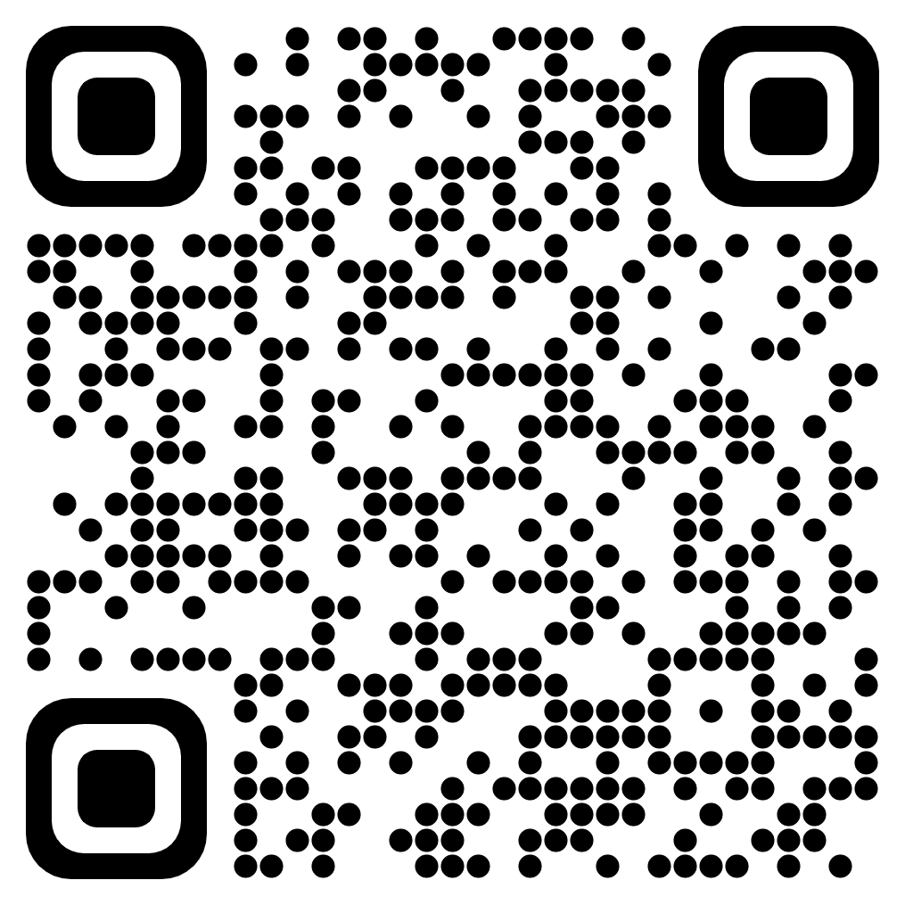
Movement CVA Tools and Guidance
https://cash-hub.org/guidance-and-tools/programme-guidance/
Notes:
Notes:
Presenter to describe the main CVA tools and guidance currently used in the Movement - Cash in Emergencies (CiE toolkit), Rapid Assessment of Markets (RAM) and Market Analysis Guidance (MAG).
These can all be found on the cash hub under Guidance and Tools.

Slide 30
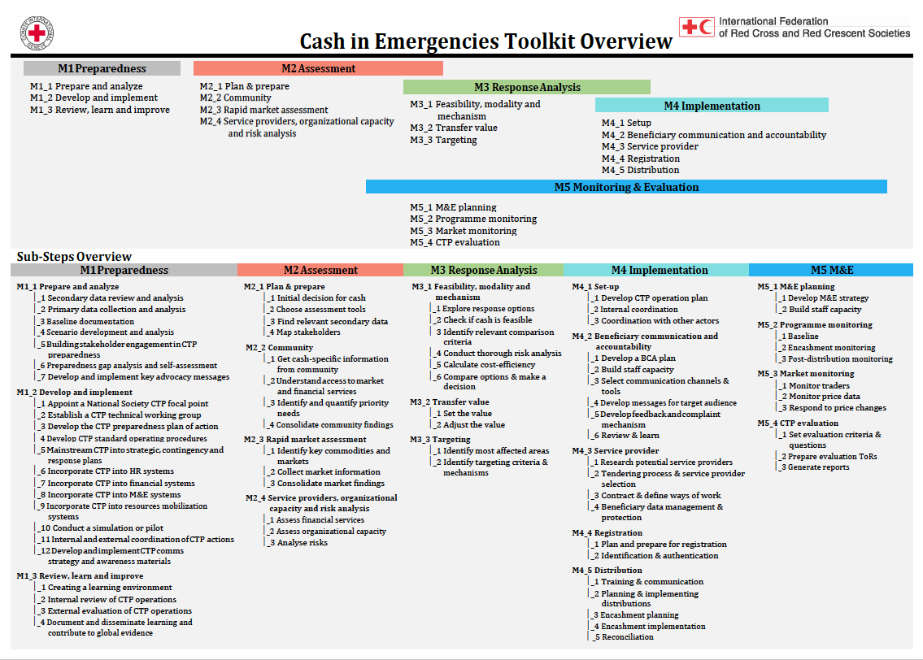
Cash in Emergencies Toolkit

Slide 31
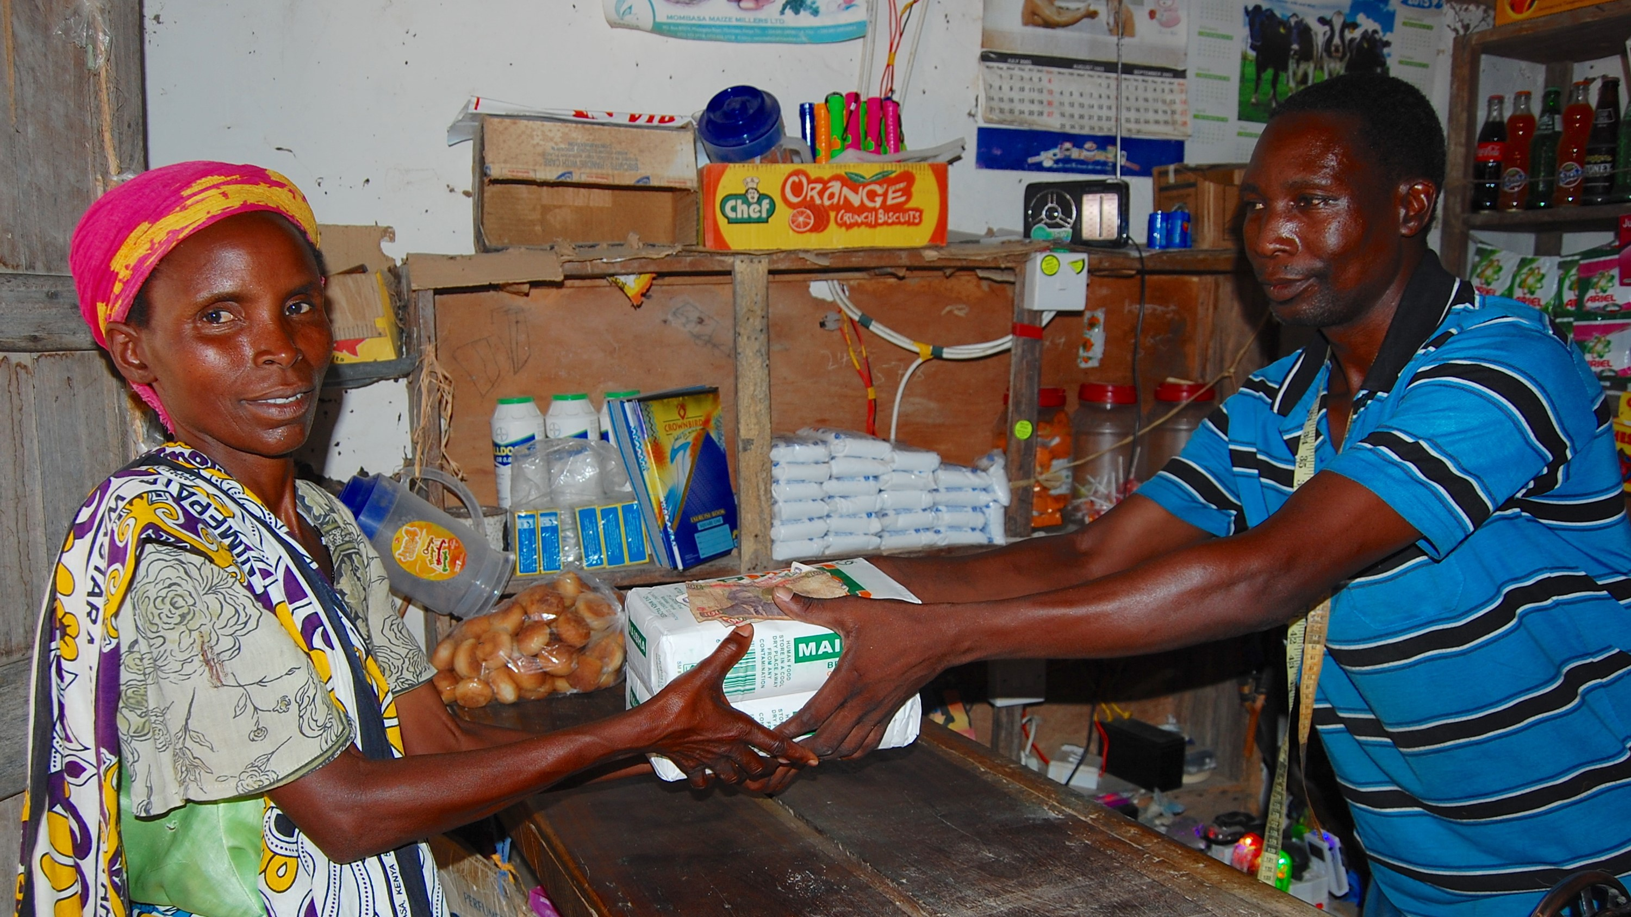
CVA Preparedness (CVAP)
What it is and why important

Slide 32
Why is CVAP Important?
Preparedness increases NS capacity and likelihood to provide appropriate use of CVA during response
Preparedness helps reduce response time and increase potential scale of response.
All roles within the NS can be supported to be better prepared (Programmes, Finance, Logistics, HR, etc.)
Links with NSD work (PER, RedReady, FbF, etc.)
To provide CVA efficiently and effectively during an emergency SOPs are a concrete step in CVA Preparedness
Engagement on coordination, collaboration and communication as part of preparedness ensures efficiency and accountability in CVA response

Slide 33
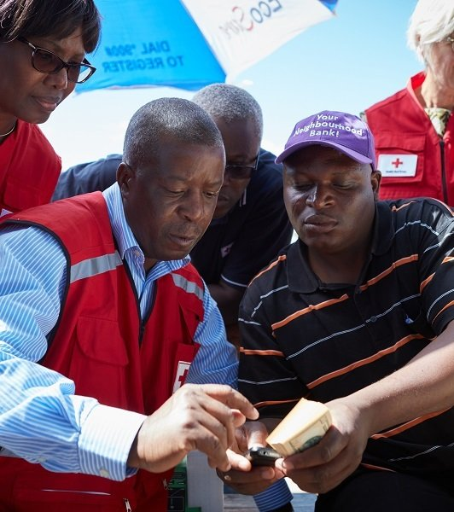
What is cash (CVA) Preparedness?
Cash Ready NS
A National Society is CVA ready when it is able and likely to deliver appropriate assistance, in the form of CVA, safely, accountably and quickly, at any time and at any scale.
CVA Preparedness
CVA preparedness is an ongoing National Society development initiative that aims to increase the state of preparedness by integrating CVA into the organization's tools, systems, procedures and staff capacity, as well as for strengthening active leadership support for CVA, coordination and communication to be CVA Ready NS.

Slide 34






The CVA Preparedness Framework: 5 Areas
COMMUNITY ENGAGEMENT AND ACCOUNTABILITY, COORDINATION AND PARTNERSHIP
LEADERSHIP COMMITMENT
PROCESSES, SYSTEMS AND TOOLS
FINANCIAL AND HUMAN RESOURCES AND CAPACITIES
TEST, LEARN AND IMPROVE

Slide 35
CVAP Theory of Change
Notes:
This slide shows the CVAP Theory of Change and how investing in the 5 CVAP Areas to build and sustain their CVA organizational capacity can boost NS CVA operational capacity and impact in meeting the needs.
NS will need to apply the investments gained under the 5 CVAP areas through implementing CVA In their responses when appropriate. As a result NS can progress the scale, quality and timeliness of their CVA operational response and be better able meet the needs of the crisis affected population in a dignified, accountable and effective manner, through CVA.

Slide 36
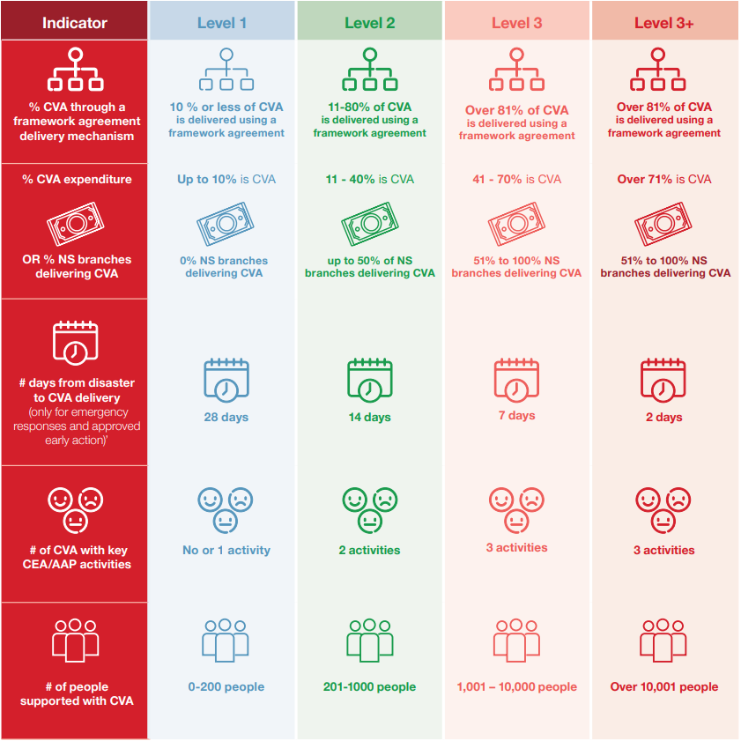
CVA Operational Readiness
Identifying CVA operational readiness with a core of the National Society by studying the CVA experience in the National society.
An aspirated Operational readiness target is developed based on the current operational level.
Based on the findings a NS will determine a CVA vision for the NS aligning with their strategic priorities.
Notes:
In addition to looking at their organisational capacity in key function areas, investing in VAP will also allow NS to develop their CVA operational capacity to deliver increasingly accountable and timely CVA during a response.
The Movement CVA operational levels measure scale, quality and speed of CVA delivery.

Slide 37
CVA Organisational Capacity Levels
Level 3+
Level 3
All systems, structures, processes and resources to deliver CVA are in place at extraordinary quality and standard. NS plays a key role in influencing external environment. NS is able and likely to deliver scalable, timely and accountable CVA without external support and is able to provide CVA support to other organisations and Movement partners.
Level 2
All systems, structures, processes and resources to implement CVA are in place at sufficient quality and standard. NS is able and likely to deliver scalable, timely and accountable CVA without external support.
Level 1
Basic systems, structures, processes and resources to implement CVA are all in place but require improvement. NS is able to deliver scalable, timely and accountable CVA with limited external support.
Almost nothing in place to support CVA implementation. NS is only able to deliver scalable, timely and accountable CVA with significant external support.
Notes:
Existing CVA capacity is measured through four CVA organisational levels. These show the necessary requirements in terms of NS organisational capacity (systems, structures, processes and resources) for the NS to be able to deliver scalable, timely and accountable CVA.
CVA organisational levels are measured through a NS CVA Capacity Self-Assessment - a core step in the CVAP process that takes place and led by the NS themselves, at the start, mid term and the end.
The results of the CVA Capacity Self-Assessment then provide the NS with a detailed picture of the their level, as well as capacity and gaps. The self- assessment also will highlight the specific areas that the NS must invest in to achieve it’s CVAP goal and the level it wants to increase to.
It is expected that a typical NS will increase an organisational level or two level by the end of its CVA preparedness journey, based on it’s own projected vision for where it wants to be.

Slide 38
CVAP Guidance & Tools
Guidance for Mainstreaming CVA - Cash Preparedness for Effective Response
CVAP tools
Minimum Requirements for CVAP
Notes:
New guidance and tools are available, including a fast track CVAP approach. (Presenter to give overview of these)
Background on CVAP journey/timeline to date:
2012- 2013 Pilot cash preparedness - Vietnam, Philippines, Senegal, Chile
2014 Independent evaluation conducted
2015 Set up Cash Preparedness TWG - first version Cash preparedness guidance and tools
developed
2018 Independent evaluation - Kenya, Malawi, Myanmar, Pakistan, Philippines, Vietnam
2019-2021 Updated guidance + tools
CVAP Pilot 2013- 2014
Tools development
Global evaluation
Revised guidelines 2020. Revised tools currently underway
CPTWG
The CPTWG was established as a central point of discussion and engagement to define, coordinate, provide, advocate for and improve the quality of mainstreamed appropriate CVA. A core group of key RCM stakeholders which forms the Steering Committee meets on a regular basis as peers to collaborate on encouraging and equipping the RCM to embrace and increase its institutional capacities in CTP. The Steering Committee also informs and provides guidance to the sub-working groups which are formed and tasked based on specific objectives.

Slide 39










CVA Preparedness Path
Assessment
Design
Implementation
Transition / Exit
Induction and Visioning Workshop
CVA Capacity Self Assessment
CVA Preparedness Plan of Action Development
Final Review, Learnings and Way forward (moving to next level
Implementation
Cash Ready NS
1
2
3
4
5
6
7
8
9
Appointment of CVA Focal Point
NS Decision of Level Cash Readiness is willing to achieve
Endorsement and Integration of CVA POA to NS operational plan
Mid-Term Review and Adjustments to the POA
3 to 4 years period
Notes:
Replace with CVA Roadmap Visual

Slide 40
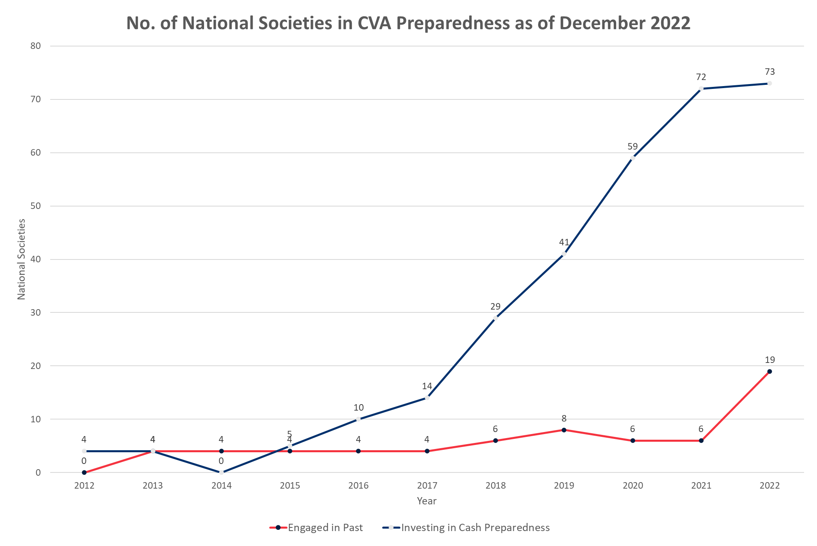
Progress since the beginning

Slide 41
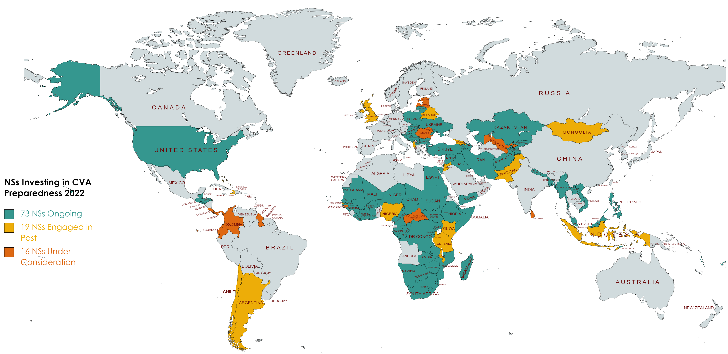
CVA Global Preparedness Mapping
Notes:
To be updated

Slide 42
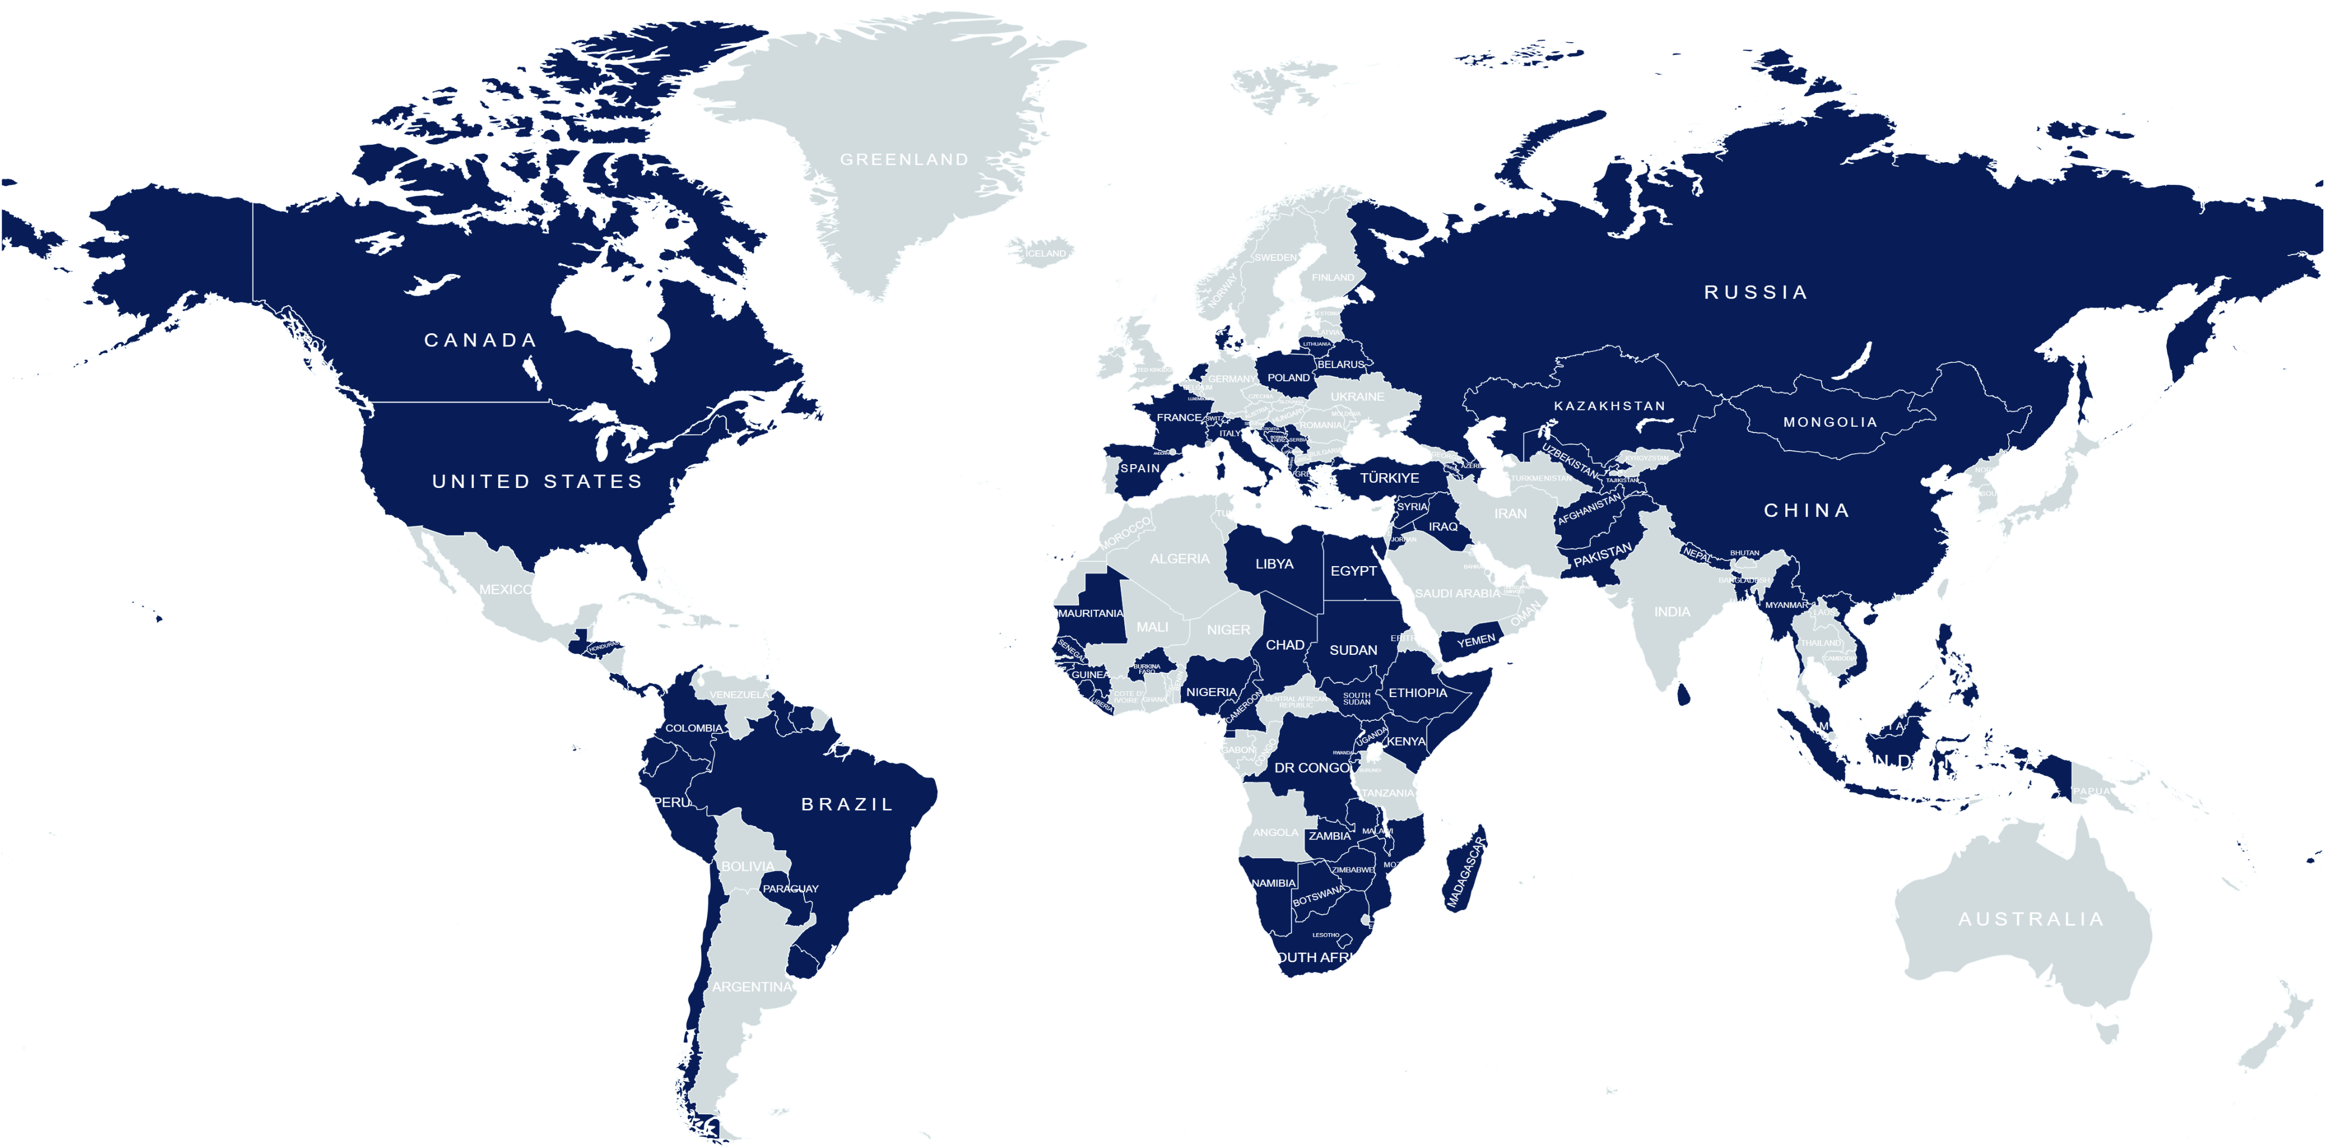
Counting Cash Initiative - 2022
Cash Expended in CHF
562,202,520
Beneficiaries Total
5,000,000
Notes:
To be updated

Slide 43
