Slide 1
NS xxx CVA Response
Lessons Learned Review Workshop
Location and date
Notes:
(Workshop version: Deeper, with focus on impact)

Slide 2
Agenda – Day One
(Insert agenda)

Slide 3
Agenda – Day Two
(Insert agenda)

Slide 4
Objectives of the Review
To capture learning from the NS xxx response, both strengths and shortcomings.
To identify priorities for improving FSL programming both in the immediate term and in the medium term
To systematically use this learning to assess the organisational system through which sectoral outcomes are delivered through CVA, across the project cycle.
To ensure that the right people, get the right assistance, in the right time, in the right way, with risks managed.

Slide 5
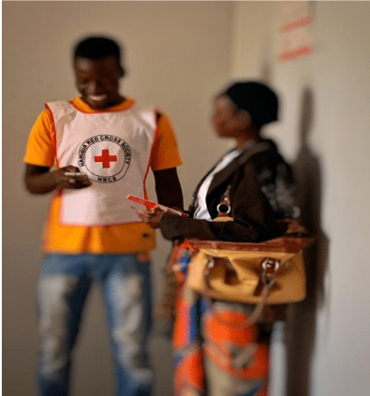
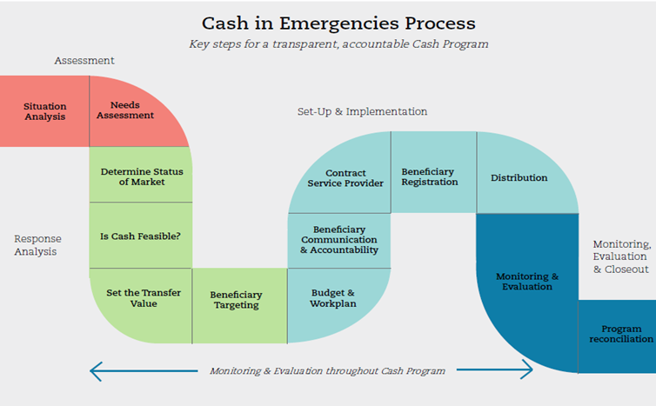
How? A brief look at the methodology
Right Time
Right People
Right Assistance
Right Way
Right Risks
Capacity of NS

Slide 6
Process versus impact
Process monitoring : to ensure that the programme is appropriate and relevant to people’s needs; that it is implemented in the way that was intended
Impact monitoring : to ensure that the programme is having the intended impact and is minimising negative impacts more effectively and efficiently than are other types of programmes
Notes:
6
The lessons learned review currently only focuses on process.
Deeper focus review may wish to expand and include aspects of impact monitoring (depending if PDM covered this – will be context specific)

Slide 7
The evidence we will use to generate our Lessons
Participants’ experiences
Qualitative data from communities
PDM reports

Slide 8
Ways of Working
Notes:
Ask for any other suggestions

Slide 9
Video
Notes:
Show feedback video of beneficiaries feedback made during field visits

Slide 10
Right time?
Notes:
To mention that we don’t directly start with the project cycle focus, as timeliness can be determined by a variety of factors across activities included in the response cycle
Total TIME SECTION 90 mins

Slide 11
Construction of the Response Timeline
Two groups.
1st group creates a timeline on the wall with the main programme activities for the response.
2nd group check the timeline against the initial planning
Timeline can be divided into project cycle steps (Assessment, Response Analysis, Implementation, M&E)
10 minutes, then 10 minutes review.

Slide 12
Right time?
Include 2-3 summary slides from PDM (see next slide) + FGDs (10 mins)
Plenary discussion about community views: do participants agree, anything to add (10 mins)

Slide 13
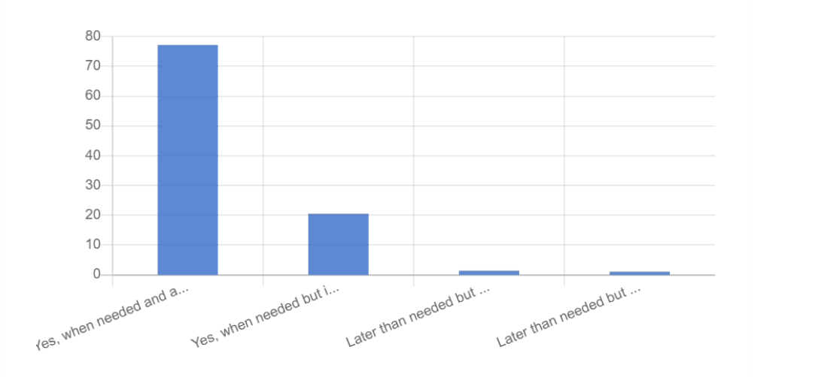
Right time? PDM and FGDs
PDM
FGD
No major disparities, but frustration about not receiving cash instalment in December
Notes:
Example slide to adapt.
Can include as many as relevant, e.g one per modality

Slide 14
Right time?
Two groups.
Group discussion on main reasons behind delays
What would you do differently? Top 3 recommendations
20 mins

Slide 15
Assessment and Response Analysis: Part 1

Slide 17
Session Outline
Session Objectives:
To discuss and agree on whether CVA was the right modality for the response? (e.g. for food security)
To reflect on how needs assessments and cash feasibility assessment have been carried out and the extent to which this provides the necessary information to inform evidence-based response analysis, based CVA on good practice
To identify main gaps/positives and learning and propose main recommendations for future interventions
Notes:
This session examines more closely how well this worked and what could be done differently in the future to better match assistance with beneficiary communities’ needs.

Slide 18
Right assistance? (modality)
Include 2-3 summary slides from PDM (see examples) + FGDs (10 mins)
Plenary discussion about community views: do participants agree, anything to add (10 mins)

Slide 19
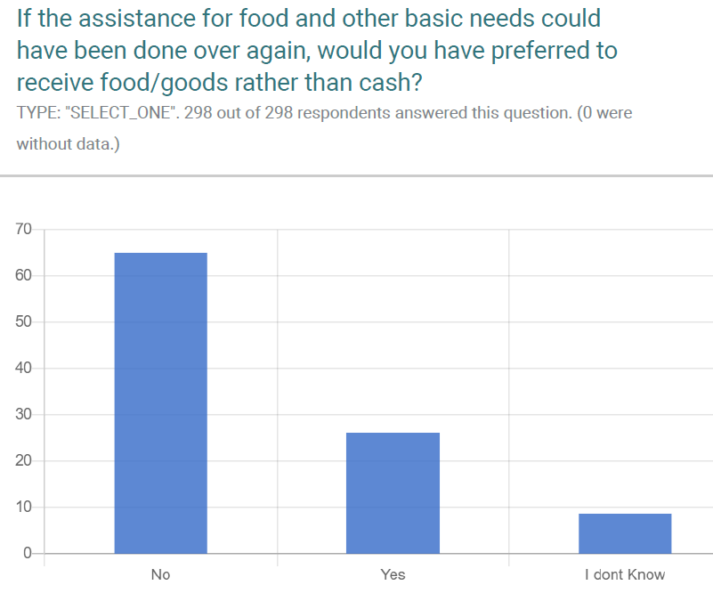
Right modality?
Would you have preferred to receive food/goods other than CVA?
FGD:
Kind of support is good
Any support she accepts
Any gifts she accept
Notes:
Example slide to adapt.

Slide 20
Info from FGD – Is CVA the preferred modality?
‘Everybody agrees that receiving CVA is better than in kind as they can buy whatever is needed’
‘People prefer CVA than in kind, as they can buy whatever is needed’
‘People in the community face many other problems, not only lack of food, that's why they prefer CVA, as this is the way to cope with other problems (school stationaries for the kids)’
‘People prefer CVA as they can buy whatever they want (uniforms and stationaries for kids, and food)
‘CVA was good for small business in the community’
‘People prefer cash as they can buy whatever they want ’
since they can access to other type of food (chicken wins, pasta, etc). Other people stressed the importance of being able to go to the hospital.
Flexibility: People can make their own choices, according to their priorities and their preferences
Power transfer: people are empowered as they are responsible to make decisions on their future
Helps the recovery process: many households invested in livelihoods
Cash spent in the local markets
Notes:
Example slide to adapt – quotes from FGDs (can add locations)

Slide 21
The assessment and response analysis process in the xxx response
Notes:
Recap of assessment and response analysis process

Slide 22
Focus on assessments and response analysis
Based on what has been presented, identify:
what went well
what should have gone better
at least 3 top recommended actions to keep or improve the quality of this phase.
Work in the same groups as before.
Be ready to present your findings and recommendations
40 mins
Notes:
Ask for any other suggestions

Slide 23
Was CVA the right modality?
Based on what has been presented so far:
Identify at 3 reasons why CVA was or not the right modality. You can look at:
What’s the best to meet the people’s needs?
Beneficiaries' preferences
Timeliness
Positive impact in the market
Cost-efficiency
20 mins
Notes:
Ask for any other suggestions

Slide 24
Assessment and Response Analysis: Part 2

Slide 26
Session outline
Session objectives:
To reflect on whether the amount of the chosen modalities (e.g. cash + in-kind) for this response was the most adequate in view of the needs of the population.
To identify positives and learning and propose main recommendations for future interventions

Slide 27
Right assistance? (amount)
Include 2-3 summary slides from PDM (see examples) + FGDs (10 mins)
Plenary discussion about community views: do participants agree, anything to add (10 mins)

Slide 28
The Right amount? – How was the money spent?
Notes:
Example slide to adapt

Slide 29
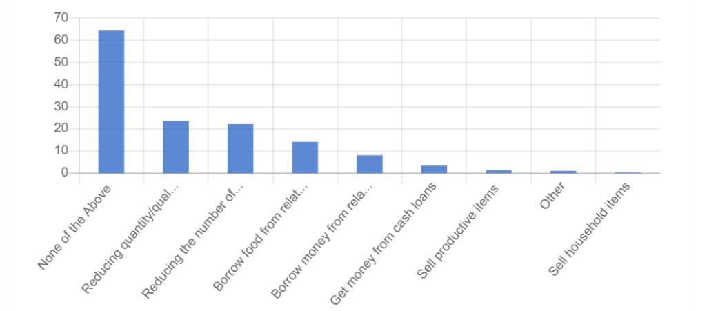
The Right amount? – Impact- Coping strategies?

Slide 30
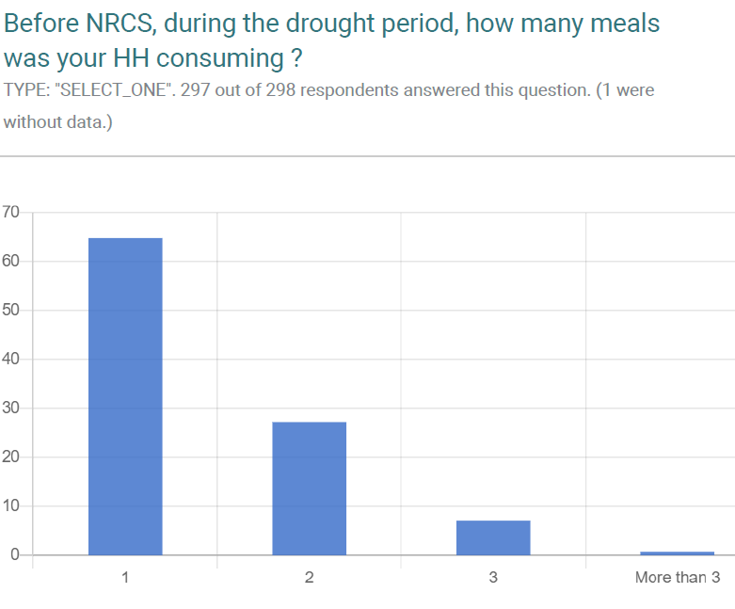
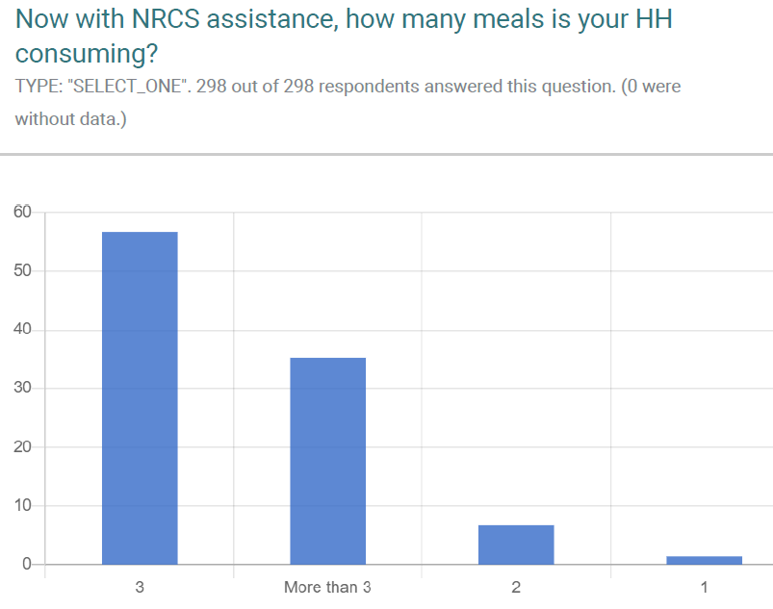
The Right amount? - Number of meals
BEFORE
NOW
Notes:
Example slide to adapt

Slide 31
Info from FGD – Was the amount provided enough for food needs?
‘Most people consider that the amount was enough, as they can eat 3 times a day, while before they used to eat once a day. Others, were complaining about the amount received as N$800 cannot cover the needs of a family. Usually, families have to strategize how to expend the money’
‘Most people consider that the amount was enough to cover the food needs’
‘The cash received covers the basic needs’
‘People consider that the amount given was correct’
‘people consider that the amount given by NRCS was enough, and covered their basic needs”
‘Most people consider that the amount (N$ 800) was enough ’
‘People consider that the amount given was correct, and covered their basic needs. On the other hand, there were people who warned that if they complained about the amount received they might be at risk of not receiving anything else
‘Most people consider that the amount was enough, and covered their basic needs, although it wouldn't hurt to increase it a little more’
Notes:
Example slide to adapt – quotes from FGDs (can add locations)

Slide 32
Calculation of transfer amount in xxx response
Notes:
Recap on transfer value calculation process – see handout

Slide 33
Focus on assessments and response analysis
Based on what has been presented and on the previous activity, identify:
what went well
what should have gone better
at least 3 top recommended actions for improvement
Work in the same groups as before.
Be ready to present your findings and recommendations
40 mins

Slide 34
Focus on analysis stage (transfer value/amount
Group Activity:
Group 1: to compare advantages and disadvantages of a fixed amount versus a variable amount
Group 2 : How often should the CVA be distributed: weekly, monthly, every two months? And should it be adapted to in line with changing market prices?
Notes:
See workshop handout

Slide 35
Right Risks?
Notes:
Additional session if time allows

Slide 36
Risks
3 classifications: contextual, programmatic, institutional
Contextual: External to the organisation: political, economic, environmental, etc.
E.g. Price increases due to global/national inflation, conflicts/displacement
Programmatic: Failure to meet programme objectives and/or potential harm caused to others
E.g. Inflationary risks caused by the programme: more buyers and limited supply can cause price increases
Internal to the organisation: fiduciary issues, financial losses due to corruption, etc.
E.g. Fraud and reputation risk for the organisation

Slide 37
Risks
The seriousness of a risk is determined by two factors:
the likelihood (probability) that a risk will occur
the impact (consequences) of the risk, when it has occurred

Slide 38
Risks

Slide 39
Risks Exercise
For the forthcoming CVA project what are the top 3 risks?
What are the key mitigating actions?
Based on this, do you think using cash is feasible? Why? Or why not?

Slide 40
Implementation and Monitoring: Part 1

Slide 42
Session outline
Outcomes:
Right People? To reflect on whether the population and households targeted were the most in-need.
To recap on how targeting and registration processes were done
To assess how CEA was mainstreamed throughout the operation
To identify main gaps/positives and learning and propose main recommendations for future interventions

Slide 43
A brief recap on targeting approaches and mechanisms
Targeting approaches:
Geographical
Blanket Vs Targeted distributions
Household Vs Individuals
Targeting criteria: vulnerability, social welfare, specific groups etc
Targeting mechanisms: community-targeting, self-targeting, categorical-targeting
Notes:
Refer participants to handout on targeting and registration

Slide 44
How was this done during the response?
Notes:
Recap of targeting and registration process – also refer to handout

Slide 45
Focus on targeting and registration
Group Activity: two groups focus on targeting, the other two on registration
Identify
On hindsight, was there any other targeting criteria/mechanism that would have been more adequate for this response?
Could have beneficiaries registered been registered differently?
Mention at least 3 top recommended actions to improve the quality of this phase next time. (30 mins)
Notes:
50m

Slide 46
Right people? (targeting)
Include 2-3 summary slides from PDM (see examples) + FGDs (10 mins)
Plenary discussion about community views: do participants agree, anything to add (10 mins)

Slide 47
Info from FGDs - Targeting
Those who received aid deserve it
…but other targeting options to consider, but fairer?
‘Participants believe that all people included in the programme deserve it, as they were the most affected by the drought and they depend on farming’
‘Participants believe that all people included in the programme deserve it’
‘Indunas should have set the selection criteria’
‘Tthere is people who receive a small grant from the government but who are poorer than some of the beneficiaries of the Red Cross – it’s not fair’
Most communities – ‘All members in the community should have received assistance from the Red Cross’
Notes:
Example slide to adapt – include quotes from FGDs (and add locations)

Slide 48
Info from FGDs - Registration
Orderly?
or affected by communication issues?
‘The community and the Indunas were involved in the selection process’
‘All people included in the programme deserve it, and they pointed to the Induna as the key to this ‘
‘Not everyone was properly informed about the project and the selection process, and that is why many households (in different villages) have not been assisted by the programme’
‘People claim they were not informed in advance of the type of help they would receive’
‘ There was too many people meeting the selection criteria and not everyone could benefit’
Notes:
Example slide to adapt – include quotes from FGDs (and add locations)

Slide 49
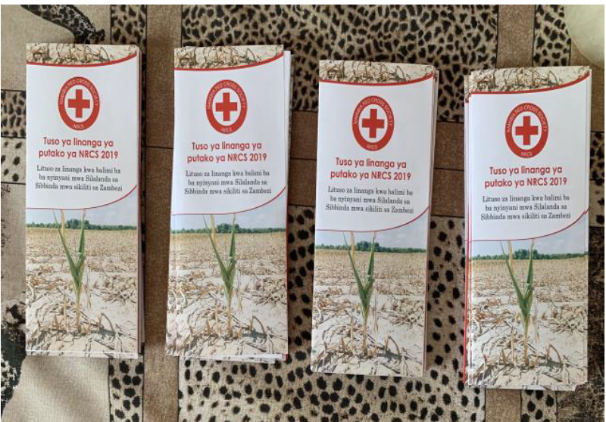
Focus on CEA
Notes:
Refer participants to handout

Slide 50
CEA video
https://www.youtube.com/watch?v=k5Gja3aIZzA&list=PLrI6tpZ6pQmTuWgH38XkEoLGjZytfUdAR&index=2&t=0s
Notes:
5m

Slide 51
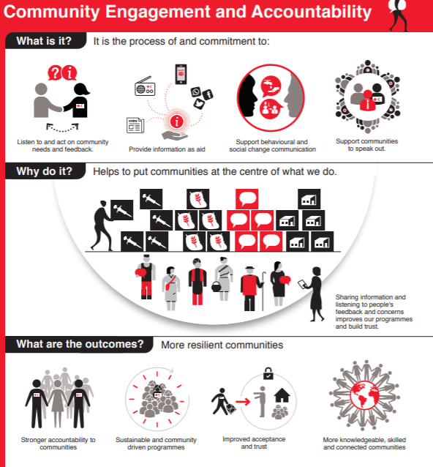

Slide 52
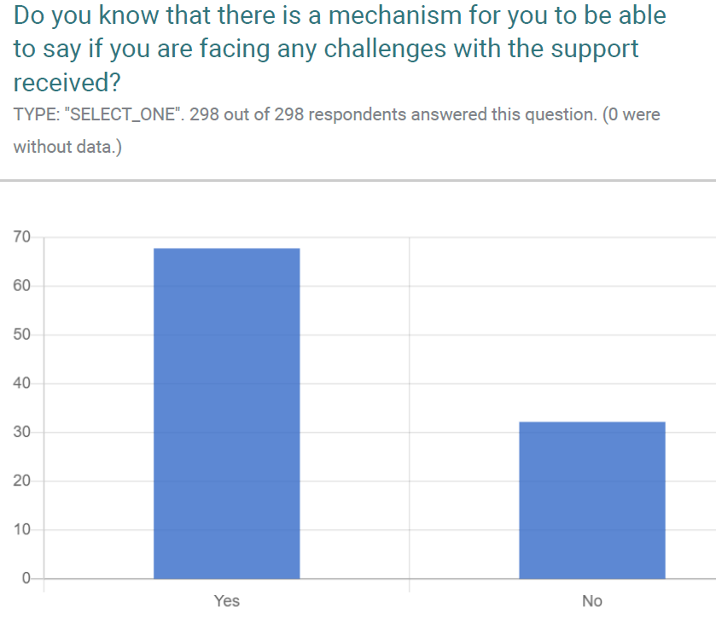
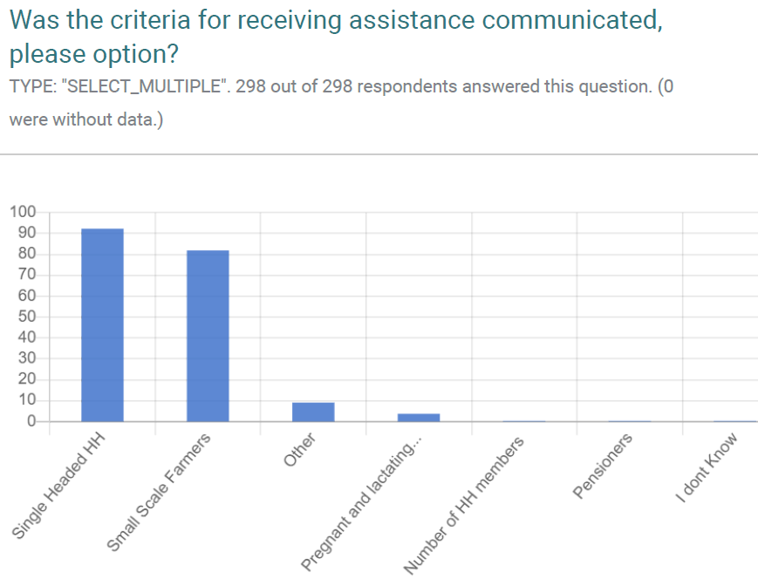
PDM on CEA
Notes:
Example slide of PDM results to adapt – CEA

Slide 53
Focus on CEA
Exercise 1: Each group focuses on one phase of the cycle and assesses and explains the CEA actions that were conducted for each phase, the gaps, and provides future recommendations

Slide 54
Implementation and monitoring: Part 2

Slide 56
Session outline
Outcomes:
The Right Way? Were the delivery mechanisms (FSP, distributions) the most appropriate for the targeted population?
To identify main gaps/positives and learning and propose main recommendations for future interventions

Slide 57
Right way? (delivery)
Include 2-3 summary slides from PDM + FGDs (10 mins) (see examples)
Plenary discussion about community views: do participants agree, anything to add (10 mins)

Slide 58
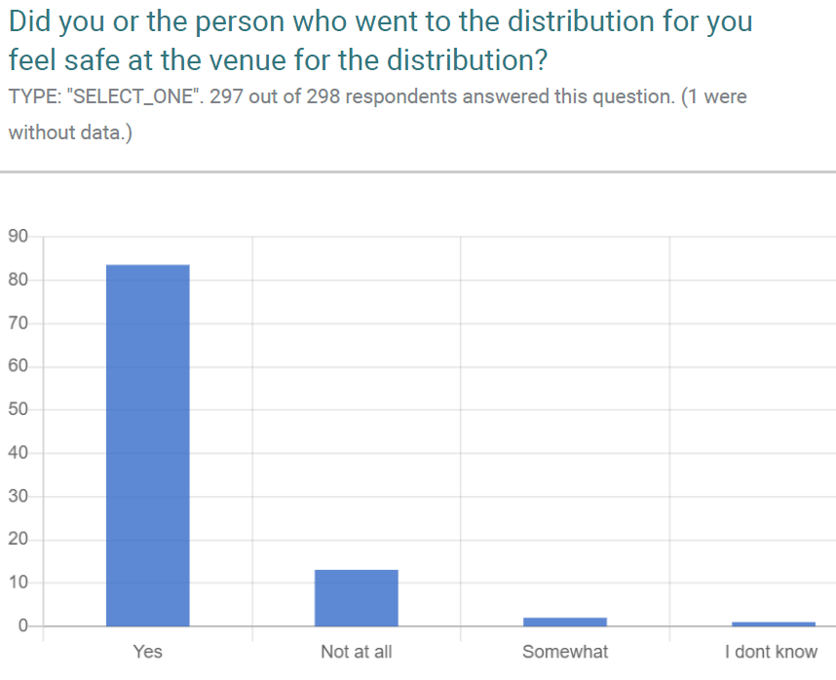
Right way? (delivery)

Slide 59
FGDs
‘Incident that affected negatively the programme was the large number of people at the post office during the distributions as several communities were convened the same day to collect the CVA’
‘People were not exposed to any risk. Suggested that women with children can be given priority’

Slide 60
Selected delivery mechanism/FSP in xxx response
Notes:
Recap on selected delivery mechanism/FSP

Slide 61
Focus on delivery mechanisms
Based on the previous information:
Group Activity: discussion in two groups on how assistance was set-up and delivered (I –selection of FSP; 2 – distribution)
Identify a) what went well; b) what should have gone better; at least 3 top recommended actions to improve the quality of this phase next time. (40 mins)

Slide 63
Session outline
Outcomes:
To reflect on the tools/processes used to monitor the response and whether these helped to adapt the response when needed.
To identify main gaps/positives and learning and propose main recommendations for future interventions

Slide 64
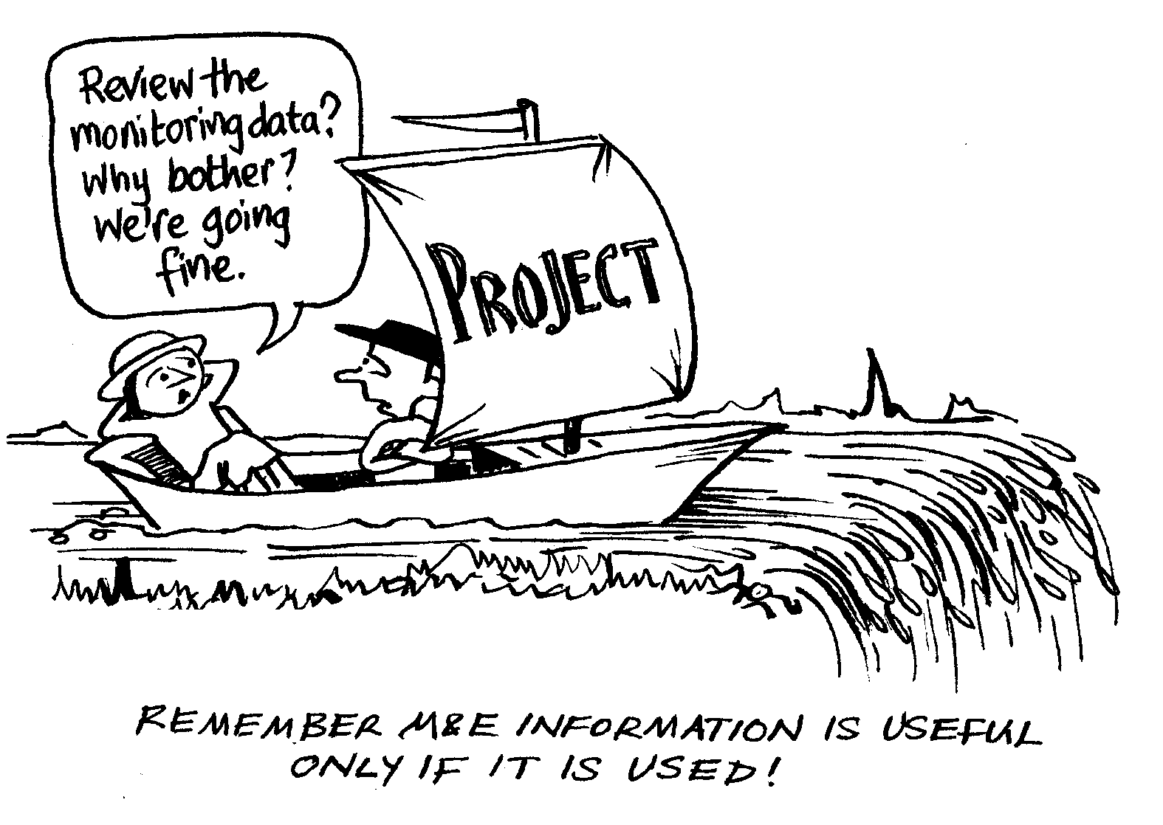

Slide 65
Snapshot of monitoring during the response
Notes:
Recap of monitoring process (PDM, encashment monitoring, market monitoring etc)

Slide 66
Focus on response monitoring system
Using the previous information:
Group Activity: each group discusses how effective the monitoring system has been for this response
Identify a) Identify situations where project monitoring led to adjustments in the response b) what went well and what were the challenges with the monitoring system (data collection tools etc) c) Main recommendations.

Slide 67
Recommendations for future CVA programming

Slide 68
Session outline
Recap and revise the top recommendations identified in the workshop
Discuss how well these are captured in the CVA Plan of Action or if additional actions needed
Review findings in line with NS CVA self-capacity assessment
Categorise, prioritise and refine the recommendations
Wrap up and closing remarks.
Notes:
See handout on recommendations

Slide 69
Focus on recommendations
In plenary:
Per project cycle step, vote for which recommendation should be the priority one
Top 3 per project step get recorded

