Slide 1
Cash and Voucher Assistance Standard Operating Procedures (SOPs) Workshop
<Insert NS name>
<Insert dates of workshop>
<Insert location>

Slide 2
Agenda – Day 1
Time | Day 1
8:30 – 9:00 | Opening and objectives of workshop
9:00 – 9:45 | Introduction to CVA SOPs
9:45 – 10:15 | Break
10:15 – 11:00 | CVA implementation process and decision requirements
11:00 – 12.30 | Review of SOPs/key CVA steps in an emergency response
12.30 – 13.30 | Lunch
13:30 -15:30 | Drafting CVA steps and actions
15:30 – 15:45 | Break / End of day (participants)
15:45 – 17:15 | Agreement and finalizing key SOP steps (faciliators and CVA Focal Point only)

Slide 3
Introduction to SOPs What should be included?

Slide 4
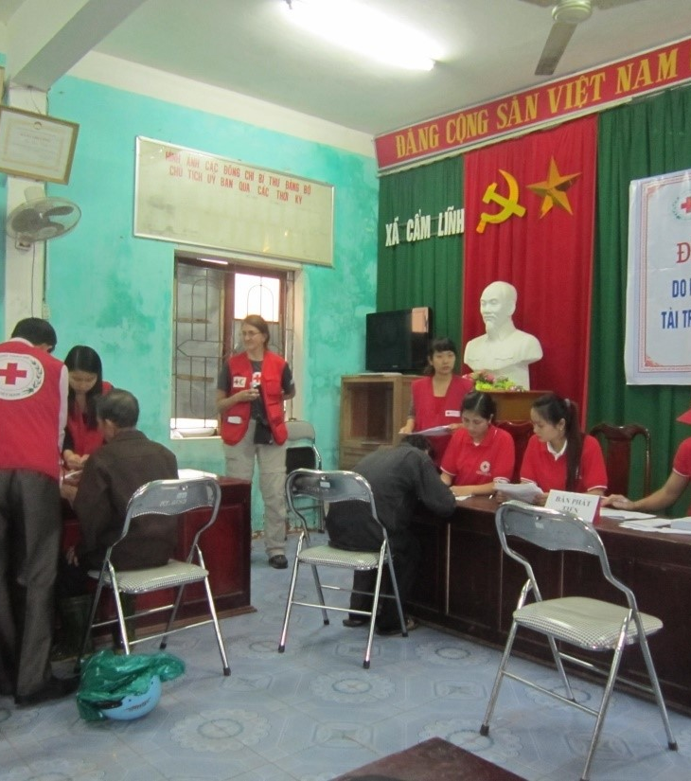
What are Standard Operating Procedures (SOPs)?
Role of the NS CVA Technical Working Group
Management and further development of the CVA SOPs will be guided by the CVA Technical Working Group, that represents all the main functions relevant for CVA, within a National Society
CVA SOPs
Standard operating procedures (SOPs) are a tool to support effective programming
Notes:
Standard operating procedures (SOPs) are a tool to support effective programming. The elaboration of CTP-specific-SOPs as part of preparedness activities, will allow for a better coordinated response where everyone in the Red Cross Red Crescent Movement will be clear of their role and responsibility. The process of elaborating SOPs is just as important as is the final document. While the assessment and programme design and implementation will fall fundamentally under the responsibility of the Disaster Management or equivalent emergency response team, the special skills and responsibilities of the Logistics and Finance departments will be required in CTP. This means that the development of the CTP SOPs needs to be guided by a CTP working group that represents all the main functions relevant for CTP within a National Society. Together, the CTP working group members should discuss and agree on ways of working, and elaborate CTPs endorsed by all. The dissemination of the CTP SOPs will be an important part of the National Society preparedness activities as well.

Slide 5
Standard Operating Procedures
Linking contingency plans and operational response
Ensures tasks listed in the contingency plan are carried out quickly and according to pre-agreed criteria
SOPs should be simple (checklist format)
Indicates how task is done
Indicates who is responsible for completion of the task
A RACI further defines roles and responsibilities
SOPs must be approved, disseminated through trainings and refined based on simulations and pilots

Slide 6
Overview of CVA SOPs template
Section | Content | Relevant annexes
Section 1 - Background | Purpose of SOPs, when they apply, who is document for, how to use SOPs, guide to using the document
Section 2 - Brief overview of CVA | Overview of CVA in country and by NS | Other NS guidelines
Section 3 – Roles and responsibilities | Summary table of functions and roles, overview of decision-making process, flow chart with decision making | RACI matrix
Section 4 - Timeline | Summary of key steps with estimated timeline
Section 5 – SOPs for preparedness | Key steps, actions and links to tools; flowchart | Key tools
Section 6 – SOPs for assessment | Key steps, actions and links to tools; flowchart | Key tools
Section 7 – SOPs for response analysis & planning | Key steps, actions and links to tools; flowchart | Key tools
Section 8 – SOPs for set up & implementation | Key steps, actions and links to tools; flowchart – per delivery mechanism (FSPs, vouchers, by hand, using IM platform, e.g RedRose) | Key tools
Section 9 – SOPs for monitoring & evaluation | Steps, actions and relevant tools + flowchart | Key tools

Slide 7
CVA process and decision requirements

Slide 8
Group work 1: CVA process and decision requirements
What are the main processes in a CVA response in terms of assessment, response analysis and set-up, implementation, and monitoring?
Where are key decisions and approvals needed?
1st group : assessment, response analysis and set-up), 2nd group: implementation and monitoring
List down steps in starting up CVA operations at NHQ
Define which steps require a management decision?
What is the ideal timeframe for approval?
30 mins group work
3. Estimate after how many days following the start of a response can the NS implement CVA?

Slide 9
Group work 1: Overview of CVA and decisions
Timeline /decision-making process flow example
Notes:
Show as example - CVAP SOPs template p7 or p8

Slide 10
Review of existing SOPs/key CVA steps during emergency response
Notes:
Adapt session for either NS who already have SOPs in place that need revising, or NS who are designing SOPs for the first time.

Slide 11
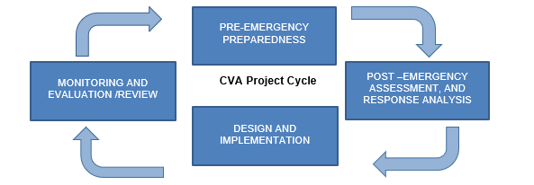
CVA project cycle
Notes:
The SOPs are aligned with 4 phase of the project cycle - see chart.
The workshop will focus on developing steps for CVA implementation post-emergency across each phase.

Slide 12
Existing NS SOPs /CVA guidance
Notes:
Optional slides if the NS already has SOPs or guidelines in place that they can build on/ revise.
Summarise what exists.

Slide 13
What do the existing NS CVA SOPs or guidelines cover?
What needs to be done – activities/steps?
Who is engaged in each activity?
The sequence of the activities?
The duration of each activity?
Process flow per CVA modality/delivery mechanism?
Notes:
Optional slides if the NS already has SOPs or guidelines in place that they can build on/ revise.
List what they contain.

Slide 14
What is missing?
Notes:
Ask participants what they think is missing from the current NS SOPs/CVA guidelines
Then flash up the answers….

Slide 15
Group work 2 - Review of SOPs
Group allocations – important groups remember
Group 1:
Group 2:
Group 3:
Notes:
Divide participants into 3 groups. Explain that:
Group 1 will be the blue stars
Group 2 will be the orange lightning
Group 3 will be the green smiles
Show example slide next

Slide 16
Brainstorm: While reviewing, think, what is good and what could use improvement?
Double-click a post-it to edit
What do you like/what is good
Are there any gaps or incorrect information
What recommendations would you make to improve it?
Group 1: We liked the section on needs assessment
Group 1: Page 4 says DM coordinator leads project development, but this isn’t the case
Group 2: Add a document on market assessment
Group2: Needs Assessment is missing providing intervention in time
EXAMPLE SLIDE
Notes:
In this example, you can see that both groups 1 and 2 made new suggestions. You can see that groups 2, 3 and 4 agreed with some feedback left by previous groups.

Slide 17
Group work 2 - Review of SOPs
Group 1: Start with assessment, response analysis and planning
Group 2: Start with set-up and implementation
Group 3: Start with monitoring & evaluation
Each group will have 20 minutes per topic. We will tell you when to change topics.

Slide 18
SOPs Brainstorm: While reviewing, think, what is good and what could use improvement?
Double-click a post-it to edit Assessment, response analysis & planning
What do you like/what is good
Are there any gaps or incorrect information
What recommendations would you make to improve it?
Group 1: It considers technical-based information
Group 2: Needs Assessment is missing providing intervention in time
Group 2: Have volunteers in all the chiefdoms
Group 1: Context-Based & needs assessment is done.
Group 2: Development of central database of vulnerable households in the communities
Group 2: Develop a central database of vulnerable households in the communities
Group 1: CVA considers the MEB per household
Group 1: Tailor-made to meet individual needs
Group 1: Community engagement

Slide 19
SOPs Brainstorm: While reviewing, think, what is good and what could use improvement? Double-click a post-it to edit Set-up & implementation
What do you like/what is good
Are there any gaps or incorrect information
What recommendations would you make to improve it?
Group 1: Involves all stakeholders
Group 2: Verification before registration is missing
Group 1: In standard Selection criteria involve an external/neutral partner
Group 1: Document Approval
Group2: Standard selection criteria is missing
Group 3
In the event of a pandemic an annex should be there stating how the project can be implemented
Group 1: Community is continually engaged
Group 1: The methodology is not mentioned
Group 1: Parameters and criteria is well documented
Group 2: Outlined Selection process only applies during COVID, normally it is the entire community involved in selection
Group 1: Identification of all stakeholders

Slide 20
SOPs Brainstorm: While reviewing, think, what is good and what could use improvement? Double-click a post-it to edit Monitoring & Evaluation
What do you like/what is good
Are there any gaps or incorrect information
What recommendations would you make to improve it?
Group 3
All steps are for monitoring for cva purpose are covered
Group 3 It should state the systemes that are reconciled and should state the frequency of reconciliation and cut of date for reconciliation
Group 3 Steps should detail all necessary information
Group2:PDM_Target beneficiaries receiving funds using proxies
Group2: Develop a central database of vulnerable households in the communities
Group2: Missing information on predistribution sensitization and exit survey
Group 1: Consider involving other stakeholders to measure the impact of the program e.g clinics, police, church leadership
Group2: Data analysis_verification of data with beneficiaries. Verifying the data inconsistencies
Group 1: There are no involvement of external stakeholders to measure the social impact of the program

Slide 21
Plenary summary of groupwork – go back to present groupwork on slides

Slide 22
Drafting CVA steps and actions (SOPs)

Slide 23
Group work 3 : Key steps and procedures on CVA (Drafting new SOPs)
What are the key steps from assessment of needs to identification and reporting?
List down in table the key steps and sub-steps (using findings from previous sessions)
Define documentary requirements
Who are involved?
Notes:
Consider mixing up the groups to ensure relevant specialists are in each group, e.g. logistics in set-up and implementation, M&E in monitoring and evaluation

Slide 24
Brainstorm: SOP steps need to be - Added? Removed? Amended?
What needs adding?
What needs removing?
What needs amending?
Notes:
Pull over any relevant post-its from the review exercise on steps….

Slide 25
Activities | Sub-steps | Documents required | Who involved (list)
Needs assessment
Markets Assessment and Cash feasibility
Determine Cash transfer Value
Define Selection Criteria
Distribution Planning
Submission of List of Beneficiaries
Fund Request and approval
Communication with FSP
Cash Distribution
Financial reporting and reconciliation
Post Distribution Monitoring
Final Reporting
Notes:
Each group to complete a table for their project phase.

Slide 26
Recap Day 1
Notes:
Going around the room, ask each participant for one thing that stood out for them the previous day/one thing they remember.

Slide 27
Agenda: Day 2
Time | Day 2
8:30 – 9.00 | Recap of Day 1
9:00– 11:00 | Drafting roles and responsibilities matrix (RACI)
11:00– 11:30 | Break
11:30 –12:30 | Finalize timeline, decisions and approvals
12.30 –13.30 | Lunch
13:30 - 15:30 | Review of NS existing tools – what to adapt develop?
15:30 – 16:00 | Break
16:00 – 17:00 | CVA SOPs – what’s next?
Notes:
Draft steps and key responsibilities
Review of decisions and approvals
These don’t have PPTs – make sure facilitator notes gives instructions

Slide 28
Designing a roles and responsibilities matrix (RACI)

Slide 29
Group work 4: Designing a RACI across the steps
Who should be responsible, accountable, communicated and informed in each step?
In groups, develop a RACI matrix
If time, group whoever finishes first can also include pre-crisis phase and refine roles against the CVAP RACI steps
Notes:
Split into same 3 groups from the end of day 1

Slide 30
Steps/Activities | Responsible | Accountable | Consulted | Informed
Collect secondary information at National level | DR, Cash focal (Lead) | Director- DR (Support) | Comms, PMER, DRM (S) | Comms, PMER, DRM, management, IFRC, PNSs (S)
Collect secondary information at field level | Chapter (Lead) | Chapter Leaders (Lead) | DR, UA | DR, UA, PMER
Coordination at national level | DR, Cash focal | Director- DR | SG/DSG, Coms, PMER, DRM | SG/DSG, PMER, DRM, management, IFRC, PNSs
Coordination at local level (District/ sub-districts, UP) | ULO | Unit Secretary/EC | DR, UA | DR, UA
Questionnaire development & finalize for assessment | DR, PMER, IM & IT | Director- DR | DRM, CEA | SG/DSG, IFRC, PNSs
Team deployment (NDRT/NDWRT/UDRT) | DR | Director- DR | SG/DSG, UA, Y&A | Units
Orientation on questionnaire | PMER/IM | DR | UA, Y&A | SG/DSG
Community consultation | ULO, NDRT/NDWRT | Unit Secretary | Unit EC | DR
Assessment conduction | RC volunteers | NDRT/NDWRT, ULO | DR | Unit EC
Report generation | NDRT/NDWRT, PMER, IM | DR | ULO | All departments, Units, Management, IFRC, PNSs and external stakeholders
Report Sharing | DR | Director- DR | PMER | All departments, Units, Management, IFRC, PNSs and external stakeholders

Slide 31
Agree timeline, decisions and approvals
Notes:
Design flow charts if there is time

Slide 32
Group work 5: Timeline, decisions and approvals
Referring back to earlier discussions in group work 1, finalise in groups which drafted SOP steps require management decisions or approvals
Make a timeline and calculate how many days it takes to deliver CVA in a typical response (if CVAP has been done)
Option to make flow charts also
Notes:
See p7-8 CVA SOPs template

Slide 33
CVA tools review and mapping

Slide 34
CVA tools
Annexes will be included to the SOPs, some of which will link to practical tools that are used for CVA.

Slide 35
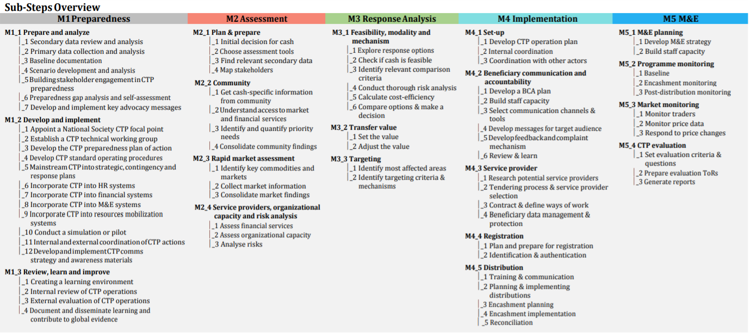
CiE toolkit overview
Notes:
This is an overview of everything included in the Movement’s Cash in Emergencies toolkit – as you can see there are tools for every step of a CVA intervention.
NS will need to have their own contextualised set of tools for doing CVA and these need to be developed or adapted alongside the SOPs.

Slide 36
Group work 6: Review of mapping of NS CVA tools
What CVA tools are currently used by the NS for CVA?
Step | Tool | Status | Responsible | Notes
Cash feasibility | Market assessment
Cash feasibility | FS and Nutrition ranking
Targeting, selection, registration, verification | Registration form
Targeting, selection, registration, verification
Design & implementation
Design & implementation
Monitoring & Evaluation | Exit survey
Monitoring & Evaluation | PDM
CEA
CEA
Notes:
In 4 groups, take one CVA project phase each.
Agree what tools the NS has in place (based on tools mapping done in advance by CVA FP)
Agree what needs to be adapted
Agree what still needs to be developed
Assign responsibilities for who will work on what

Slide 37
Brainstorm: What additional tools would be useful that the NS does not have?

Slide 38
SOPs – what next?
Notes:
Participants may be wondering what’s next with the SOP documents.
CVA FP with the support the partner NS will use the workshop inputs to finalize a draft version of the SOP and RACI. This will be shared with NS leadership and will need to be signed off before becoming an official document adopted. But this is not a one off exercise…..

Slide 39
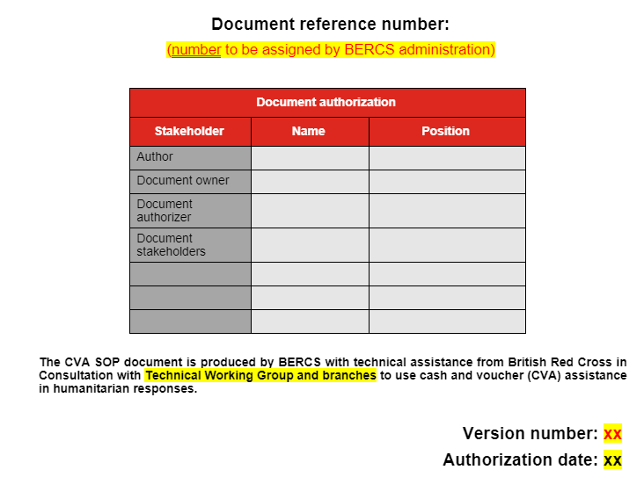
Notes:
Back on the first page of the SOPs, there should be an indication of the version number and authorisation date. The SOPs are a living document that will be updated on a regular basis. This may be annually, or after each large intervention. In each of these cases, SOPs would be revised and re-presented to management for further sign off.

Slide 40
“Where there is a need to deviate from the SOPs, this must be highlighted with an explanation of why the deviation must be made, a proposal for an alternative and sought written approval from senior leadership.
Thereafter, the CVA Focal Point will revise the SOPs accordingly, particularly after the simulation exercise and pilots. Revisions to SOPs will be endorsed by the SG/USG and approved by the Board.”
Notes:
So, what happens if a situation arises where a project comes up, but there is no relevant information in the SOPs?
In this case, project staff may need to create new processes or tools to deal with the immediate situation at hand.
But words similar to the above clause should be put in the SOPs and adhered to – show text above

Slide 41
Annexes and further guidance/tools….
Important to note that the SOPs are a guide for CVA overall – individual departments may have other documents, such as checklists, policies etc, which underpin how specific tasks are completed
For example: CVA guidelines for finance staff
All such documents should be flagged with the CVA Focal Point and they can be included as annexes to the SOPs, where necessary

Slide 42
Next steps following workshop
CVA Focal Point to finalise SOPs document
Submit to leadership for approval
Tool development alongside to continue
Trainings on SOPs and tools at HQ and branch level
Testing SOPs in simulation and pilot projects

Slide 43
Thank you! Questions?

