Slide 1
Rental Assistance, an introduction
Insert appropriate photo for your context here.
DATE
Notes:
This is a 15 minute presentation.

Slide 2




Why consider rental assistance?
People would often prefer to rent an apartment rather than live in a collective centre.
Can provide choice, safety, protection and access to adequate shelter.
It is flexible and can support people on the move.
Useful option for urban responses, but also useful in peri-urban, and rural.
Applicable to migration, conflict, pandemic and disaster responses.
The Red Cross Red Crescent Movement is an experienced actor in this programming response option.
Supports vulnerable people to meet shelter needs, considering minimum housing standards and tenure security.

Slide 3
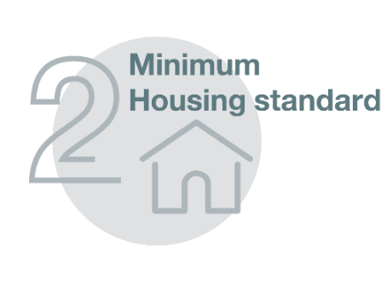







What is Rental Assistance
Rental Assistance is not only about the rental payments.
(Incl. upgrades/ repairs and other support)
You do not need all components for a rental assistance programme

Slide 4
Components | Description and some examples (not exhaustive)
1. Information | Supporting people to understand the rental market and normal rental practices Supporting people to find adequate accommodation to rent Supporting property owners and service providers to understand shelter adequacy Informing the host community and target community about the programme
2. Housing Standards | Establish minimum housing standards and undertaking adequacy checks on rental properties Assessing monitoring the housing market quality (and quantity and cost).
3. Security of Tenure | Supporting tenants and property owners with appropriate rental agreements Ensuring both parties understand their rights, roles and responsibilities
4. Exit Strategy | What will happen when rental support ends? How will people maintain access to adequate shelter?
5. Technical Advice | Advice/visits to support use, maintenance, utility use/reduction, ventilation Help with accessing support from government Referrals to other programmes Legal advice, mediation and collaborative dispute resolutions
6. Payments | Payments can be total or partial rental payments (to tenant or landlord) & Cover utilities or not Grants for furniture, Grants to support Deposits Payments for adaption for people with disabilities or age related adaptions
7. Advocacy | Advocacy to government, donors and other relevant institutions (e.g. on barriers to migrants renting, inclusion in existing social protection programmes related to housing support etc.)
8. Complimentary programming | Often to support inclusion and exit strategy. Livelihoods, psycho-social support, health, WASH, civil documentation, referrals

Slide 5

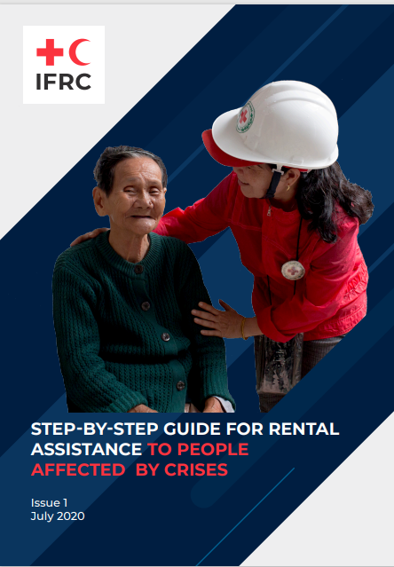
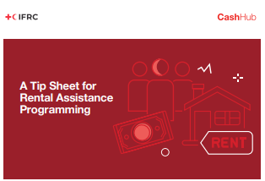
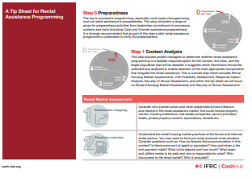

Existing sources of information

Slide 6
We know this is too small to read
Steps
0. Preparedness
Context Analysis
Design and Plan
Implement and Monitor
Evaluate, Report and Learn

Slide 7
Approaches that can be explored
Approach ref. | Example Approach Summary
1 | Multiple components of rental assistance with rental payment paid to tenant
2 | Multiple components of rental assistance with tripartite agreement and payment to property owners from RCRC
3 | Select components of rental assistance to increase access to rental housing for target population – e.g. Insurance for property owners or deposit payment support.
4 | Information on rental practices provided to target population, no rental payment support offered.
5 | Expansion of rental assistance social protection programme (payment either to tenant or property owner)
6 | RCRC finds and rents apartments from property owners and sub-lets at no rental cost (note there may still be utility costs etc.)
7 | RCRC rents entire hotel/hostel and provides accommodation directly to target population with individual rooms.
8 | RCRC has a framework agreement with hotels / hostels and makes rental accommodation available for short stay-free of charge (e.g. perhaps using a voucher programme).
9 | Shelter repairs/upgrades to support property owners to create new habitable rental unit with the condition of a rent-free period being offered for target household. This is sometimes known as the “occupancy free of charge (OFC)” rental approach.
10 | RCRC establishes a platform for both property owners & tenants with vetting of property owners and assessment of minimum housing standards.
11 | Self-registration with fully remote support to tenants and remote vetting of properties.
Select approaches most suitable to context for further discussions

