Slide 1
Example 2.1.3 - Shelter Programme Overview covering Rental Assistance
Note: This is a real example of a summary presentation highlighting programme design for both rental assistance and hosted arrangement assistance. Giving information on: targeting, programme location, rental payment support amounts, activity implementation plan, budget, eligibility criteria. This programme was undertaken in Slovakia as part of the Ukraine 2022 response.

Slide 2
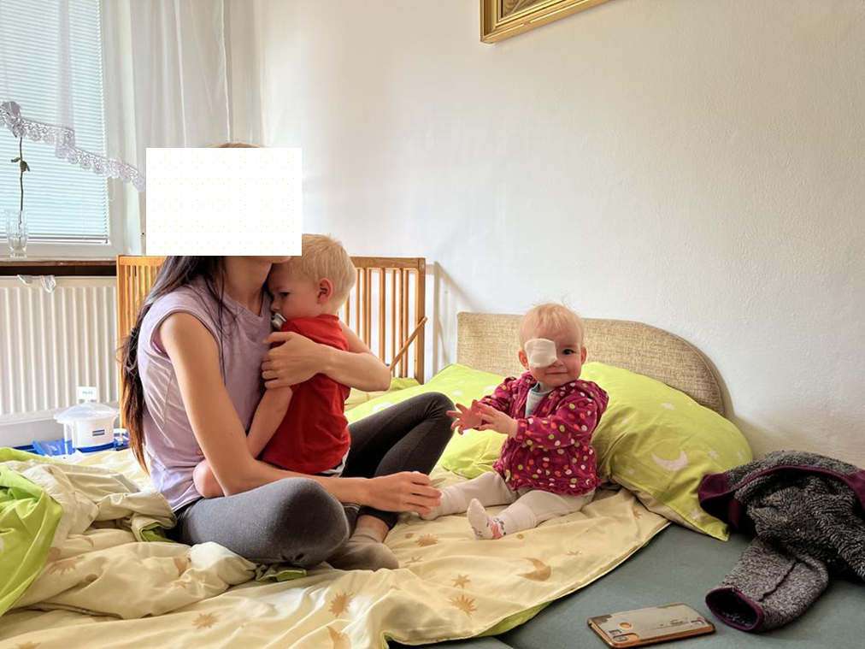
Shelter, Housing & Accommodation assistance for Ukrainian refugees in Slovakia
Emergency shelter assistance including MPC grants.
Mid to longer-term housing and accommodation assistance through rental and host family support.
Information assistance and integration.
Implementation of DG-Home Safe home guidance and developing good practices and learning from communities hosting initiatives

Slide 3
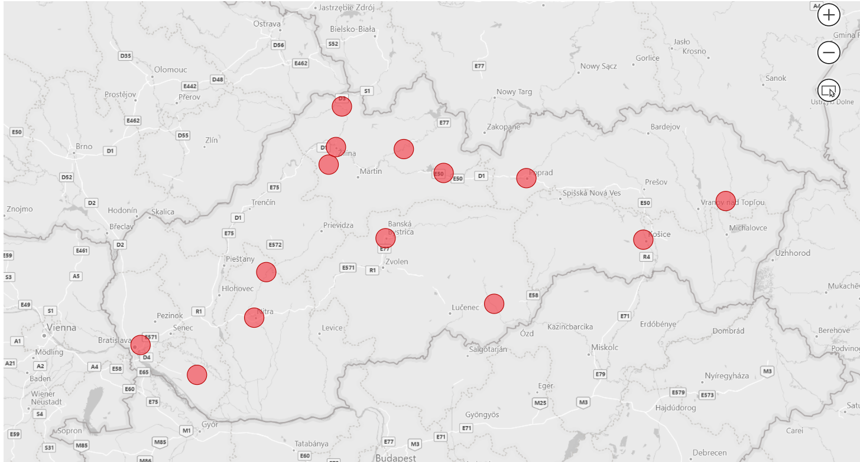


Slide 4
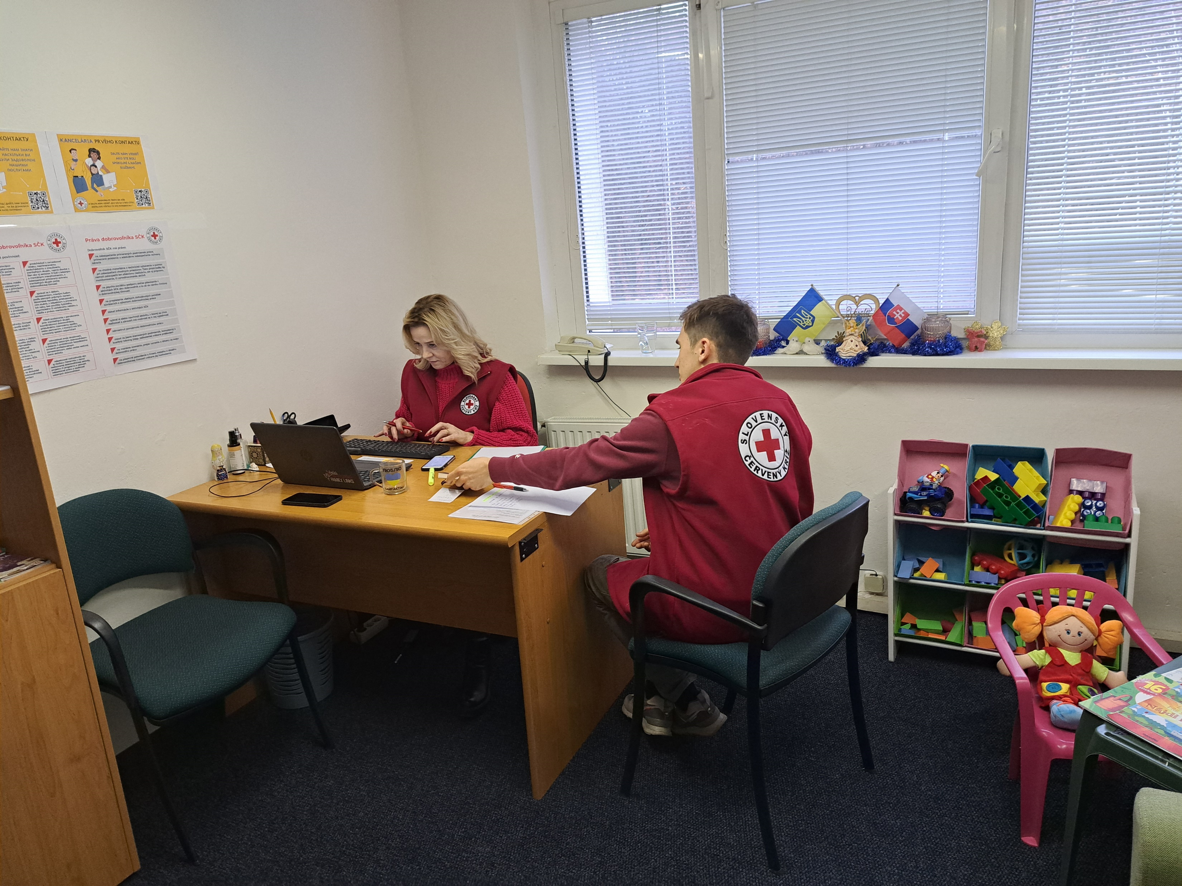
From emergency to mid-term recovery
1. Rental Assistance: six-month rental assistance is being provided to Ukrainian Refugees families who have been granted Temporary Protection Status.
2. Host family Support: the top-up support for six months, in addition to the Slovak government’s housing allowance support, is provided to hosting families who are hosting refugees’ families to cover the recurrent housing cost for six months.
3. Rental contribution to Slovak Families: Programme also aims to provide a rental contribution to Slovak families who are at risk of eviction due to economic conditions or temporary incapacity to work.
4. Support to access the housing/accommodation and other services including integration
HSPs provide information, language courses PSS, and work with refugees’ families to identify a pathway for integration through case management.

Slide 5
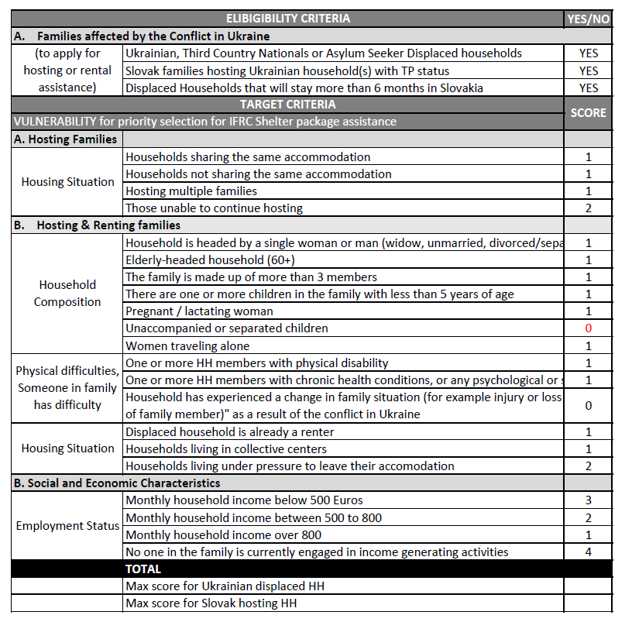
Identification and Targeting
Selection Criteria and prioritization
Criteria based on the physical, socio-economic, gender, age, current situation, etc are in place to reach the most in need.
Scoring-based criteria to prioritize the most vulnerable households.

Slide 6
Process
Enrollment and Payments: EspoCRM application is used to register, enroll, and certify payments, while payments are made to the beneficiary’s bank account through RedRose. Kobotool is used for housing adequacy standards verification and monitoring.
Automated eligibility determination:
Eligibility is determined by the espoCRM, the rental amount and the number of rooms are automatically assigned to the applicants for rental apartments.

Slide 7
Rental value and top-ups
Description Rental Assistance | 1 bedroom | 2 bedrooms | 3+ bedrooms
Rental Assistance/month outside Bratislava | 450 | 600 | 700
One-off payment for housing items | 400 | 400 | 400
One-off adaptation for Disability | 500 | 500 | 500
One-off winter support | 300 | 300 | 300
Rental Assistance to Displaced households: 370
Slovak Families(Target 60) rental contribution of above value plus one-off payments for winterization without a security deposit.
Hosting families- (Target 140) 112Euro/month plus a one-off payments
Meeting housing adequacy standards is a must.
Extension for additional months for most vulnerable cases.
Support for measures to adapt house to the needs of people with mobility restrictions

Slide 8
Progress to date
Registered Feb 18, 2023 | 345
Successful applications/245K distributed | 172
Verification successful | 190
Rejected due to inactivity | 15-20%
Rental hosting proportion | 63:37
Extension for additional 3 months for most vulnerable cases for all 3 groups is in progress.
Criteria have been finalized and implementation in espo is in progress.
Testing of the registration and application form of Slovak families will be concluded this week and registration will start.
Responding to evolving needs.

Slide 9


Social cohesion through energy saving
Hosting families reported increased consumption of water, gas, and electricity.
To promote and sustain solidarity families support,
Sensitization to the refugees to adopt energy-saving behavior, and some measures for homeowners.
Proposal for an increase from 300 to 400 for a few selected cases.
Criteria have been developed.

Slide 11
Backlog
The significant backlog between registration and the other two steps
Main reasons:
Shortage of the accommodation
Availability of the landlords and hosting families for an appointment.
Less willingness to rent for <a year, families with children and Pets
Less proactive applicants> rejection due to inactiveness.
Changing minds after completion of administrative procedures.
Drop off: Leaving apartments without information/ withdrawing from TPS etc.

Slide 12
Notes:
End registration May, with 30% rejection we estimate to reach to 627 hh for registration.

Slide 13
Spent to date: 245,000
Underspent 144,000

Slide 14
Exit Strategy
The exit strategy will mainly rely on the government’s response.
Sharing clear information to target households about the programme duration and on Government social protection and housing programmes.
Extending the tenancy duration for the most vulnerable families.
Working towards integration and inclusion by providing language, cultural orientation, and referrals, supporting individualized objectives of rental and hosting beneficiaries, removing the barriers to sustaining accommodation and self-sufficiency, and enhancing employability potentials.
Leveraging form Safe home programme.

Slide 15
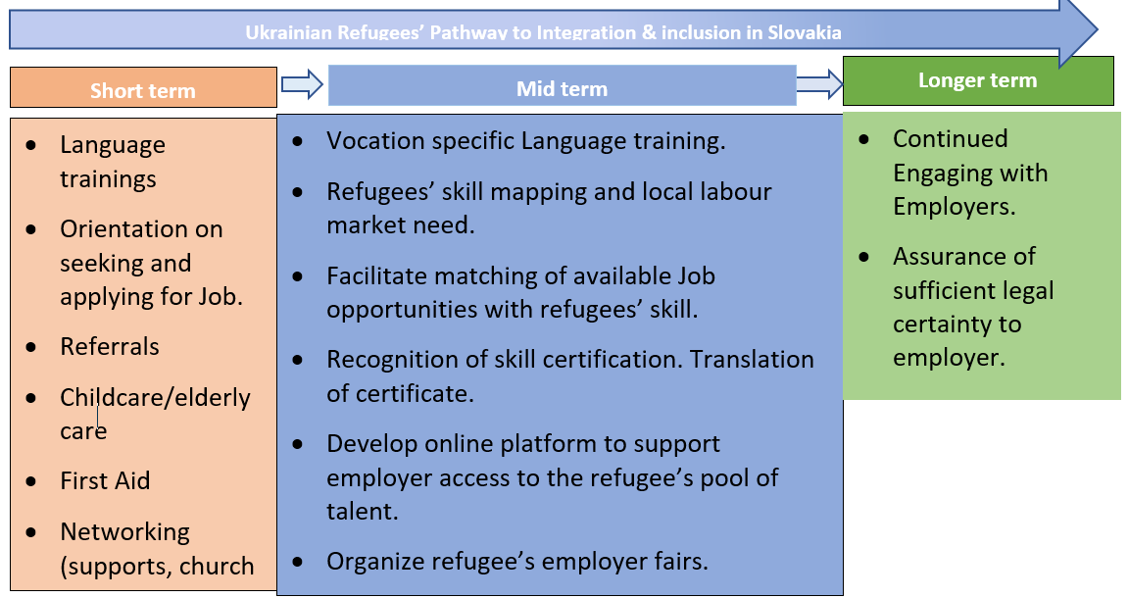
Livelihood (labor market integration)

Slide 16
Practical Barriers:
Lack of Accommodation and poor health.
Inability to care Child or elderly in the family
Perception about refugees.
Language
Recognition of qualifications and skills.
Legal status and Slovak labor laws and administrative procedure.
Finances and guidance required to develop skills.
Lack of qualification, experience, and skill to meet the Slovak labor market demand.
Enabling conditions:
Temporary protection directive grants access to employment.
Shrinking of working age population and increasing demand for skilled labor in EU countries.
Literacy and skill among Ukrainian refugees.
Slovak Red Cross is already involved in activities to promote integration
Individual characteristic: Motivation, Social Capital, Language proficiency and Skills

Slide 17
Cont…..
Essential activities for LH and inclusion for the working-age population.
Conducting short language courses with predetermined duration and curriculum
Developing and conducting standardized PSS session
Developing and conducting a Cultural orientation session
Providing information on social services, laws, housing, and other services.
Providing First Aid training.
Preparing and conducting Job counselling sessions and life skills training
2. Labor market integration activities. Mapping Skills of working-age refugees
Mapping skills demand in the market
Analyzing the profile of individuals.
Identifying the training institutes.
Providing vocational training.
Vocational-specific language courses.
Translation and recognition for diplomas, certificates, and degrees identified during profile analysis
Support to single mothers for employability start-up assistance for kindergarten for 3 months
Training of Red Cross staff
We are at Planning and design stage

Slide 18
Area of focus
Recruitment of Inclusion staff
Standardization of the practices among branches.
Development or identification of the course content, duration, and costs and financial grants/fee distribution process
Uninform reporting.
HSPs are heavily involved in case management; overstretched capacity

