Slide 1
Example 2.1.5 -Household Orientation
Note: This is a real example of a presentation that was used in orientating households in the programme, prior to application. It was used in Slovakia as part of the Ukraine 2022 response.

Slide 2

Process & standard procedures for
the Shelter Programme
Registration of families needs and preferences
(Head of HH
at HSP)
HH informed about selection status - eligible / not eligible for assistance
(SMS)
Branch staff will contact the HH for orientation on assistance package at the HSP
(phone call /SMS)
HH to find rental accommodation and inform the SRC staff
House visit with SRC, Tenant and Landlord (verification of adequacy and safety standards)
Enrollment in the shelter program
(Head of HH
at HSP)
Sign Agreements
Rental Contract
Agreement LL, tenant & SRC
(Head of HH
at HSP)
1st Payment
1 month rent
Security deposit
House adequacy
(Bank transfer to the Landlord)
Monthly monitoring & payment
Payments are done on a monthly basis and conditional to monitoring visit and sign off of SRC staff
Additional support
Employability
Education
Health care
One-off winterization payment – third month
3 additional months of support for the more vulnerable cases
Exit of the Program

Slide 3
Rental Assistance Package
 | 1 Room | 2 Rooms | 3 Rooms
Eligibility | 1 adult and 2 children (0 – 5) | 1 adult and up to 3 children (0 - 5 -10), 2 adults and 1 child , 2 adults and 2 children etc. | Anything above
Rental payment / month | 450 € | 600 € | 700 €
Inside Bratislava | +50 € / month | +75 € / month | +100 € / month
Additional one-off cash assistance
  One-off payment of security deposit (one month rent on first month payment)
  Ad hoc support for disability adaptation work on first month – 500 Euros
  Payment for house repair/maintenance and purchase of HH items on first month – 400 Euro
  One-off payment for winter bills on third month – 300 Euros
  3 months extension for very vulnerable cases (25% max) to be approved by HQ
Notes:
How and where to reach Ukrainian HHs?
Collective centres? Church facilities
Host families who dont want to continue
Ask municipalities etc

Slide 4
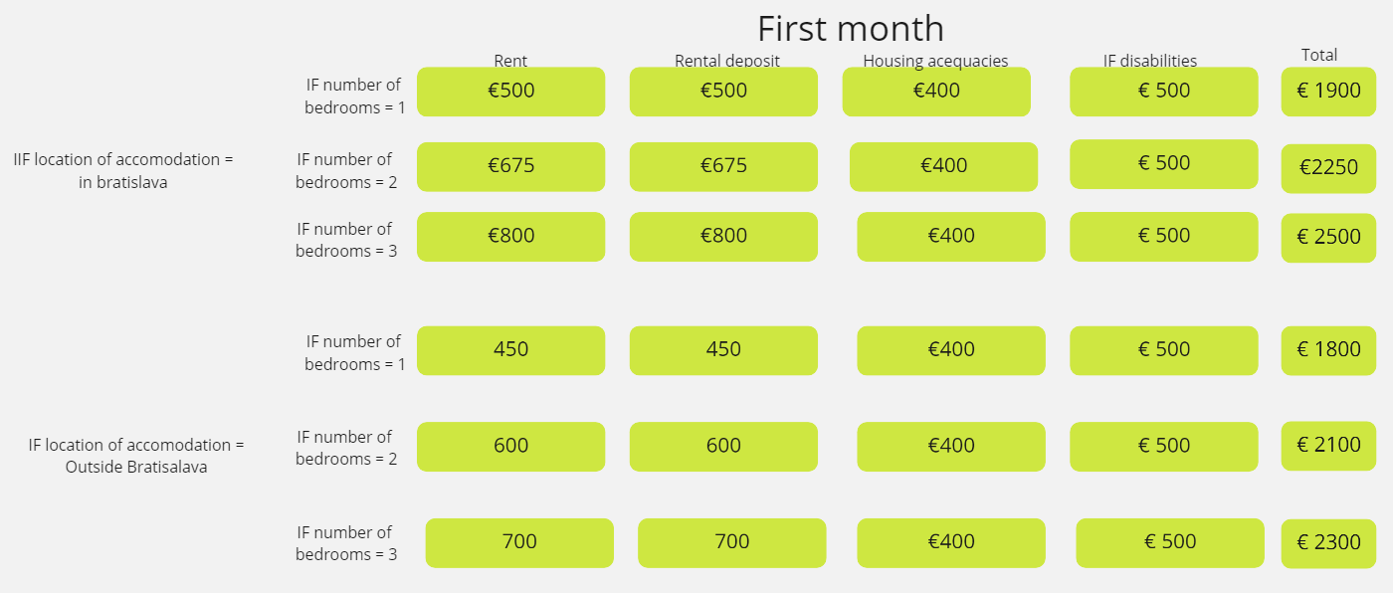
Rental Assistance Amounts and Schedule
+
+
+
=
+
+
+
=
+
+
+
=
+
+
+
=
+
+
+
=
+
+
+
=

Slide 5
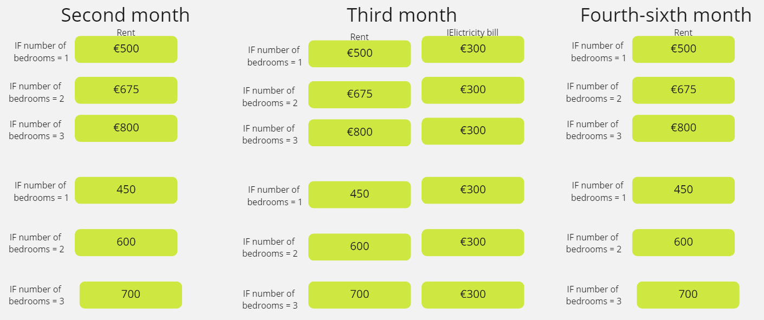
Rental Assistance Amounts and Schedule
+
+
+
+
+
+

