Slide 1
Example 2.2.3 - Staff orientation rental programme
Note: This is a real example of a presentation used to on-board new staff in Slovakia so that they would have some understanding of the rental programme.

Slide 2

Shelter Response for Slovakia
Ukraine and Neighboring
Countries Operation

Slide 3
Selection Criteria
Different sets of eligibility criteria for:
  Rental assistance for refugees fleeing Ukraine
  Slovak families hosting displaced households
Vulnerability scoring system with points awarded based on:
  Current housing situation
  Household composition
  Disability status
  Legal status
  Employment status and income

Slide 4



Process & standard procedures for
the Shelter Programme
Registration
(KOBO form)
Identification of families needs and preferences
(Scoring system)
Selection of families
using the selection criteria
(EspoCRM)
Enrollment in the shelter program
(Application form)
House visits
(Minimum Standards Checklist)
Agreements
1st Agreement Sign LL & SRC
2nd Agreement HH & SRC
1
2
3
4
5
6
Contract
Sign Rental Contract between Landlord (LL) & Tenant (HH)
1st Payment
+ one off payments for housing adequacy (hosting) /deposit, housing items (rental), disability adaptation support
Monthly monitoring & payment
Payments are done on a monthly basis and conditional to monitoring visit and sign off
Additional support
Employability
Education
Health care
One-off winterization payment – November (host family support
3 additional months of support for the more vulnerable cases
Exit of the Program
7
8
9
10
11
11
12

Slide 5
Selection Criteria
Different sets of eligibility criteria for:
  Rental assistance for refugees fleeing Ukraine
  Slovak families hosting displaced households
Vulnerability scoring system with points awarded based on:
  Current housing situation
  Household composition
  Disability status
  Legal status
  Employment status and income
Notes:
Scoring system > We will apply a scoring system based on a ‘yes’ ‘no’ system whereby a score of 1 is given for yes and a score of 0 for no.
the No minimum threshold is considered for eligibility, however the priority will be given to those scoring the highest.
SCORE for priority selection
40 – 61: High Priority
21 – 39: Medium Priority
1 – 19: Low Priority

Slide 6
Scoring Matrix ?
Notes:
Scoring system > We will apply a scoring system based on a ‘yes’ ‘no’ system whereby a score of 1 is given for yes and a score of 0 for no.
the No minimum threshold is considered for eligibility, however the priority will be given to those scoring the highest.
SCORE for priority selection
40 – 61: High Priority
21 – 39: Medium Priority
1 – 19: Low Priority

Slide 7
Host Family Support Package
Description | Amount | Target HH
Host family support (hosting TP holders) | 108 € Based on 15% of average Gov assistance | 450 HHs
One-off Disability / house adaptation work | 500 € | 15% of total target – to be paid on first month
One-off housing adequacy and HH items | 400 € | 500 HHs - to be paid on first month
One-off winter support | 300 € | 500 HHs – to be paid on third month
Additional one-off cash assistance
  3 months extension for very vulnerable cases (25% max) to be approved by HQ

Slide 8
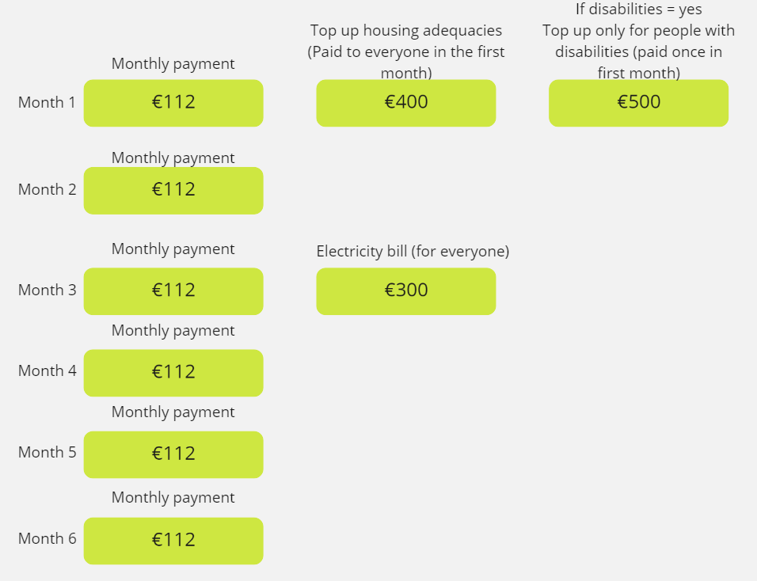
Host Family Support
Amounts and Schedule
+
+
+

Slide 9

Rental Assistance Package
 | 1 Room | 2 Rooms | 3 Rooms
Eligibility | 1 adult and 2 children (0 – 5) | 1 adult and up to 3 children (0 - 5 -10), 2 adults and 1 child , 2 adults and 2 children etc. | Anything above
Rental payment / month | 450 € | 600 € | 700 €
Inside Bratislava | +50 € / month | +75 € / month | +100 € / month
Additional one-off cash assistance
  One-off payment of security deposit (one month rent on first month payment)
  Ad hoc support for disability adaptation work on first month – 500 Euros
  Payment for house repair/maintenance and purchase of HH items on first month – 400 Euro
  One-off payment for winter bills on third month – 300 Euros
  3 months extension for very vulnerable cases (25% max) to be approved by HQ
Notes:
How and where to reach Ukrainian HHs?
Collective centres? Church facilities
Host families who dont want to continue
Ask municipalities etc

Slide 10
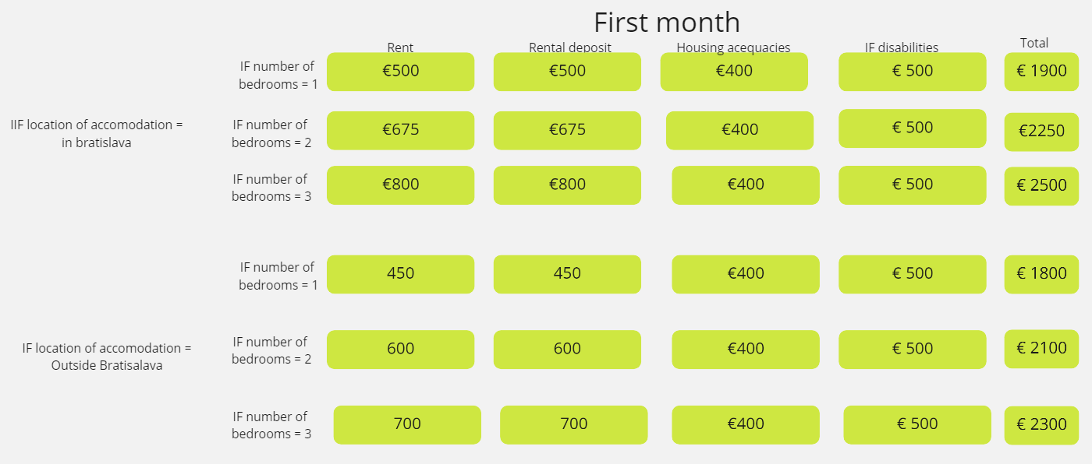
Rental Assistance Amounts and Schedule
+
+
+
=
+
+
+
=
+
+
+
=
+
+
+
=
+
+
+
=
+
+
+
=

Slide 11
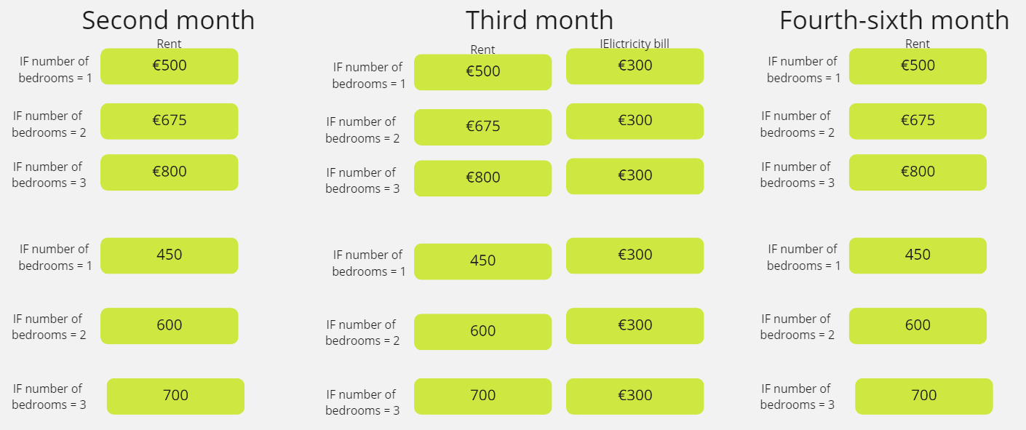
Rental Assistance Amounts and Schedule
+
+
+
+
+
+

Slide 12
Exit Strategy
3 months extension of support
For the most vulnerable cases (150HH) the program will provide 3 additional months for rental payment or to support hosting families.
Case management
Referral mechanism to the social system welfare in case the families still need to be supported.
Monitoring Process
It will help to manage each case and understand in advance what are the needs of the families and what additional support they might need so the operation can unlink the families in a proper way at the end of the program.
Additional Support Services
  Health care
  Education / Childcare
  Employability
Reimbursement of the deposit
This is an additional fee/ financial support/allowance that the families will have if they return the apartment in good condition after 6 months.
Voluntary return
  Referral to other agencies providing voluntary return support (IOM, HCR…)
Notes:
What is the governmment offering in the long term (social housing schemes? Rental subsidies? ratio for foreigners?) - we need to check with the branches
Reimbursement of the deposit as a contribution to
What is the referral system in place? Local authorities / government auth or the coordination mechanism(UNHCR?)

Slide 13
What support can PGI and CEA offer?
COMMUNITY ENGAGEMENT & ACCOUNTABILTY
PROTECTION, GENDER AND INCLUSION
Training of staff and volunteers and ongoing support, along with PGI and MHPSS;
Support to Liaison Officers;
Support setting up and managing feedback mechanism;
Share critical information about availability of services, legal rights and how the RC can support in local languages and through trusted communication channels;
Conduct perception surveys and Focus Group Discussions with people using the HSPs to improve RC programmes and access to information.
Support to SRC/IFRC program staff to integrate PGI fully into the program;
Share referral pathways so that people with specific vulnerabilities can access additional services;
Support to Liaison Officers;
Together with CEA, analyse feedback and provide advise on necessary adjustments to programming to ensure full inclusion;
Provide support in managing reporting of critical reports on SEA.

Slide 14
What support can MHPSS
offer?
Mental health and psychosocial support – possible activities (DRAFT, the implementation plan will be defined later)
Tentative suggestion of possible entry points – the exact implemented programs/activities will be decided based on DG Sante assessment and other possible assessments!
STEP 1
PSS sensitization for all SRC staff, possible inclusion MHPSS criteria in the registration form
STEP 2
PSS training (PFA & self-care) and training how to identify MHPSS needs in registration & follow up phases, training in safe referrals for those meeting displaced people
STEP 3
Providing community-based PSS services based on the needs (for example life skills training, supporting healthy coping mechanisms, bereavement support, physical exercise to manage stress or recreational activities. Support how to talk with children about the conflict and its consequences.)
Facilitators could be recruited from the Ukrainian and Slovak communities to help the integration into the society.
Sessions could be arranged at the closest HSP (?)
STEP 4
2 peer support programs could be set up: one for HSP staff members and one for hosting family community members
STEP 5
Following up and updating referral pathways for both beneficiaries and staff members (and host family members if needed).

Slide 15
IM CVA
Integration

Slide 16















Information Management
rrimco.Slovakia@ifrc.org
Planning, Monitoring, Evaluation and Reporting
rrpmerco.slovakia@ifrc.org
PGI Coordinator
TBD
Mental health and psychosocial support
rrmhpss.slovakia@ifrc.org
Humanitarian Service Point
Cash & Voucher
rrcvaim.slovakia@ifrc.org
Operation Manager
rropsman.slovakia@ifrc.org
Community Engagement and Accountability
rrceaofficer.slovaki@ifrc.org
Shelter
rrshelterco.slovakia@ifrc.org
Slovenský Červený kríž
Helpline
Ops Manager
katarina.rakicka@redcross.sk
helpline@redcross.sk
TBD
NS Humanitarian Service Point
ukrajina@redcross.sk

Slide 17



Most used data collection tool
Used for creating forms, surveys, etc.
Managed by Information management personnel
Tool maintained and administered by IFRC Budapest
Data stored within IFRC server
Data exported in different formats, mainly in excel .xlsx
Only admin and authorized users can see the data (GDPR).
Every IFRC staff can access and create data collection forms.
Ireland
https://kobonew.ifrc.org/

Slide 18


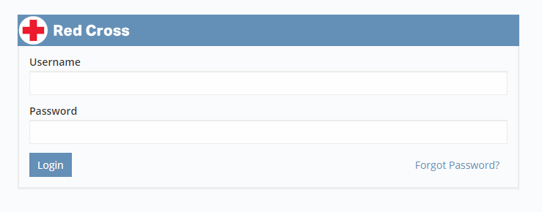
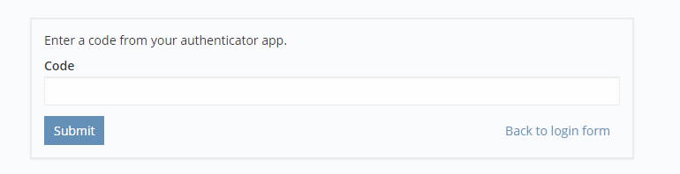
What is this?
EspoCRM is a web application that allows users to see, enter and evaluate all your company relationships regardless of the type. People, companies, projects or opportunities — all in an easy and intuitive interface.
CRM → Customer Relationship Management
Use for Cash case management
Maintained by Netherlands Red Cross
Access only to
https://ukrainecrm.ifrc.org/
Multifactor Authentication

Slide 19
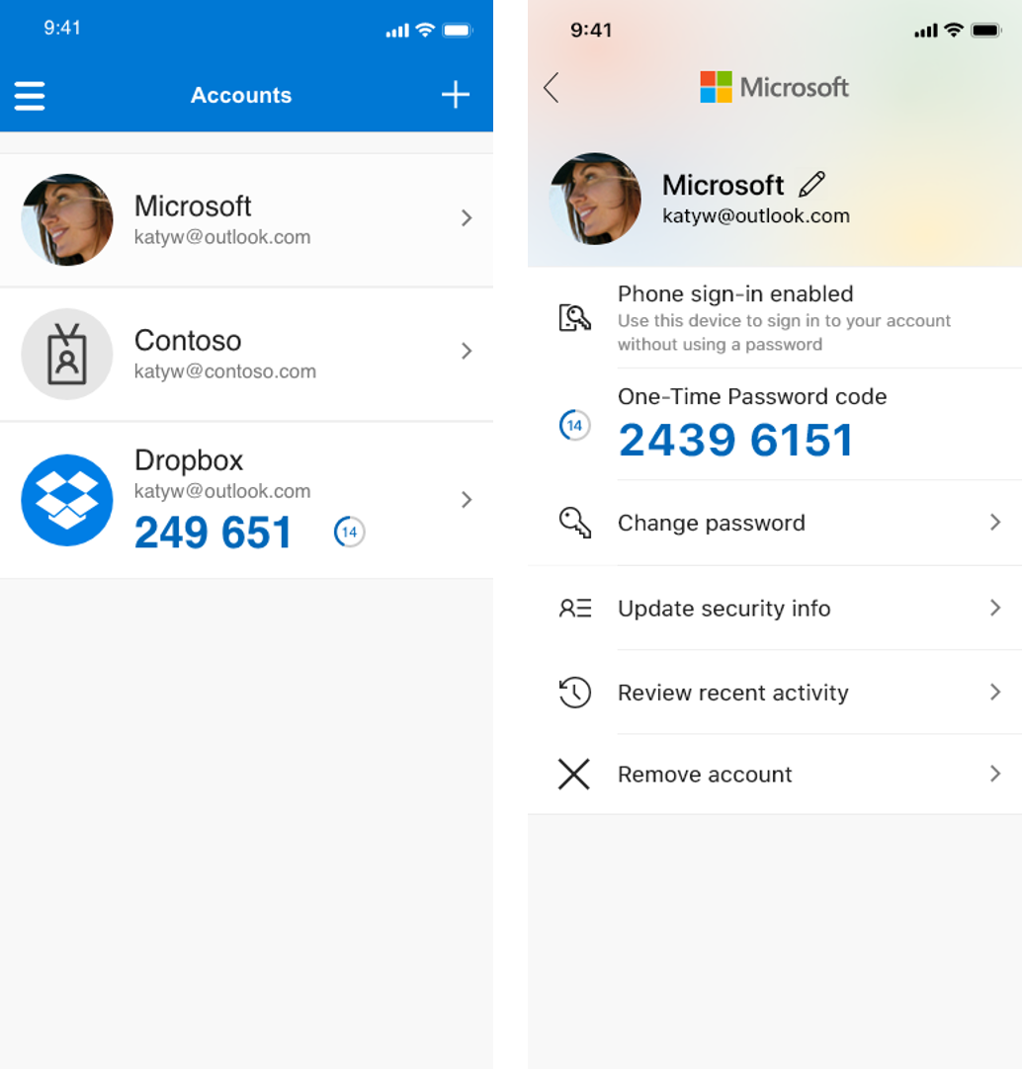
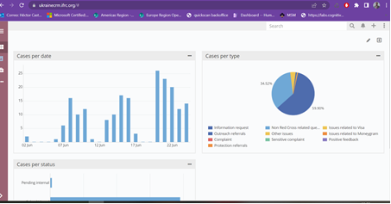
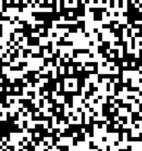
Send email
Set up MFA
Login
Sign up process
Fernando Suarez
fsuarezjimenez@redcross.nl
Sanne
sberendschot@redcross.nl
Ukraine Response
ukraineresponse@510.global
Send code 249651
Validates
&
send credentials
Now we can see the web site app
Username:
xxxxxxxxxxxxxx
Password:
Xxxxxxxxxxxxxx
QR
Download authenticator
App and scan QR

Slide 20

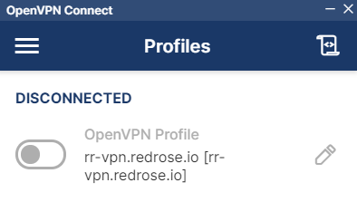

Application used for cash transfer
Agreement between Red Rose and IFRC IT – Budapest
We only have user access
Red Rose are the ones who code and customize the application
Accessible only through VPN
Access to only
To request access, we got to send an email to rrcvaim.budapest@ifrc.org
Require to have good internet connection
Also requires to MFA before login
RED ROSE
https://ifrc-ufa.redrosecps.com/

Slide 21
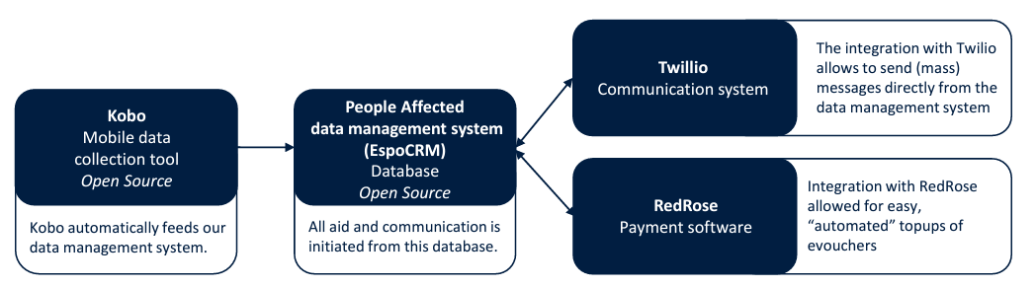
Desired Structure for Information System
Docs:
https://docs.espocrm.com/
St. Maarten & Aruba
Link to case of study
Case of study here

Slide 22



Approaches
Internal process
Helpline
RED ROSE
Application for Shelter Program
API / Manual
Scoring Criteria
API

Slide 23
Escalates
Approaches
Create a case
Helpline

