Slide 1
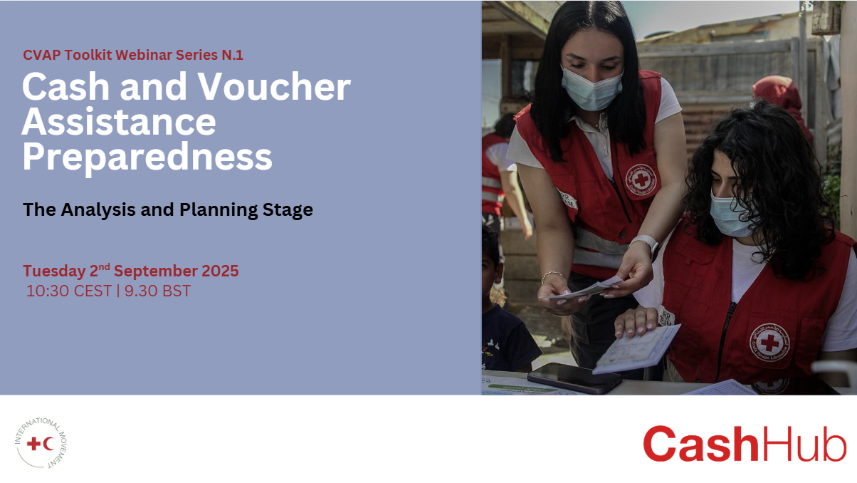

Slide 2




Thank you for joining
Please kindly mute your microphones when not speaking
Following the call, we will share the presentation slides and the relevant materials with all of you
Please be advised that today’s session will be recorded
There will be a Q&A session at the end of the webinar
Notes:
2

Slide 3

Cash and Voucher Assistance Preparedness: The Analysis and Planning Stage
^{2nd September 2025}
 | Agenda | Speaker
5 mins | Housekeeping & Opening | Cara Wilson, Cash Hub Helpdesk Manager, British Red Cross
10 mins | Overview of the Analysis and Planning Stage | Moosa Shifaz, Officer, Cash Preparedness and Capacity Building, IFRC
20 mins | National Society Experiences | Hasmik Khachatryan, Head of Population Movement Department, Armenia Red Cross Society Elisia Abdo, Economic Security Program Manager, Lebanese Red Cross Hasmik Khachatryan, Head of Population Movement Department, Armenia Red Cross Society
20 mins | Q&A with Panel Discussion | Marta Alejano, Cash Advisor, Cash Hub, British Red Cross Lisbet Maegaard Elvekjær, Senior Cash Lead, Danish Red Cross
5 mins | Wrap Up

Slide 4
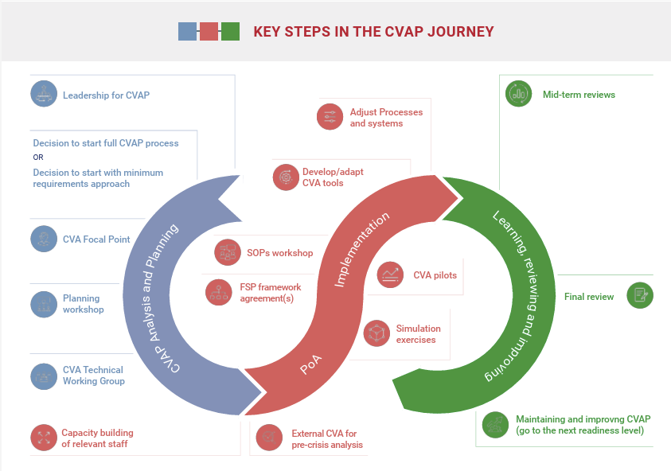

Slide 5
CVAP
ANALYSIS AND PLANNING OVERVIEW
for Cash Hub Webinar
Hasmik Khachatryan
Head of Population Movement
Department
CVA focal point
02 September 2025
ARMENIAN RED CROSS SOCIETY
ՀԱՅԿԱԿԱՆ ԿԱՐՄԻՐ ԽԱՉԻ ԸՆԿԵՐՈՒԹՅՈՒՆ
WWW.REDCROSS.AM

Slide 6
Implemented CVA interventions
 | Year | Operation (Disaster/emergency response or long-term program) | Locations | Supporting Partners | Total Budget | # of people supported with CVA
1 | 2021 | Planned disaster response to NK displacement | RA | UNHCR | 952,000,000.00 | 14000
2 | 2021 | Host family support | RA | ICRC | 526,210,000.00 | 17540
3 | 2023-2024 | 1763 L Gvnmt of RA decision for NK CVA support | RA | IFRC | 986,260,000.00 | 20290
4 | 2023-2024 | 1763 L Gvnmt of RA decision for NK CVA support | RA | ICRC | 982,830,000.00 | 20,315
5 | 2023-2024 | 1763 L Gvnmt of RA decision for NK CVA support | RA | Swiss Red Cross | 19,070,000.00 | 3954
6 | 2023-2024 | 1763 L Gvnmt of RA decision for NK CVA support | Ararat, Armavir Kotayk | Austrian Red Cross/ Echo | 275,000,000.00 | 5500
WWW.REDCROSS.AM
Notes:
Slides just for info- ARCS gained experience then went into Analysis and planning phase, Preparedness phase was shifted with implementation and conducted in parralel.

Slide 7
Implemented CVA interventions
/continuation/
 | Year | Operation (Disaster/emergency response or long-term program) | Locations | Supporting Partners | Total Budget in AMD | # of people supported with CVA
7 | 2023-2024 | 1763 L Gvnmt of RA decision for NK CVA support | RA | other donors | 82,150,000.00 | 1643
8 | 2023-2024 | 1763 L Gvnmt of RA decision for NK CVA support | RA | UNHCR | 3,070,000,000.00 | 61400
9 | 2024 | DREF ALaverdi- RA Gvnmnt decree N1033-L | Lori Tavush | IFRC | 42,400,000.00 | 824
10 | 2024 | DREF ALaverdi- RA Gvnmnt decree N1298L | Lori Tavush | IFRC | 81,100,000.00 | 1050
11 | 2023 | DREF HAILSTORM 2023 | Lori and Tavush region | IFRC | 109,760,495.00 | 2150
12 | 2024-2025 | EMERGENCY APPEAL CASH for Livelihood | RA | IFRC | 121,626,500.00 | 309
13 | 2022 -2023 | Rental Subsidies for Syrians and Covid affected families | RA | ADA | 45,000,000 | 320
14 | 2017 | Rental Subsidies for vulnerable families of Syrian displaced populaiton | RA | Neighbors in Need | 52,800,000.00 | 559
WWW.REDCROSS.AM
Notes:
Slides just for info- ARCS gained experience then went into Analysis and planning phase, Preparedness phase was shifted with implementation and conducted in parralel.

Slide 8
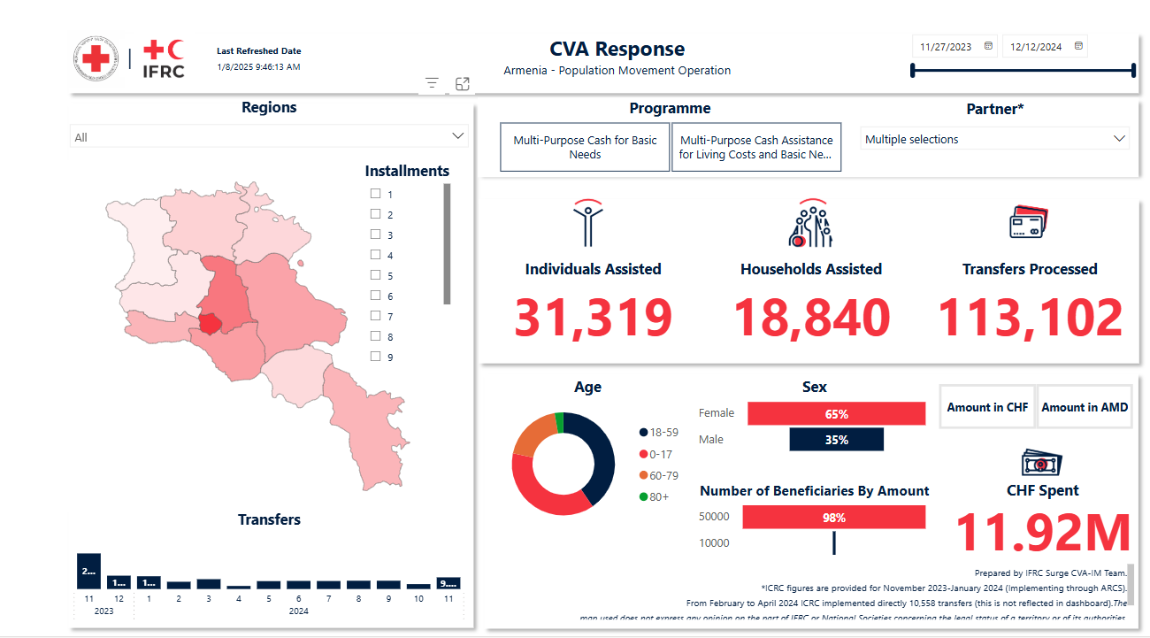
WWW.REDCROSS.AM
Notes:
Only 2024 year with numbers

Slide 9
2023-2024 NK response
1763L – 113 102 transfers
In total CHF 11 920 000
In partnership with | # of transfers | AMD | CHF
UNHCR | 61,400.00 | 3,070,000,000.00 | 6,545,510.00
IFRC | 20,290.00 | 986,260,000.00 | 2,144,832.00
ICRC | 20,315.00 | 982,830,000.00 | 2,055,097.00
Swiss Red Cross | 3,954.00 | 19,070,000.00 | 417,539.00
Austrian Red Cross/ ECHO | 5,500.00 | 275,000,000.00 | 575,712.50
Other donors | 1,643.00 | 82,150,000.00 | 171,664.00
 | 113,102.00 | 5,415,310,000.00 | 11,910,354.50
WWW.REDCROSS.AM

Slide 10
Phases of ARCS CVA Programming and Preparedness
Implementation 2013
CVA self-assessment 2022
Implementation
2020-2021
CVA SOP October 2024
Implementation 2017
PER / CVA- November 2024
Implementation
2024-2025
CVA self-assessment March 2025
CVA Vision statement March 2025
WWW.REDCROSS.AM
Notes:
The implementation is a continued process in the duration of time, the preparedness phases are changing.

Slide 11
PER for CVA Programming and Preparedness
17.1 | NS has a CBI preparedness plan, properly budgeted and resourced with clear activities and outputs, based on analysis and discussion with key stakeholders.
17.2 | CBI preparedness plan is tailored to address NS opportunities and barriers to be ready to provide scalable emergency CBI.
17.3 | NS has an up-to-date database of CBI trained and experienced staff and volunteers at headquarter and branch levels across sectors and support services to implement CBI within the response cycle.
17.4 | NS has pre-disaster feasibility cash analysis and baseline about market systems, prices and seasonality, mapping of other actors and coordination structures.
17.5 | NS has regularly revised CBI SOPs with clear roles and responsibilities outlined at each stage of the response process, based on lessons learned from previous responses.
17.6 | NS has mapped CBI delivery mechanisms, service providers and has in place agreements including activation mechanism with money transfer providers.
17.7 | NS has an up-to-date, approved CBI toolkit that adapts CiE tools to the NS specific contexts.
17.8 | NS routinely uses the CBI toolkit which is revised and updated based on feedback from preparedness and response actions.
17.9 | NS leads CBI coordination mechanism both internally within the Movement and externally with other CBI actors in the country (public authorities, UN, NGOs, etc...).
WWW.REDCROSS.AM
Notes:
PER is not really express the NS capacity for CVA implementation. Meantime, it gives an overview of what could be improved for DM situations.

Slide 12
CVA SELF-ASSESSMENT WORKSHOP
Preparations with technical team- IFRC Europe, IFRC Armenia, Swiss RC and ARCS CAV focal point- agenda and topics development
Information sharing with relevant staff, discussions on participation
Sensitization of SG and confirmed meaningful participation
Workshop 18-19 March 2025
Participants: IFRC, PNSs, DM, PM, Finance, HR, Procurement, Communication, Youth, branch representatives, ICRC
Communication of the Workshop expected Outcome with Management and Staff
WWW.REDCROSS.AM

Slide 13
Considerations for CVA visioning discussion
Q1 - Shift from in-kind to CVA
How does the NS want to position itself in relation to the Movement ambition for scaled-up CVA? Will it seek to align with the 50% by 2025. If not, what is realistic? What are the blockages within the NS?
Suggested probes:
This question will likely be a free form discussion - participants should be as open as possible regarding how the NS intends (or not) to align with the Movement ambition for CVA.
Specifically probe on social protection as follows:
What is the current situation with social protection in-country and does the NS wish to invest more in supporting linking CVA to national social protection in the future? - The government puts more efforts on provision of the assistance through cash modalities.
Is there scope for the NS to play its auxiliary role when it comes to CVA and social protection (therefore reaching a greater number of vulnerable people with CVA)? - NS is able to enlarge the scope of the CVA. How well understood is the NS auxiliary role with government regarding CVA? Is there an opportunity to invest more, as part of the CVAP vision for CVA at-scale? – it is well understood, there is opportunity to invest more
WWW.REDCROSS.AM
Notes:
A useful tool on CVA Vision statement development was shared, discussions around it were short as not everything was relevant. Example question

Slide 14
CVA SELF-ASSESSMENT WORKSHOP:
VISION STATEMENT
WWW.REDCROSS.AM

Slide 15
CVA SELF-ASSESSMENT WORKSHOP:
VISION STATEMENT
Armenian Red Cross Society
Cash and Voucher Assistance Vision Statement
Vision statement
The Armenian Red Cross Society will seek to maintain 50% of its programming through CVA by 2030. Where appropriate and driven by the needs of the most vulnerable, this will be through multipurpose cash during the emergency and early recovery phase, combined with sectorial cash during recovery. We will continue to complement national government social protection systems, including new pilots, and livelihood support programs”
Our Vision Goals:
Through this vision, the Armenian Red Cross Society aims to:
Promote and advocate with the Republic of Armenia Government about the role of the National Society as auxiliary in the humanitarian area and the relevance of CVA in response.
Elaborate on utilization of Government systems for Armenian Red Cross Society and registration online platforms, eligibility checks etc.
Implement CVA Preparedness Plan of Action developed during the self-assessment workshop
Continue to utilize the banking system opportunities and consider other types of delivery mechanisms through greater collaboration and partnership with private and public sector actors in country.
Enhance programme quality through investing in Information Management based beneficiary management and feedback
Institutional Commitment
‘The joint commitment contained within this statement is important for the Armenian Red Cross Society is to remain a relevant actor in-line with the RCRC Movement’s CVA ambition and within the external environment for visibility and positioning as a key CVA actor, amidst a rapidly changing landscape and donor preferences. Multipurpose cash will be the default CVA modality due to its ability to be a people
and community-centred form of assistance that ensures quality and accountability, based on the affected population’s needs and preferences, are at the core of the response.
Engaging with local and national authorities to promote CVA will be key alongside Armenian Red Cross Society own activities, to support the development of the role of NS as auxiliary and eventual partner for government national social protection programming’.
WWW.REDCROSS.AM

Slide 16
CVA SELF-ASSESSMENT WORKSHOP:
VISION STATEMENT
Our Vision Goals:
Through this vision, the Armenian Red Cross Society aims to:
Promote and advocate with the Republic of Armenia Government about the role of the National Society as auxiliary in the humanitarian area and the relevance of CVA in response.
Elaborate on utilization of Government systems for Armenian Red Cross Society and registration online platforms, eligibility checks etc.
Implement CVA Preparedness Plan of Action developed during the self-assessment workshop
Continue to utilize the banking system opportunities and consider other types of delivery mechanisms through greater collaboration and partnership with private and public sector actors in country.
Enhance programme quality through investing in Information Management based beneficiary management and feedback
Institutional Commitment
‘The joint commitment contained within this statement is important for the Armenian Red Cross Society is to remain a relevant actor in-line with the RCRC Movement’s CVA ambition and within the external environment for visibility and positioning as a key CVA actor, amidst a rapidly changing landscape and donor preferences. Multipurpose cash will be the default CVA modality due to its ability to be a people
and community-centred form of assistance that ensures quality and accountability, based on the affected population’s needs and preferences, are at the core of the response.
Engaging with local and national authorities to promote CVA will be key alongside Armenian Red Cross Society own activities, to support the development of the role of NS as auxiliary and eventual partner for government national social protection programming’.
WWW.REDCROSS.AM

Slide 17
CVA SELF-ASSESSMENT WORKSHOP:
VISION STATEMENT
Institutional Commitment
The joint commitment contained within this statement is important for the Armenian Red Cross Society is to remain a relevant actor in-line with the RCRC Movement’s CVA ambition and within the external environment for visibility and positioning as a key CVA actor, amidst a rapidly changing landscape and donor preferences. Multipurpose cash will be the default CVA modality due to its ability to be a people and community-centred form of assistance that ensures quality and accountability, based on the affected population’s needs and preferences, are at the core of the response.Engaging with local and national authorities to promote CVA will be key alongside Armenian Red Cross Society own activities, to support the development of the role of NS as auxiliary and eventual partner for government national social protection programming’.
WWW.REDCROSS.AM

Slide 18
Lessons learnt
Organize preliminary sensitization for the Management and general staff
Organize a technical leading group for self -assessment
Preparedness timely actions are crucial
Advocacy to government for MOUs and pre- agreements is needed
Understanding of main gaps should be done preliminary / Market analysis experience is missing/
Vendors and traders mapping for utilization of other cash provision modalities / vouchers is missing
FSP selection should be diversified to allow better access for the most vulnerable population
ADAPTATION of TOOLS is IMPORTANT
Cooperation and coordination with other partners is important
WWW.REDCROSS.AM

Slide 19
CVA SELF-ASSESSMENT WORKSHOP:
Reports, finalization and endorsement
Documents prepared for endorsement:
Vision statement
Capacity Self-Assessment
Plan of Action
RACI Matrix
CVA SOP
Discussions with Management:
- Not to complicate and endorse only the Vision Statement and SOP
WWW.REDCROSS.AM

Slide 20
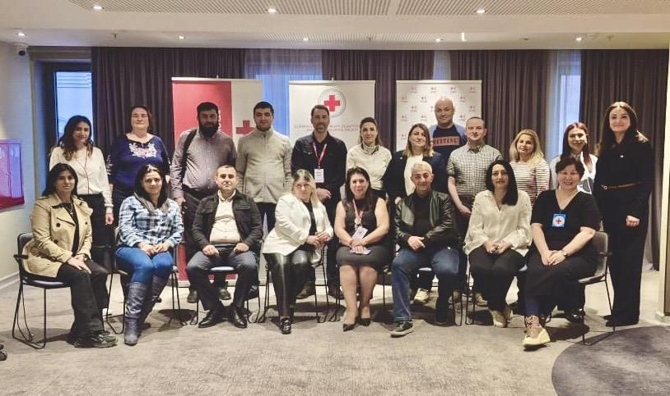
THANK YOU
WWW.REDCROSS.AM

Slide 21
Lebanese Red Cross
Disaster Management Sector
Economic Security Program
Cash Preparedness

Slide 22
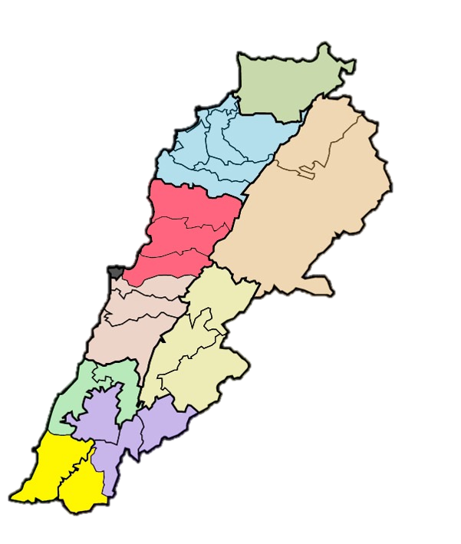
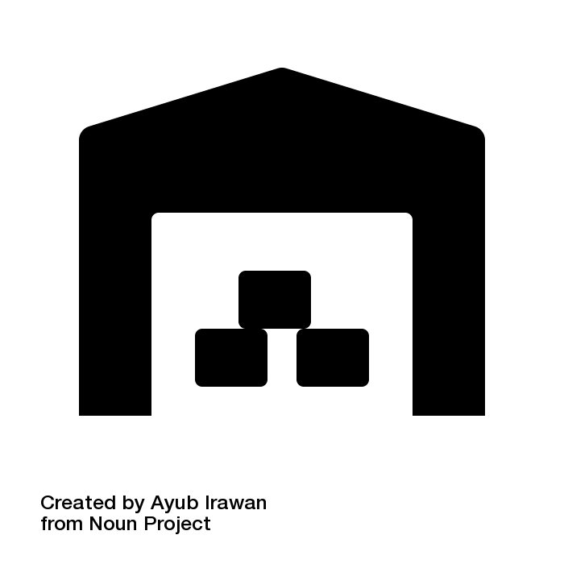




Disaster Management Sector
The Disaster Management Sector (DMS) is one of the Operational Sector within the Lebanese Red Cross (LRC).It was established in 2013 as a unit and then became an Operational Sector since 2018.
DMS Goal:
The DMS is committed to ensuring the appropriate level of preparedness and implementing timely and effective response and sustainable recovery efforts in the event of disasters, emergencies, and crises, all while utilizing a people-centered approach
Geographical accessibility
Large skilled and committed volunteer base
Acceptance and trust from the community
21
Centers / Teams
898
DMS Volunteers
DM Center
DM Team
1,366
LRC Surge Capacity Volunteers
8
Regional warehouses
DM Team
Warehouses
Notes:
-

Slide 23




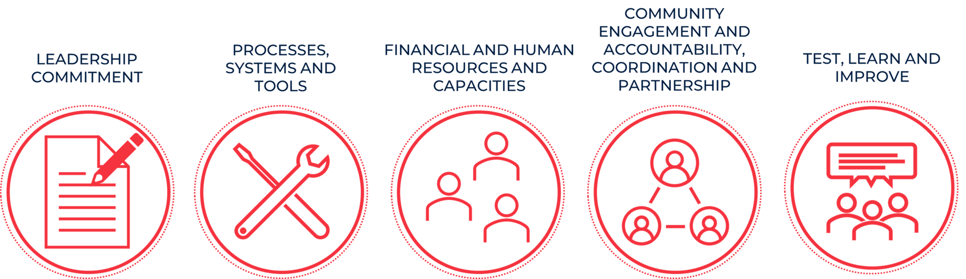
Economic Security Program
Objective: | Enhance economic security by addressing poverty, improving food security, and strengthening livelihoods and market access, ensuring long-term stability and dignity for vulnerable communities.
 | Cash and voucher assistance (MPCA and Thematic CVA) In-kind distribution Livelihoods Initiatives
Economic Security Program
Establish and strengthen the systems, processes, and capacities required to deliver scalable, timely, and accountable Cash and Voucher Assistance (CVA) during emergencies. The objective is to ensure that assistance is responsive to the needs and preferences of affected populations, while upholding humanitarian principles and preserving the dignity of those we serve.
Cash and Voucher Assistance Preparedness “CVAP”
Restoring
Family Links

Slide 24



LRC CVA and CVAP Timeline
2014 - 2025
LRC implements and grows as a CVA actor
January - April 2025
CVAP planning, sector engagement and visioning
May 2025 onwards
CVAP self-assessment and workplan
By 2021, MPCA established as a default response modality, and framework agreements in place with FSPs.
LRC CVA Vision Statement finalized and endorsed by senior management
CVAP workplan finalized, informed by the findings of the self-assessment workshop.
LRC completes their first CVA pilot in response to the Syria refugee crisis in 2014.
Decision taken by senior management to initiate CVAP process.
CVAP Self-Assessment Workshop held in May 2025, attended by 36 LRC staff members.
CVA continues to be integrated into responses to other crises.
Bilateral and strategic engagements across LRC sectors secure commitment to CVAP and inform LRC’s CVA vision.
CVAP workplan commenced Q3 2025.
LRC uses MPCA at scale for first time in response to Beirut blast.
LRC engaged in country-wide humanitarian response, using MPCA as response modality.
Collaboration on CVAP between LRC, IFRC, BRC, Cash Hub and CCoE.
Notes:
Purpose of this slide is to contextualize where initiating CVAP process fits into LRC’s ‘CVA story’ and demonstrate that the initiation of the CVAP process came late into your CVA journey.
Reflect on what LRC were doing in advance of doing in advance of CVAP.
Areas to highlight:
Collaboration between the various movement partners throughout planning process.
The fact that LRC were doing this whilst also juggling a major humanitarian response.
Where the sector engagement took place

Slide 25
The ‘Engagement Phase’ and Visioning
Bilateral engagement with key stakeholders built shared understanding across sectors and ensured the vision was shaped in line with operational realities.
It enabled tailored conversations, ensured early buy-in and prepared teams for meaningful workshop participation.
Sector insights directly informed the vision statement, ensuring relevance and resonance.
The process ensured the Vision Statement was not just aspirational but strategically aligned and endorsed by senior leadership ahead of the Self-Assessment Workshop.
Decision to start CVAP
Visioning Workshop
Vision Statement
CVAP Self-Assessment
CVAP Workplan
Baselines defined
Bilateral Stakeholder Meetings
Vision Statement Drafted
RCM CVAP Roadmap
LRC adaptation to Roadmap
Notes:
Deep dive into the sector engagements:
How this was done.
When this was done.
Why: There were conversations that needed to be had with certain sectors needed to be given space to happen outside of a workshop. Also, being pragmatic. We were in the middle of a large multi-sector humanitarian response, it wasn’t realistic to secure the time of the appropriate people for multiple workshops over multiple days.
Engagement phase was an enabler – recognizing that as a National Society we were far along our CVA journey, which was both a positive in feeling comfortable to adapt these tools in a way which suited us and our needs. But given this, also aware that within some sectors some work was needed etc… this additional phase ensured the planning workshop was smooth.
- Highlight that the movement materials for the visioning workshop informed that bilateral engagement process and how we went about that.

Slide 26
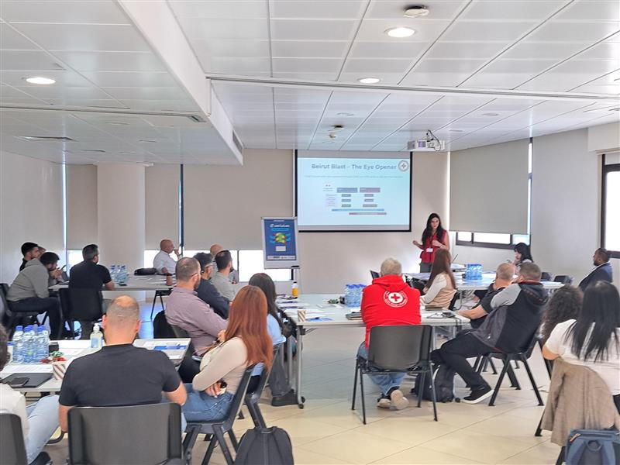
CVAP Self-Assessment Workshop
Leadership engagement: Under SGs and sector directors were present, reinforcing strategic alignment and institutional buy-in.
Cross-sectoral representation: Participants included, operations, HR, IT, MEAL, youth, shelter, WaSH, and DRR — ensuring input from across LRC.
CVA-experienced staff: EcoSec and DMS teams contributed operational insights from past CVA implementation.
Support services inclusion: HR, finance, procurement, ICT and IM teams helped assess systems readiness and integration needs.
Partner support: IFRC, BRC, NorCross, and the MENA Cash Centre of Excellence made up the facilitation team and provided technical guidance.
Notes:
Outline the planning that went into the workshop, and the strategic process of ensuring working groups had the right people in them.
Preparation beforehand, Group division to ensure that every position is in an appropriate group (area), Facilitation group met on Friday, and the Workshop was on Monday and Tuesday to ensure that all logistical matters are ready and the questions were reviewed and understood.

Slide 27
Lessons Learned and Reflections
The collaboration with multiple movement partners, including IFRC, BRC, the Cash Hub and the Cash Centre of Excellence brought clarity on the process, shared responsibility and a wealth of experience from other contexts.
Doing this in parallel to a significant humanitarian response was valuable in identifying blockers and enablers when discussing and developing a workplan.
Taking the time to bilaterally engage key internal stakeholders was an enabler to a successful self assessment, ensuring buy-in from all levels of leadership as well as preparing them for fruitful discussions in the workshop.
The vision statement guided discussions and decisions made in the self assessment workshop, particularly given this was agreed and signed by senior leadership in advance.
Ensure the right people are in the room for discussions, and if this is not possible, don’t be afraid to adapt so there remains space for their valuable contributions.
Notes:
As per the slide.
Worth highlighting on the last point that we missed a couple of people, but we left the assessment report open for feedback for a couple of weeks, and had some additional bilateral conversations (such as the one we had with Karina) so people could still feed into the final findings.

Slide 28
Thank you for your time

Slide 29

Karacak
Learning and resources cash-hub.org
Webinars cash-hub.org/resources/webinar-series/
Cash Helpdesk www.helpdesk@cash-hub.org
cash-hub.org/helpdesk/

Slide 30
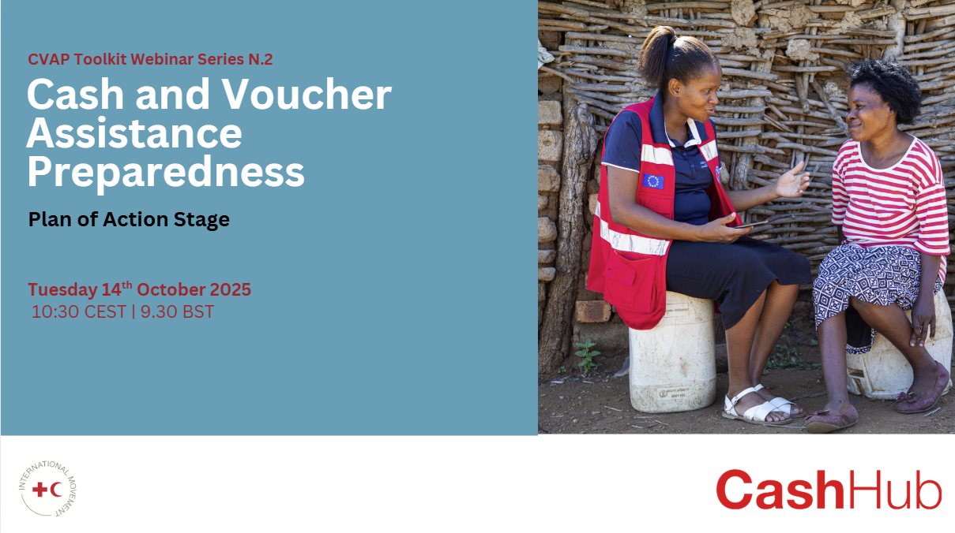

Slide 31


